Slide 1
USACE Proposed
“Water Supply Rule”
Use of USACE Reservoir Projects for Domestic, Municipal and Industrial Water Supply

Slide 2
Why NWC can & should comment.
        National Waterways Conference
        September 27, 2017
        J. Tom Ray
        jtray@lan-inc.com
        254.855.0880

Slide 3
Points
Background
Overview of the Comments to Date – Who is supporting?
Is the Rule needed?
Recommendations for NWC Consideration
“…avoiding consequences & supporting the USACE resolution of the actual problems…”

Slide 4
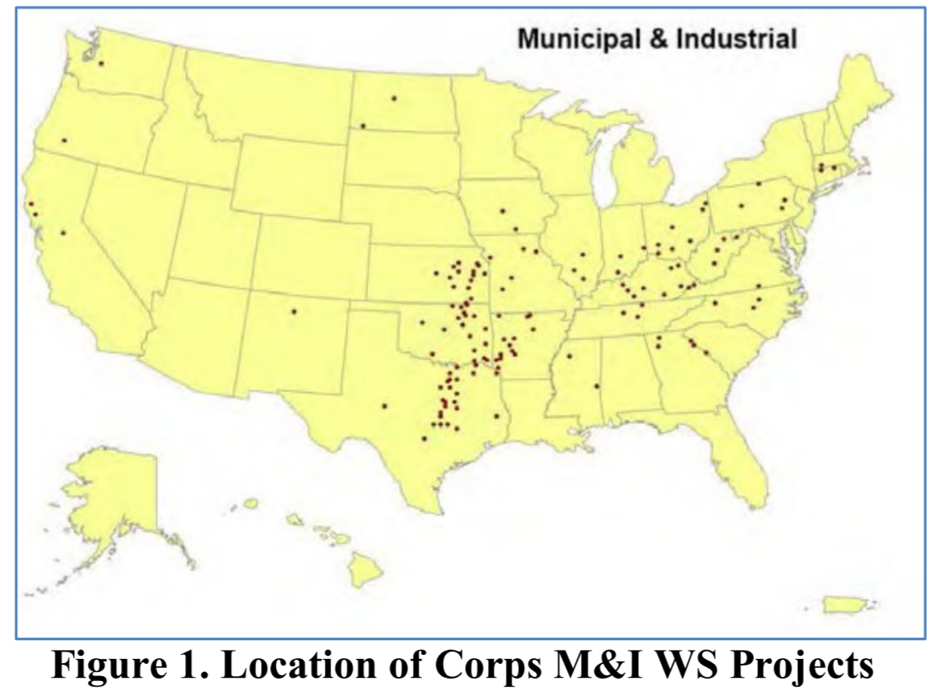
Location of Corps M&I WS Projects
Prior-Appropriation
States
2014 IWR Database Report

Slide 5
Location of Corps M&I WS Projects
Prior-Appropriation
States
2014 IWR Database Report

Slide 6
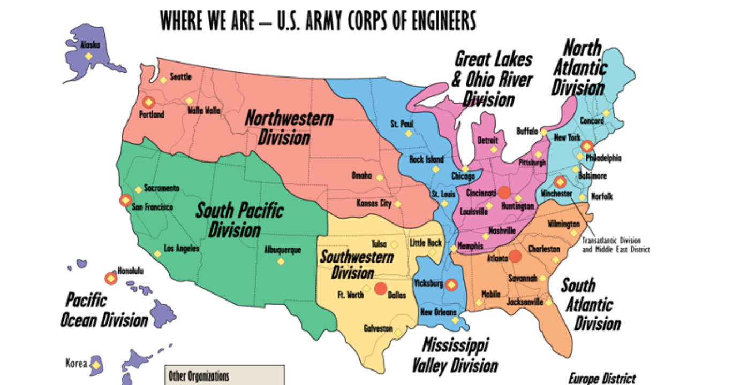
DISTRIBUTION OF M&I BY USACE DIVISIONS
13%
21%
46%

Slide 7
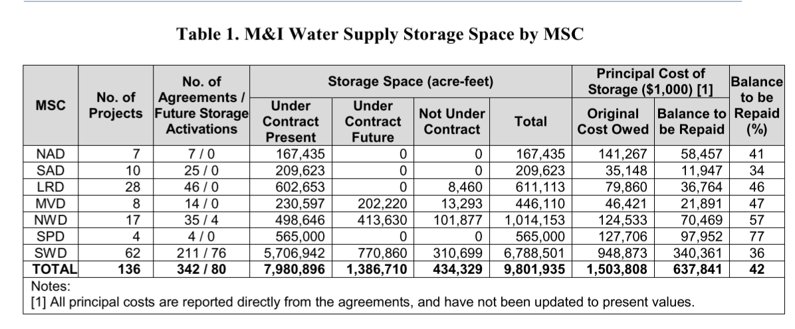
M&I Use of Storage Space
4.43% as of 2014 Database Review
71.3 % as of 2014 Database Review

Slide 8
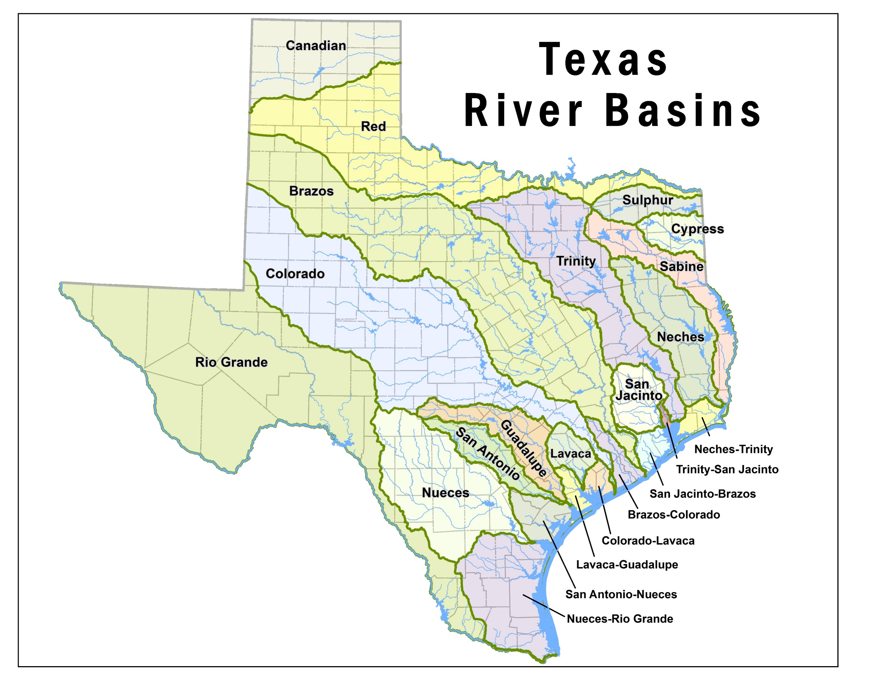
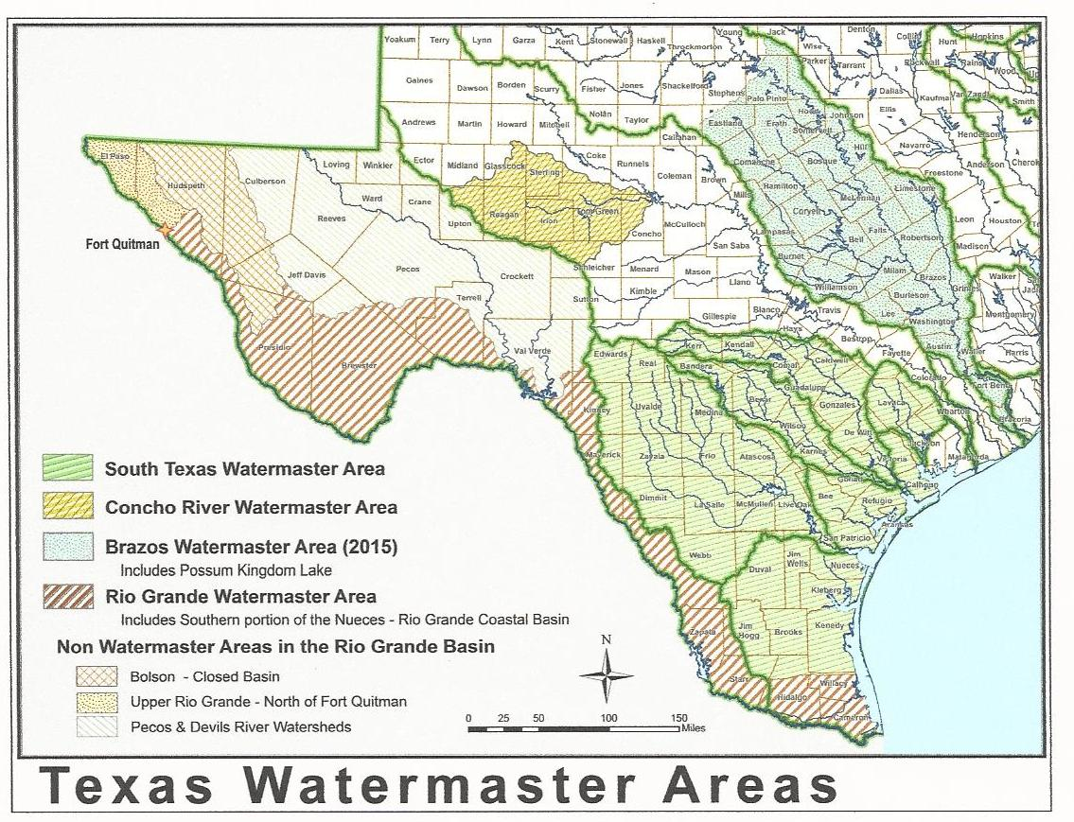
Texas M&I Water Supply – Efforts to “Protect”
Point 1 – Intra-state river basins
Point 2 - Interstate Compacts
Point 3 – “Water Master Areas
Canadian River Compact
Pecos River Compact
Red River Compact
Rio Grande Compact
Sabine River Compact

Slide 9
Why Water Supply Managers are Concerned?
Nationwide
State Primacy
  Water Availability vs. Storage
  Storage Accounting & Allocation
  Federalism issues
Stakeholder/district & division-level input
Vague/ambiguous

Slide 10
Why are Others Concerned?

Slide 11
Review of Comments – USACE Website (to date)

Slide 12
Review of Comments – USACE Website (to date)

Slide 14
Why Others are Concerned?
State Primacy
Ambiguity/clarity
Water availability vs. storage
Accounting
Federalism issues
National application
Stakeholder input

Slide 15
Conclusion?
Proposed Rule Lacks Support & Has Generated Concerns
No ‘National’ Issue To Address
‘Stakeholder’ Input
Substantial Changes Warrant Withdraw & Re-proposing

Slide 16
For
NWC Consideration:
Comment Letter to USACE
Withdraw proposed rule or restrict
Encourage COE to identify insufficient / inconsistent regulations
Ensure current guidance is applied (post-1986)
  WS Manual
  Planning Guidance Hd
Areas that need to be address
  Surplus water pricing
Specific studies as needed
Initiate ‘stakeholder’ input

