Slide 1
US Army corps of engineers Levee Safety and 408 Update
Presentation for the National Waterways Conference
September 2017
Eric Halpin, Deputy Dam and Levee Safety Officer, HQ USACE
Tammy Conforti, Special Assistant for Levee Safety, HQ USACE

Slide 2
Status on the National Levee Safety Initiative
Focus on traditional authorities related to the USACE Levee Safety Program
Moving forward on mutually beneficial activities
USACE Levee Safety
National Levee Safety
Inspections,
Risk Assessments,
Risk Communications,
Policy & Guidance,
Management,
Technology
Reviews
National Levee Safety Program is authorized but not appropriated
Mutually Beneficial
Activities that are Both
Authorized & Appropriated
Notes:
Though authorized by Congress, a National Levee Safety Program has not yet been implemented. (See Title IX of the Water Resources Development Act of 2007, as amended by Section 3016 of the Water Resources Reform and Development Act of 2014 for a more complete understanding of this effort). No timeframe has been established for implementation of a National Levee Safety Program however, there are several USACE activities that are beneficial to a National Levee Safety Program.
To demonstrate, a Venn diagram drawn here to represent the USACE Levee Safety Program and a National Levee Safety Program. Each circle is intended to represent the relative size of the programs. The USACE Levee Safety Program has been invested over $500 M to establish a National Levee Database – a database of the Nation’s levees, conduct levee inventory, inspections, risk assessments; and develop a program that emphasizes life safety, risk-informed decision making, and increased awareness of the benefits and risks associated with levees. The National Levee Safety Program is a huge program that includes National Committee on Levee Safety, National Guidelines, Grants to States, State and Tribal Program Guidelines, Levee Rehab Fund, Reports to Congress, and Levee Inventory and Review.
The two programs overlap (the scopes and benefits are mutual) are shown.

Slide 3
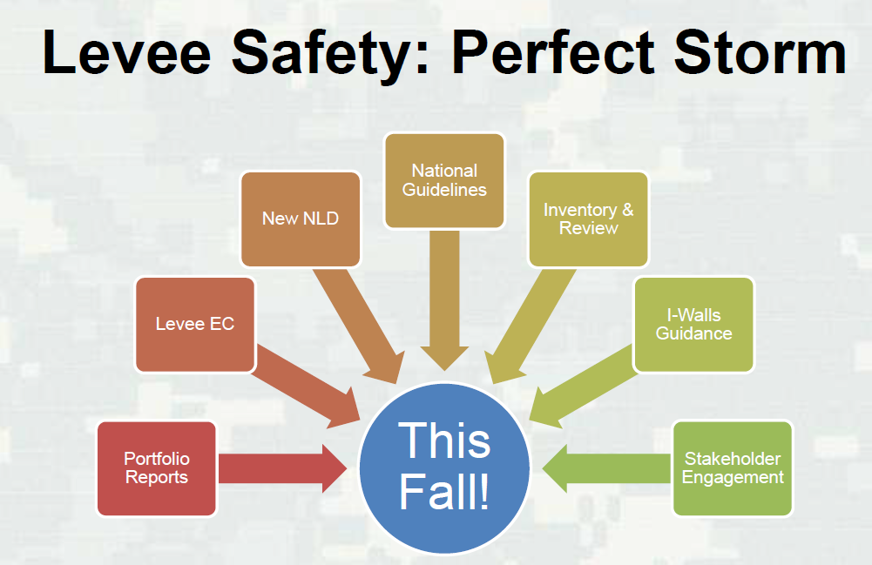
Levee Safety Hot Topics

Slide 4
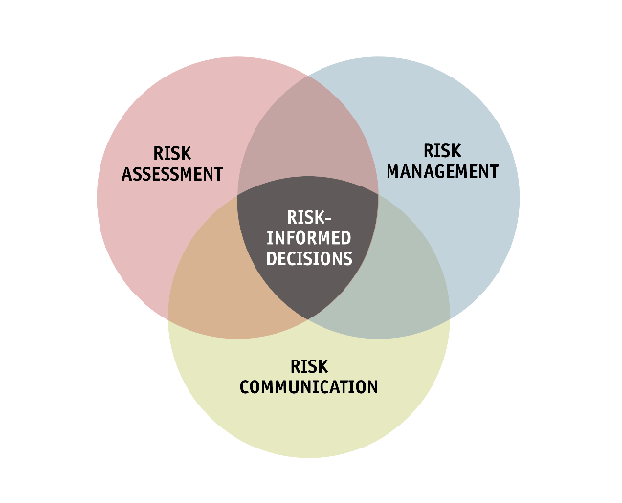
NEW Over-arching levee policy
(EC 1165-2-218)
Organized around the Risk Framework
Provides directive policy (long-term)
References other documents to detail procedures
Supersedes:
Previously issued memos and
other interim guidance
USACE previous NFIP Accreditation
guidance (EC 6067)

Slide 5
Risk assessments – when are they required?
Portfolio
Management
Primarily selected by risk/some other considerations
Funded by Program
Usually cost-shared
Design
Follow studies, Section 408
Design deficiencies
Timing set by Program
Selected by OMB
Construction
Usually cost-shared
Usually cost-shared
NFIP Accreditation
Cost-shared
USACE O&M
Changed Condition
Post implementation
Benchmark risk assessment in lieu of screening
Proposed by sponsors or major rehab
Planning Studies
Risk Assessment

Slide 6
Path Forward
Aug-17
Sep-17
Oct-17
Jul-17
Nov-17
Dec-17
Jan-18
Feb-18
Mar-18
Apr-18
May-18
Internal Review
Agency-wide Review
ATR
LSSC
LSOG
FEMA
External Review
Sponsors
Stakeholders
International Levee Partnership
Publication
Comment Analysis and Summary
Revisions
External webinars
Comment Analysis and Summary
Revisions
Final Leadership Review
Internal & external webinars
Communication products
Notes:
Internal Review – 60 days for internal review beginning early June
External Review – 60 days for external review November/December. Will try to align it with external review of Inspection Checklist.
Publication – Spring 2018

Slide 7
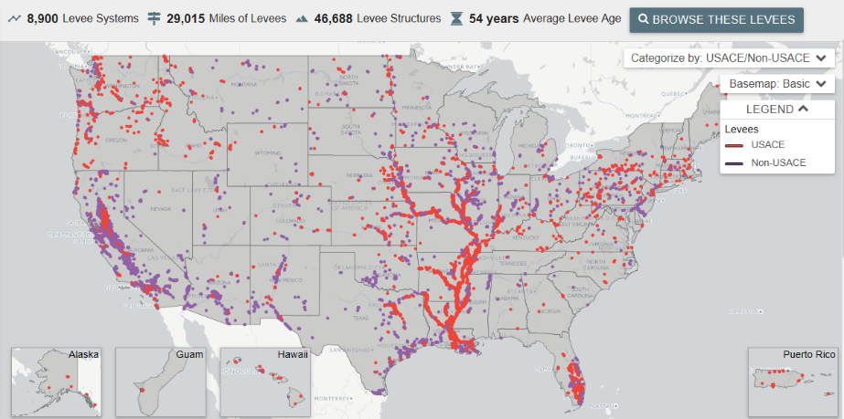
National levee database – levee inventory
Total Levee Inventory: 8,900 levee systems = ~29,000 miles of levees
New Website External Release – November 2017
Notes:
Overview of the NLD inventory as of September 2017.

Slide 8
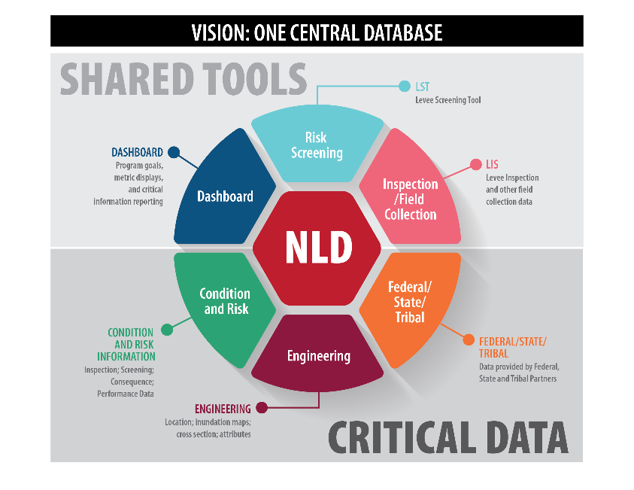
National levee database - Update
Notes:
This is graphic shows how the NLD and the associated USACE tools (e.g. USACE Levee Inspection System and USACE Levee Screening Tool) and data fit together. The USACE Levee Inspection System (LIS) is a tool that USACE has used to perform levee inspections on 14,000 miles of levees. The “NLD” will soon be comprised of the inspection tool and the screening tool and a dashboard feature. All inspection data and screening data will be located within the NLD such that it can be reviewed or searched.
Each State will have the ability to generate their own specific dashboard within the NLD by using a series of drop down menu options. And finally, the most important point of this slide, you need data to make all those shared tools and functions be relevant. All the tools and great capabilities in the NLD have to have good data to be effective. The focus of the Inventory effort is to populate that information in the NLD – and remember the continuing data slide – to keep adding data and information. Keep the NLD a living database.

Slide 9
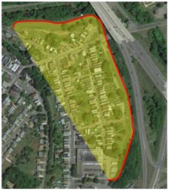
national levee Inventory and Review - initial engagements
Federal Agencies
  National Park Service
  International Boundary Water Commission
  National Fish and Wildlife Service
  USDA and FEMA
States
  California
  Illinois
  Ohio
  Pennsylvania
  Texas
Notes:
This is a list of states that has been engaged previously (as the state reached out to USACE to conduct pilots). California shared its levee database which makes up the majority of the Non-USACE levee systems. Pennsylvania inspections conducted this year are shown.

Slide 10
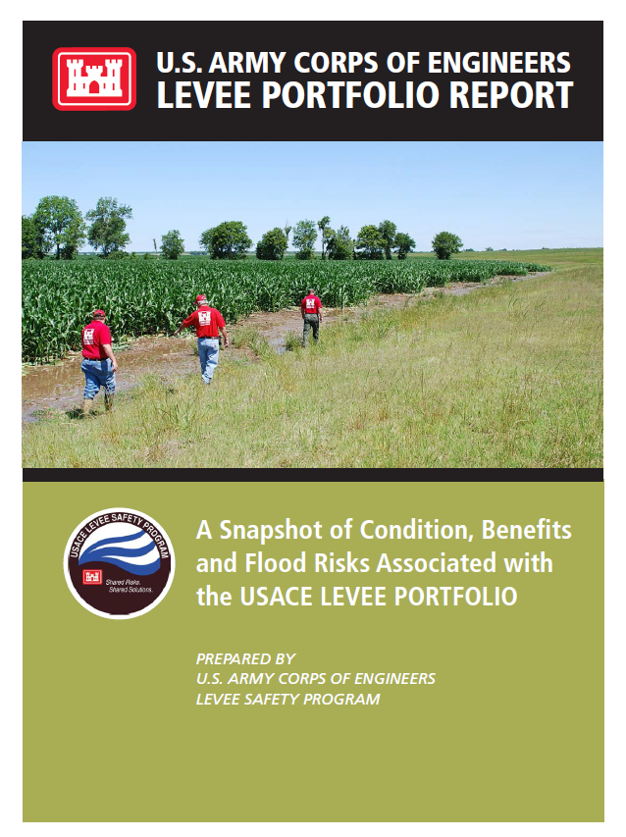
Summary of the findings (due out fall 2017)
Executive Summary
Section 1 : Introduction
Section 2 : USACE Levee Portfolio Characteristics
Section 3 : The USACE Levee Safety Program Risk Framework
Section 4 : Risk Characterization of the USACE Levee Portfolio
Section 5 : Hazard: What are the Hazards and How Likely are they to Occur?
Section 6 : Performance: Understanding Levee Characteristics & Components
Section 7 : Consequence: Who and What are in Harm’s Way?
Section 8 : Mitigating Risk Drivers in the USACE Portfolio
Notes:
The USACE portfolio report outline is shown here and is planned to be released in the Fall 2017. This Levee Portfolio Report shares our current understanding of the portfolio of levee systems within the USACE Levee Safety Program. Managing this portfolio of levees requires an understanding of the levees in the portfolio, the risk management approaches USACE uses to understand and manage the portfolio, and the roles of USACE, other federal agencies, states, tribes, regional districts, and local communities in assessing, managing, and communicating levee-related flood risk.
Since 2006, USACE has been working to establish a comprehensive inventory, inspection, and risk assessment of all levees in its portfolio. With the inventory and initial inspections complete, the first round of risk assessments on the entire portfolio is expected to be completed in 2018. This inventory, inspection, and assessment effort provides a much more complete picture of the USACE Levee portfolio than we have ever had: where the levees are (inventory); their condition (inspection); and the flood risk associated with the levees (assessment).
This report aims to collect the best available information on the USACE levee portfolio and:
- Increase the understanding of the benefits and risks associated with levees in the USACE portfolio for all stakeholders by summarizing portfolio
- Provide a summary of risk factors associated with the USACE levee portfolio so that all those with levee responsibilities, including USACE, can make informed risk management decisions on programmatic investments, including policy and technical guidance and research and development.
- Establish a baseline set of information on the USACE levee portfolio, including the condition and risk associated with the full portfolio and various segments of the portfolio to enable future trends analysis.

Slide 11
Hazard: What are the hazards and how likely are they to occur?
Notes:
Levees in the USACE portfolio range from a design overtopping ACE of 50% to 0.02% -- in colloquial terms, from the 1-in-2 chance to the 1-in-5,000 chance of occurring in any given year. The majority of the levee systems within the portfolio have an overtopping ACE of 0.5% or less (1-in-200 chance). Overtopping frequency alone doesn’t tell the story about levee risk.
For example:
USACE – 272 NFIP Accredited Systems (only 12% of the USACE Portfolio). About 1/3 of these NFIP Accredited Systems are characterized as very high to moderate risk. Risk tells a different story as it goes beyond the levee itself and considers the consequences behind the levee.

Slide 12
Consequences: people behind levees
% of Population within the USACE Levee Portfolio
by range of population residing behind levee systems
2,100 miles
2,400 miles
3,100 miles
3,200 miles
1,800 miles
1,300 miles
Over 11 million people live and work behind levees within the USACE portfolio
Source: LST March 2017
Notes:
Approximately 11 million people live and work in the area behind USACE portfolio levees; approximately the same population as the combined population of Los Angeles, Chicago, and Houston. However, this population is not equally distributed behind all the levees. Some leveed areas significantly more urban than others-- 86 percent of the 11 million people are concentrated behind just 154 levee systems.

Slide 13
Consequences: property behind levees
Over $1.3 trillion in property value behind levees within the portfolio
58% of levee portfolio by length has
greater than $100 M in property value behind it
Source: LST March 2017
Notes:
Mirroring population, there are a relatively small number of highly urban levees (146 levee systems) that represent areas with property value in excess of $1 billion, with the majority of levees (1,140 systems) having less than $100 million in property value behind the levees

Slide 14
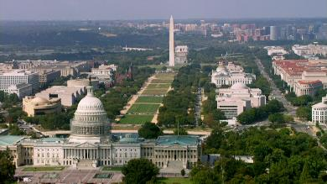
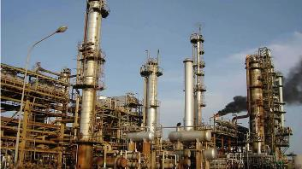

Consequences: Who and What are benefiting from levees?
Other infrastructure behind the levees in the portfolio….
National Historic Sites (i.e. National Mall)
Over 300 Colleges and Universities
34 Major Sport Venues
25% of the National Daily Refining Capacity
Notes:
USACE portfolio levees reduce the risk of flooding to some of our most vital infrastructure. From roads and schools, to police and fire stations, to historical sites and national treasures, there are countless structures that provide invaluable services to our communities and nation that
are located behind levees. These structures help to sustain our economy and provide venues for recreation, among other functions.

Slide 15
Mitigating Risk Drivers in the USACE Levee Portfolio
$21B is estimated needed to address risk factors associated with the levee portfolio
Emb. Stability
Culverts
Emb/Fnd Seepage
Floodwalls
$13 B
Emb. Erosion
$8 B
$300 M
Notes:
The extrapolated portfolio cost to address risk drivers and improve evacuation effectiveness for very high, high, and moderate risk levee systems in the USACE portfolio ranges from $6.5 billion to $38 billion, with an expected cost of about $21 billion. The upper and lower bound ranges of estimated cost show the range in uncertainty of the estimate.
The expected cost of $21 billion is broken down into approximately $13 billion for structural improvements to mitigate risk drivers for breach prior to overtopping, approximately $8 billion in armoring of levees to reduce the risk of breach following overtopping, and about $300 million to improve evacuation effectiveness.

Slide 16
Section 408
US Army Corps of Engineers Update
Notes:
Streamlining Actions:
More scalable
More delegation of decisions
Reduce redundancies and/or improve integration with Regulatory
Better define and constrain when Section 408 applies
Challenges
Resources for timely reviews
Scalable/nonprescriptive requirements leads to inconsistent implementation between districts
Still learning and improving, but there is demand for instant change
Coordination with USACE on status updates

Slide 17
Background
33 USC 408 (Section 408)
Provides USACE authority to grant permission to alter a USACE civil works project if
  Does not impair usefulness of the project
  Not injurious to the public interest
Current USACE policy for granting permission is EC 1165-2-216

Slide 18
Benefits of Section 408
Provides others a mechanism to alter/repair/rehabilitate an existing project without reauthorization
Ensures Civil Works projects continue to deliver the public benefits intended
Allows for ensuring compatibility of new infrastructure with existing federal projects
Ensures alterations do not have unintended negative impacts to the public

Slide 19
Why are we here?
Heightened attention on infrastructure projects
Desire for streamlined processes and improved coordination among Federal agencies
There is an increase need for information, timelines, status, and upward reporting on high visibility projects
Fast-41/Dashboard/Pipelines/Transportation

Slide 20
Basic Steps
Initiation
Pre-Coordination
Written Request
Request Package
Coordination
Compile Required Documentation
Review and Decision
Formal Reviews
Document Decision and Conditions
(non-fed sponsor endorsement required)
WRDA 2016 Timelines
30 days, determine package is complete
90 days, make a decision
NTE 120 days

Slide 21
Interim Guidance
Nov 2016 – delegated several HQ level decisions to Divisions.
Jun 2017 – clarified application of 408 related to “navigable waters” reducing number of activities needing 408 permission.
Jun 2017 – issued guidance to implement contributed funds authority in WRDA 2016
Aug 2017 – District Commanders now have authority to delegate their 408 decisions.

Slide 22
Future Changes
Expand the type of project sponsor O&M activities that do not require Section 408
Reduce internal duplication of effort with other processes (Regulatory, Operations, Real Estate)
Further reduce HQ level decisions
Create an option for multi-phased reviews
Remove 60% design requirement
Establish timelines for reviews per WRDA 2016
Create tracking database
    (Expect draft 408 guidance out for broad review before the end of the calendar year).

Slide 23

QUESTIONS?
Eric Halpin, P.E.
Deputy Dam and Levee Safety Officer
Chief, Dam and Levee Safety Engineering Branch
U.S. Army Corps of Engineers
Headquarters
441 G Street NW, Rm 3E65
Washington, DC 20314-1000
(202) 761-7662 TEL
(202) 257-6183 CEL
eric.c.halpin@usace.army.mil

