Slide 1
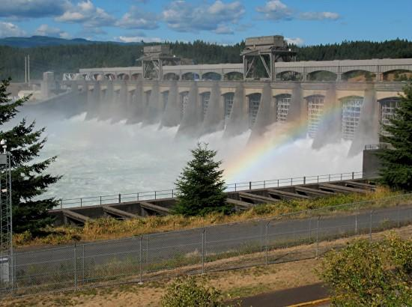

USACE CIVIL WORKS UPDATE
National Waterways Conference
St. Louis, MO
Edward E. Belk, Jr PE
Chief, Programs Integration Division
Directorate of Civil Works
September 27, 2017
US Army Corps of Engineers
BUILDING STRONG®
Notes:
1
I’m delighted to have a chance to talk to you today.
Today’s meeting offers a chance to develop a partnership as you go about your mission of advocating for water resources not only for your region, but for the Nation as a whole.
Today I’ll talk about the new Administration and its views on infrastructure, and how it could play out for us in the Corps of Engineers.

Slide 2
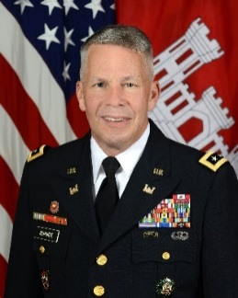
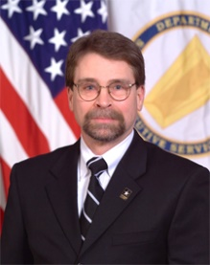
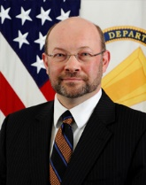
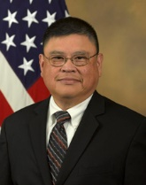
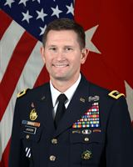
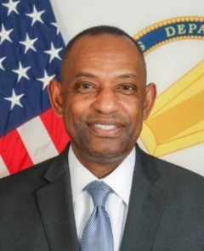
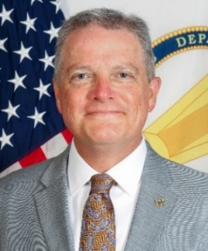
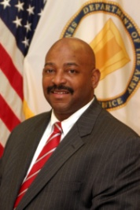
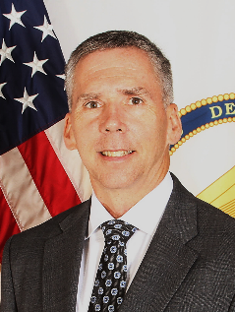
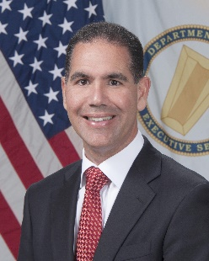
ARMY CIVIL WORKS LEADERSHIP
HQDA
LTG Todd Semonite
Chief of Engineers & CG USACE
Doug Lamont, SES Vacant Eric Hansen, SES Vacant Vacant
Sr. Official Performing Duties of ASA(CW)
PDASA DASA, Mgt/Bud DASA, Proj Rev DASA, Pol/Leg
HQUSACE
MG Ed Jackson James Dalton, SES Eddie Belk, SES Dr. Larry McCallister, SES Tab Brown, SES
DCG-Civil/Emerg Ops Director, Civil Works Chief, Programs Chief, Engineering & Constr Chief, Planning/Policy
Corps Enterprise Leadership
Brenda Johnson-Turner, SES (Real Estate) Karen Baker, SES (Environmental)
Ray Alexander, SES (IIS)
Dr David Pittman, SES (ERDC)
David Cooper, SES (Chief Counsel)
Stu Hazlett, SES (Contracting)
Photo not available
Tom Smith, SES Jose Sanchez Wesley Coleman
Chief, Ops/Reg Acting Dir., Contingency Ops Acting Director
Institute for Water Resources
2
Notes:
As you know, we are in a time of change, so let me start with the team leading our program.
On the top row, ASA(CW) Darcy and PDASA(CW) Crook left with the outgoing Administration. We do not yet have nominees to fill those positions; Doug Lamont, who had been Deputy ASA for Project Review, has been filling in as Acting ASA(CW)
The next 2 rows show our leadership team at HQ. Note we currently have 3 positions being filled on an interim basis by SES from the field who come to DC for 4-month assignments. (Their names appear in blue on this chart and they have blue outlines around their pictures.)

Slide 3
Civil Works: Focus on Delivery
Embrace and Operationalize Risk-Informed Decision Making
Make, Justify and Document Decisions at the Most Appropriate Level
Synchronize Headquarters Functions to Support MSC and District Project Delivery
Integrate and Synchronize Agency Policy and Guidance
Incorporate Social and Environmental Benefits into Project Formulation, Design and Implementation
6

Slide 4
Civil Works Investment Trends
(Excludes Supplemental Funding)
FY 2018
Budget Amount
$5,002M
7

Slide 5
CIVIL WORKS FY 2017 APPROPRIATION *
$ Millions
Total: $6.038 Billion
Water Supply $21 M
Expenses ** $186 M
Expenses ** $186 M
Regulatory $200 M
Regulatory $200 M
Environmental
$588 M
Navigation,
Ports $1,462 M
FUSRAP $112 M
Operation &
Maintenance
$3,149 M
Flood Damage
Reduction
$1,731 M
Navigation,
Inland
$1,209 M
Miss. R. & Tribs. $362 M
Recreation $293 M
Hydropower $199 M
Investigations $121 M
Emergency
Management $37 M
* Does not include supplemental appropriations
** Includes Office of Asst. SecArmy (Civil Works)
8

Slide 6
MAJOR CONSTRUCTION PROJECTS
($5 M or More in FY17 Work Plan)
Columbia R. at Mouth
22
16
Mud Mtn. Dam
Delaware R.
70
Columbia R.
Fish Mitigation
Fargo-Moorhead
20
Upper Miss. R.
Restoration
Boston Hbr.
Missouri R. Fish &
Wildlife Recovery
31
E. Br.
Clarion R.
Lake
18
33
OH & ND Envi.
Infrastructure
Muddy R.
15
Maywood
Yuba R. Basin
McCook &Thornton Res.
Luckey
56
34
7
Des Moines R.
7
Shallow Lamds
62
Raritan Basin
Sacramento R.
Bank Protection
9
12
6
16
10
8
23
Folsom Dam
Iowa Army Ammunition Plant
6
Chicago Sanitary & Ship Canal
5
5
DuPont
7
Great Egg Hbr.
53
Bolivar Dam
82
9
Delaware Coast
Natomas Basin
Missouri R. Levees
42
Wood R. Levee
Monongahela Locks/Dams 2,3,4
63
7
32
St. Louis
Poplar Island
30
Topeka
17
Blue R.
Turkey Cr.
26
AIWW Bridges
at Deep Cr.
8
Levisa & Tug Forks
71
Isabella Dam
22
250
20
12
Olmsted Lock & Dam
Ohio R. Shoreline
Santa Ana River
Mainstem
Kentucky Lock & Dam
39
40
Center Hill Lake
49
Carolina Beach
Chickamauga Lock
37
12
7
5
Brunswick Co.
Bayou Meto (MR&T)
12
Myrtle Beach
28
Yazoo Basin (MR&T)
18
Charleston Hbr.
Flood Risk Management
Central City, Ft. Worth
60
Miss. R. Channel (MRT)
43
Savannah Hbr.
6
J.B. Johnston W’way
6
44
Miss. R. Levees (MR&T)
Aquatic Ecosystem Restoration
Atchafalaya Basin (MR&T)
Comite R.
18
Jacksonville Hbr.
Buffalo Bayou & Tribs.
13
11
7
Navigation
9
La. Coastal
Tampa Hbr.
Brays Bayou
12
Houston-Galveston Ship Channel
9
5
Pinellas Co.
16
68
FUSRAP
San Antonio Channel
10
Herbert Hoover Dike
Multipurpose
S. Fla. Ecosystem
Restoration
115
Numbers in circles = $ million budgeted
9

Slide 7
FY 2017 – New Starts
Investigations
    Atlantic Intracoastal Waterway Bridge Replacement at North Landing, VA (NAV)
Construction
    Boston Harbor Deep Draft Improvements, MA (NAV)
    Charleston Harbor Deep Draft Navigation Improvements, SC (NAV)
    Jacksonville Harbor Deepening, FL (NAV)
    Tampa Harbor, Big Bend, FL (NAV)
    Ohio River Shoreline, Paducah, KY (FRM)
    Mud Mountain Dam, WA (ENR)
7
Notes:
There are 7 Life Projects: Life Projects include: East St. Louis, IL; American River Watershed, CA (Folsom Dam Modification); American River Watershed, CA (Folsom Dam Raise); Rio Puerto Nuevo, PR; Santa Anna River Mainstem, CA; Yuba River, CA; Raritan River Basin Greenbrook, NJ;

Slide 8

CONSTRUCTION PROJECTS IN FY18 BUDGET
34
$5 M or More. Actual funding for these and other projects to be determined in FY18 appropriation
Columbia R. at Mouth
22
Mud Mtn. Dam
70
Columbia R.
Fish Mitigation
Missouri R. Fish &
Wildlife Recovery
30
Boston Hbr.
58
33
Upper Mississippi
River Restoration
Maywood
Yuba R. Basin
Shallow Lamds
37
12
Luckey
20
Raritan
Basin
Hamilton
City
6
Folsom Dam
Iowa Army Ammunition Plant
16
7
50
15
DuPont
8
21
Natomas Basin
7
E. Br. Clarion R. Lake
36
Poplar Island
25
St. Louis
58
Isabella Dam
175
Olmsted Lock & Dam
25
Rough R. Lake
40
Santa Ana River
Mainstem
29
Center Hill Lake
Lower Miss. R. Mainstem (MR&T)
108
Flood Risk Management
50
Savannah Hbr.
Aquatic Ecosystem Restoration
Navigation
Buffalo Bayou & Tribs.
16
Herbert Hoover Dike
82
FUSRAP
Multipurpose
S. Fla. Ecosystem
Restoration
77
Numbers in circles = $million budgeted
8
BUILDING STRONG®

Slide 9
FY 2018 Key Budgeting Metrics
CONSTRUCTION
  All – Meet environmental, legal, mitigation requirements
  FRM, NAV, HYDRO – Benefit to Cost Ratio (BCR)
  FRM, NAV – Dam Safety & Seepage Stability (Continuing DSAC 1 & most DSAC 2)
  FRM – Risk to Life Index (Warning time, flow, depth, …)
  AER – Point values for loss prevention for significant natural resources
  NAV – Life Safety
O & M
  FRM, NAV, HYDRO – Risk & Consequences Assessment
  AER, ENS, FRM, NAV, HYDRO – Biological Opinion; Efficiency of habitat acres improved.
  REC – Park Capacity and Facility Condition Index, Visitation …
  NAV – Tonnage movements (Harbors: tons; Waterways: ton-miles)
  NAV – Subsistence Harbors and Harbors of Refuge
ALL ACCOUNTS
  Continuing/New/Completing/Years to Complete
  ESA & Regulatory compliance
  Health, Safety, Caretaker, Legal, Subsistence
9

Slide 10
FY 17/18 Journey
27 Feb OMB Verbal Pass Back to Corps/Army
16 Mar Administration Budget Blueprint Released
27 Mar Chief Recommendations Briefed to Army
20 Apr OMB FY 18 Passback
21 Apr Corps/Army Reclama
05 May FY 17 E&W Approps Signed into Law
23 May FY 18 Budget Release
24 May FY 18 Budget Hearing, FY 17 WPlan Release
13
Notes:
The Budget includes $6.7 million in Investigations for proposals to deepen and/or widen Houston Ship Channel, TX; Manatee Harbor, FL; Matagorda Ship Channel, TX; Mississippi River Ship Channel, Gulf to Baton Rouge, LA; Mobile Harbor, AL; New Haven Harbor, CT; Norfolk Harbor, VA; Port of Long Beach, CA; San Juan, PR; Seattle Harbor, WA; and Unalaska (Dutch) Harbor, AK; and includes funding to complete study of the Inner Harbor Navigation Canal, LA; and continue study of the GIWW, Brazos River Floodgates and Colorado Locks, TX.
The Construction account includes funding to complete construction of the Delaware River Main Channel Deepening, NJ, PA &DE and AIWW Deep Creek Bridge, VA; and continue construction of Olmsted Locks and Dam, Savanah Harbor Expansion, and Columbia River at the Mouth Jetty Rehabilitation.
O&M continues to focus on those high commercial use coastal harbors and channels and inland waterways that reduce risk of failure and provide the greatest return on investment in order to maintain safe, reliable, efficient, and sustainable waterborne transportation. The FY 17 Budget includes $951 million from the Harbor Maintenance Trust Fund, the highest amount ever budgeted.

Slide 11
Policy Challenges/Opportunities
Program Development Challenges
  Climate Change Adaptation
  Declining infrastructure performance, deferred maintenance and recapitalization of $270B, and White House infrastructure initiative
  Construction Backlog of $75B and Deauthorization Process
  Keeping Continuing Auth Program Healthy (New Starts, Resumptions, etc)
  Sustainable Long Term Investment Planning vs. Funding Uncertainty
Execution Challenges (USACE Credibility and Reliability)
  No-Earmark Appropriations, Work Plans, and Two-Tier Program
  Carryover – Remarkably Sensitive
  Reprogramming Limitations
  Continuing Contract Limitations
  Cost Growth and Life Cycle Cost Management
  Execute the Program, Deliver on Schedules/Commitments
14

Slide 12
CLOSING THOUGHTS
Addressing the Nation’s Infrastructure Investment Gap is a Shared Federal, State and Local Responsibility
The Corps Doesn’t Deliver Anything by Itself… Critical that We Not Lose Focus on Our Partners and Our Commitments
Navigation Investment is Essential for the Nation’s Global Trade and International Competiveness
Economically Justified FRM Investment Reduces Risk to Economic Activity, Lives, Livelihoods and Quality of Life
Infrastructure Investment: Financial (and Generational…) Challenge
Elevated Priority Afforded to Infrastructure Investment?
What are YOUR ideas?
16

Slide 13
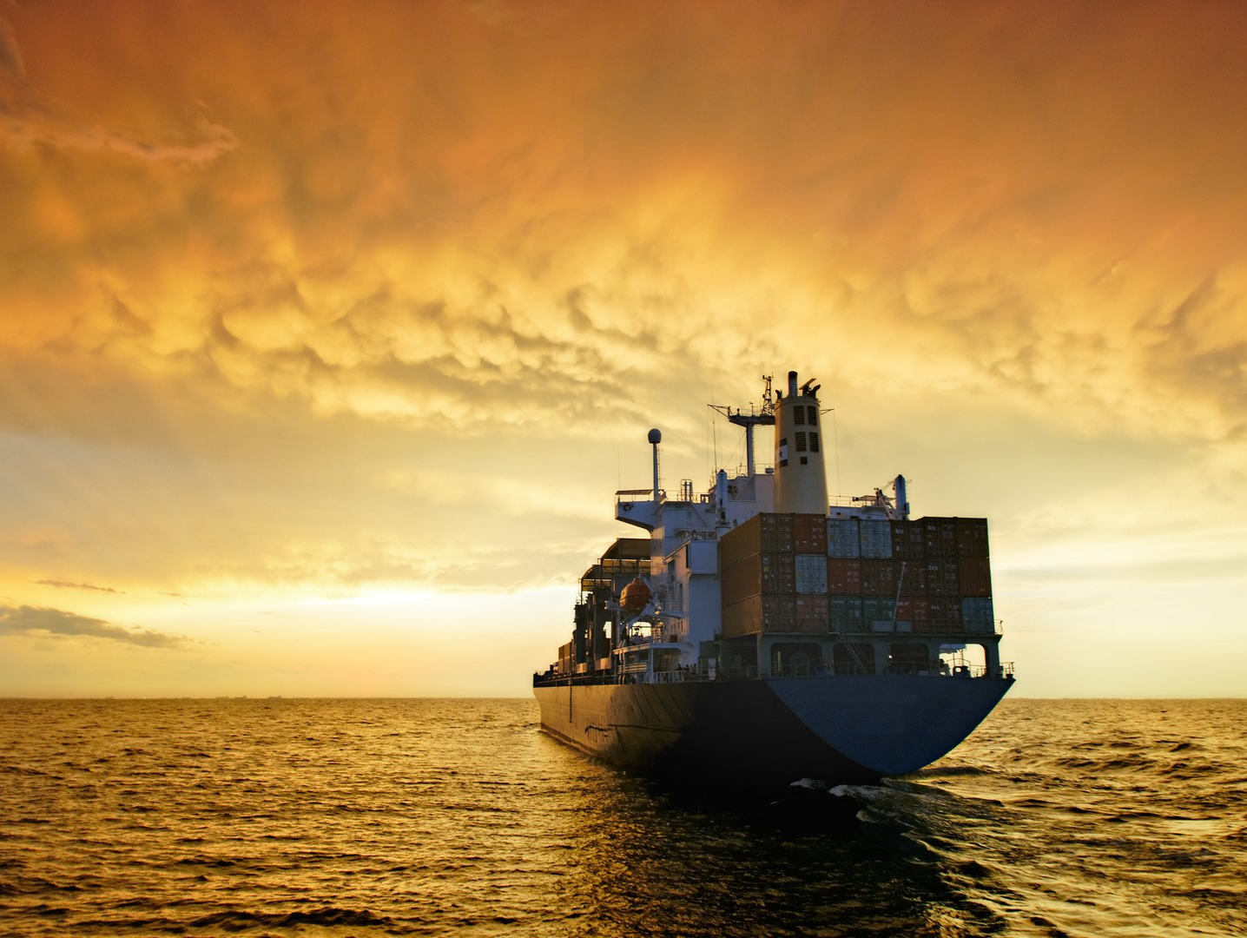
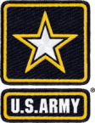
Thank You!!
BUILDING STRONG

Slide 14
Future Opportunities & Demands
U.S. Population Projected to Increase by 110M in 30 Years
Over 50% of US Population Located within 50 Miles of Coastline…Plus “Center Coast”….FRM Implications
U.S. Imports and Exports Projected to Increase Significantly
Panama Canal New Locks Now Opening - Worldwide Fleet of Post-Panamax Vessels to Increase
Opportunities for Economically Justified Port Expansions
Improving Grain Yield Trends and Improved Panama Canal Efficiencies ➔ Increased Grain Exports
Environmental Mitigation Activities Likely Significant
Future AF/P3 Opportunities, Where They Make Sense

