Slide 1
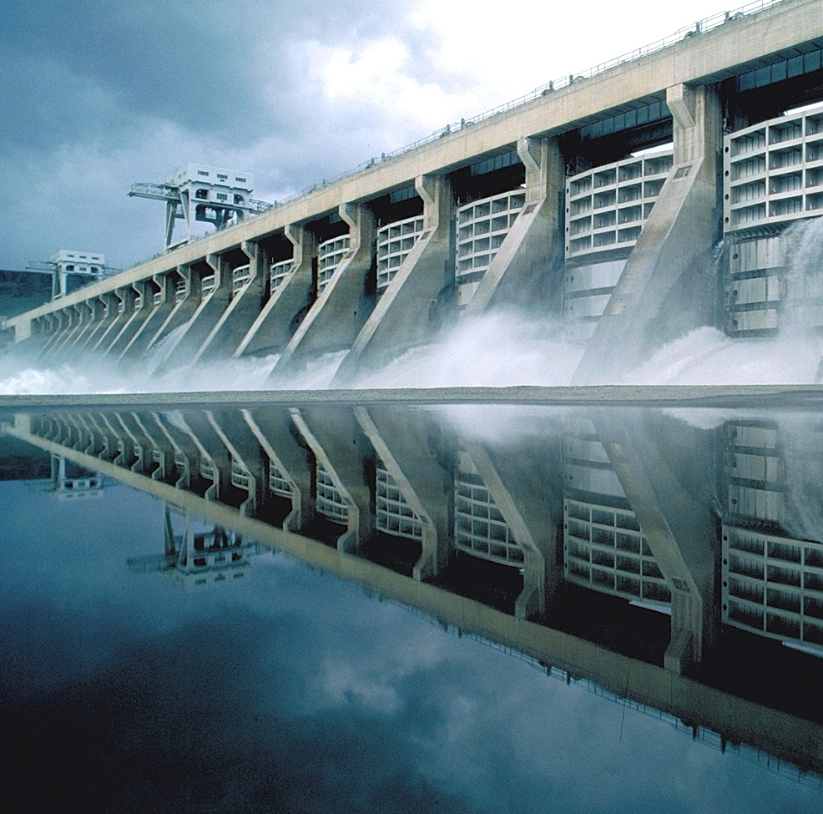

THE ARMY CIVIL WORKS PROGRAM
Saving Lives and Property
Enhancing our Economy
Protecting our Environment
Supporting our Nation’s Defense
National Waterways Conference Legislative Summit
7 March 2017
James Dalton, PE
Director of Civil Works
US Army Corps of Engineers
BUILDING STRONG®
Notes:
1

Slide 2

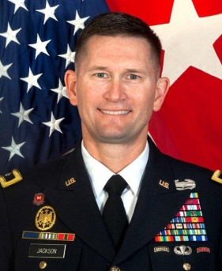
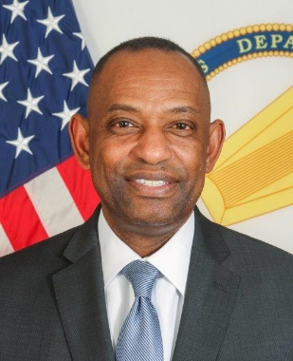
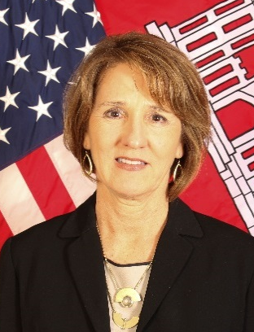
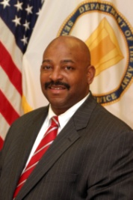
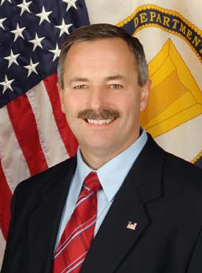
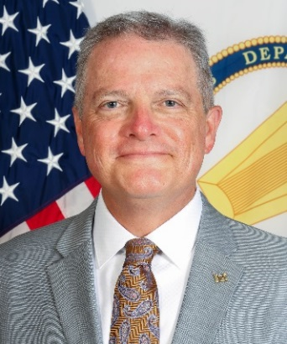
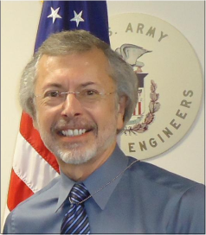
HQUSACE CIVIL WORKS LEADERSHIP
As of: 8 Jan 2017
Deputy Commanding General, Civil and Emergency Operations
MG Ed Jackson, PE ( 3L94 ) 761-0099 ( CECW-ZA )
Director of Civil Works
Mr. James Dalton, PE ( 3L92 ) 761-0100 ( CECW-ZB )
Ms. Susan Whittington Acting Chief ( 3E92 ) 761-1983
Operations and Regulatory Division (CECW-CO)
Great Lakes and Ohio River Div. RIT ( CECW-LRD )
North Atlantic Div. RIT (CECW-NAD)
Mr. Theodore Brown, PE Chief ( 3G92 ) 761-0115
Planning and Policy Division (CECW-P)
Mississippi Valley Div. RIT ( CECW-MVD )
Southwestern Div. RIT (CECW-SWD)
Mr. David Dale Acting Chief ( 3B92 ) 761-4601
Office of Homeland Security ( CECW-HS )
Director of Contingency Operations
Northwestern Div. & Pacific Ocean Div. RIT (CECW-NWD/POD)
Dr. Larry McCallister, PE Acting Chief ( 3H92 ) 761-8826
Engineering and Construction Division (CECW-EC )
South Atlantic Div. RIT (CECW-SAD)
South Pacific Div. RIT (CECW-SPD)
Mr. Edward Belk, PE Chief ( 3I92 ) 761-4100
Programs Integration Division (CECW-I )
Program & Project Management CoP
Institute for Water Resources
Mr. Robert Pietrowsky Director (703) 428-8250 (CEIWR)

Slide 3

President Dwight D. Eisenhower initiated the last truly great national infrastructure program - the building of the Interstate Highway System. The time has come for a new program of national rebuilding.
President Trump
Address to Congress, 28 Feb 2017
new political landscape
Notes:
3

Slide 4
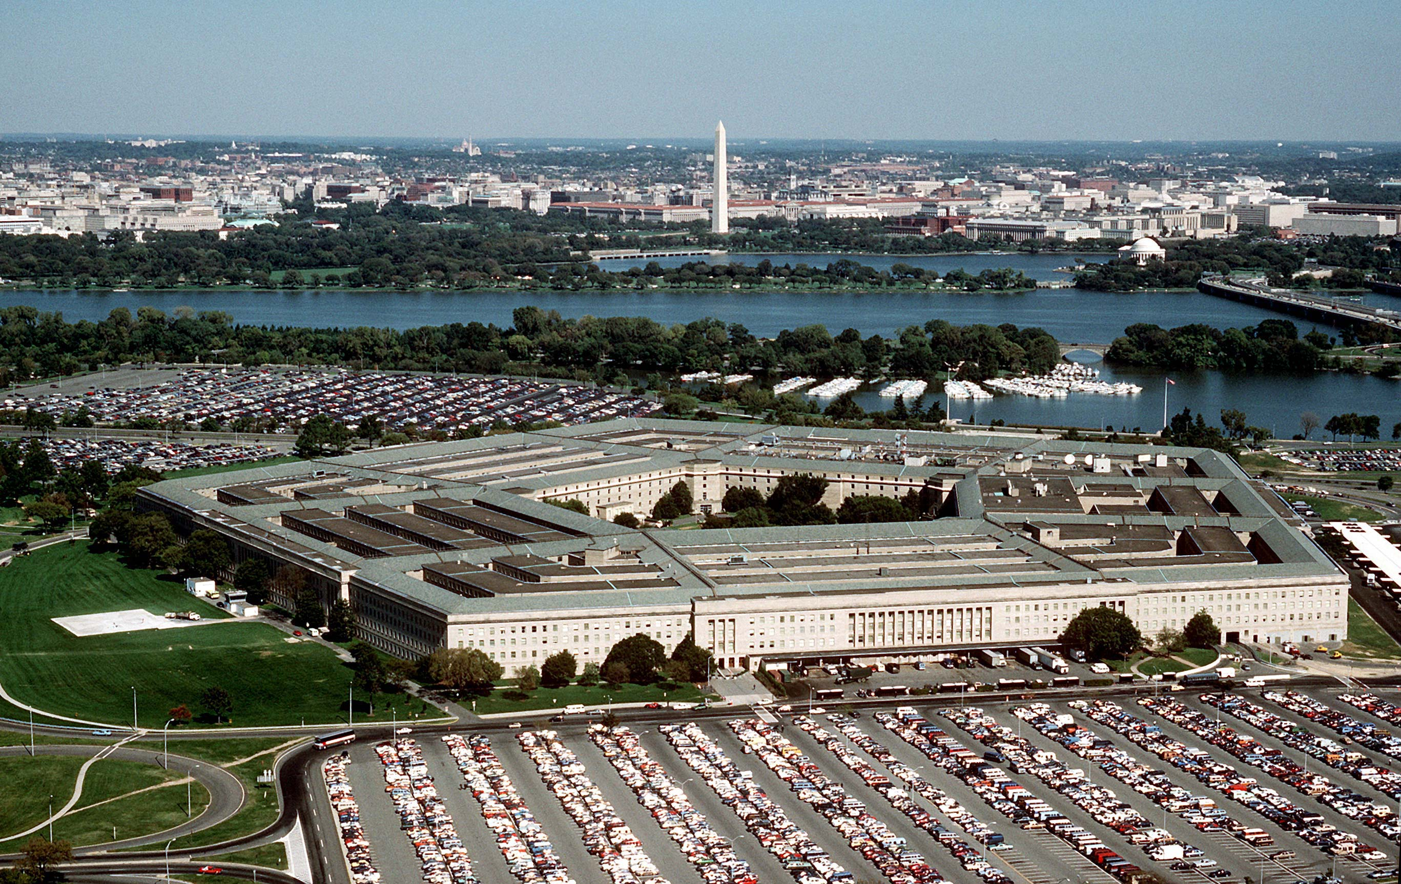

PENTAGON-LEVEL leadership
No SecArmy or ASA(CW) nominated
Timetable uncertain

Slide 5
Civil Works BUDGET STATE OF PLAY
Continuing Resolution (CRA) until 28 Apr 2017
Currently constrained to “least of…”
FY17 Workplan?
$1.025 B Supplemental for Storm Damage Repair
Initial FY18 Guidance
Water Supply $7 M
Expenses ** $185 M
Regulatory $200 M
Navigation,
Ports $1,011 M
Environmental
$480 M
FUSRAP $103 M
Flood Damage
Reduction
$1,214 M
Navigation,
Inland
$923 M
Hydropower $196 M
Recreation $267 M
Emergency
Management $35 M
By Business Line
Total: $4.62 Billion

Slide 6
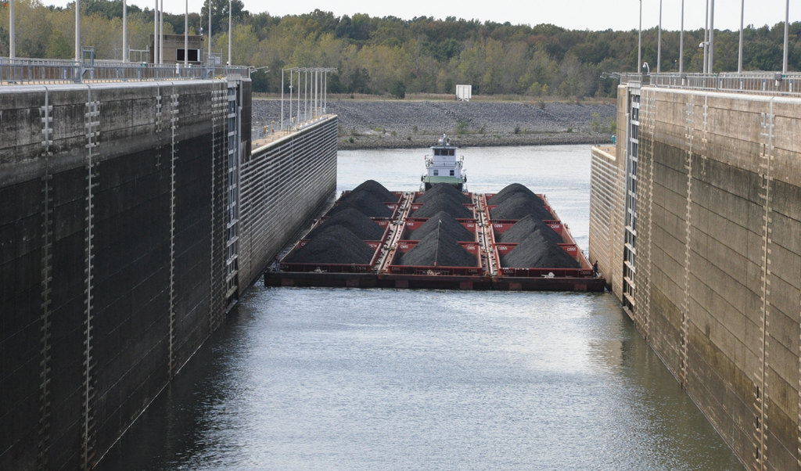
NAVIGATION - INLAND
Ongoing Projects
Olmsted L&D
Monongahela L&D 2, 3 & 4
Kentucky L&D
Chickamauga L&D
Potential Upcoming
Upper Ohio Navigation Study
Notes:
What I’ll do for the next few slides is to go through our major business lines and outline the major work we have ongoing in each.
In inland navigation, Olmsted is by far our biggest. This is a “mega-project” with a cost now calculated at over $3 billion. We’ve been spending at capacity, about $250 million a year, to complete.
But we also have work ongoing on the Monongahela and at Kentucky and Chickamauga Locks, both on the Tennessee River.
Coming up, the Upper Ohio River Navigation Study was authorized in WIIN 2016; and we have a study ongoing to replace one of the locks at the Soo Locks, between Lakes Superior and Huron on the border between the U.S. and Canada.

Slide 7
Potential Post-Panamax PortS
NY/NJ completed last year
Construction underway at Charleston & Savannah
Potential Upcoming: Boston, Norfolk, Jacksonville, Mobile, Houston, Freeport
NAVIGATION - COASTAL
Seattle
55
51
51
Tacoma
Columbia R.
43
43
50
Coos Bay
37
47
Boston
40
50
N.Y./N.J.
50
50
Oakland
Baltimore
50
50
55
Norfolk
50
68
L.A./Long Beach
Morehead City
45
53
San Diego
47
52
47
45
Charleston
Sabine-
Neches
Waterway
Savannah
42
47
Ponce
Houston/Galveston
55
Mobile
Jacksonville
48
45
40
50
45
42
55
44
Canaveral
Freeport
56
45
45
Miss. R.:
Gulf to
Baton
Rouge
Port
Everglades
45
48
Corpus Christi
52
42
45
Miami
50
Brazos Island
52
42
42
Current Depth
Authorized
Study Underway
Notes:
At our ports, our major effort is to deepen harbors to accommodate the new, bigger ships made possible by the deepening and widening of the Panama Canal, completed last year. We completed the deepening of New York-New Jersey Harbor to 50 feet last year, and have construction underway to deepen Charleston and Savannah to 52 and 47 feet respectively. Other project where we are or either doing pre-construction & design or have studies ongoing include Boston, Norfolk, Jacksonville, Mobile, Houston and Freeport, TX.
7

Slide 8
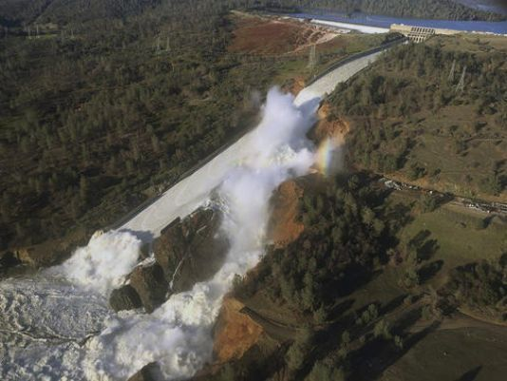
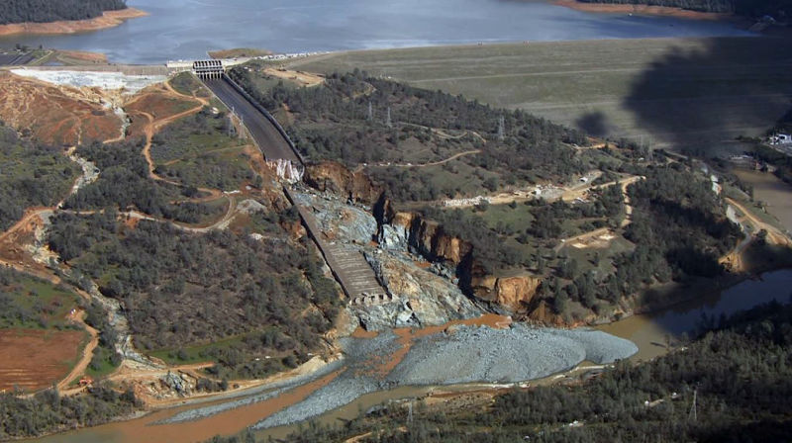
Flood risk management
Dam Safety
  300 dams classified as actionable
Levee Safety
  National Levee Database (NLD)
Centers of Expertise
  Risk Management Center (Denver, CO)
  Dam Safety Modification (Huntington, WV)
  Modeling, Mapping & Consequences Center (Vicksburg, MS)
Oroville Dam, CA
Notes:
8

Slide 9
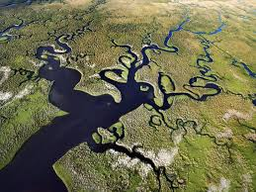
Aquatic ecosystem restoration
ONGOING:
South Florida Ecosystem Restoration
Louisiana Coastal Restoration
Columbia River Fish Mitigation
Missouri River Fish & Wildlife Recovery
Chicago Sanitary & Ship Canal Dispersal Barrier
Upper Mississippi River Restoration
Notes:
9

Slide 10
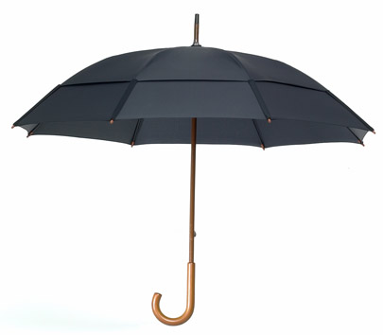
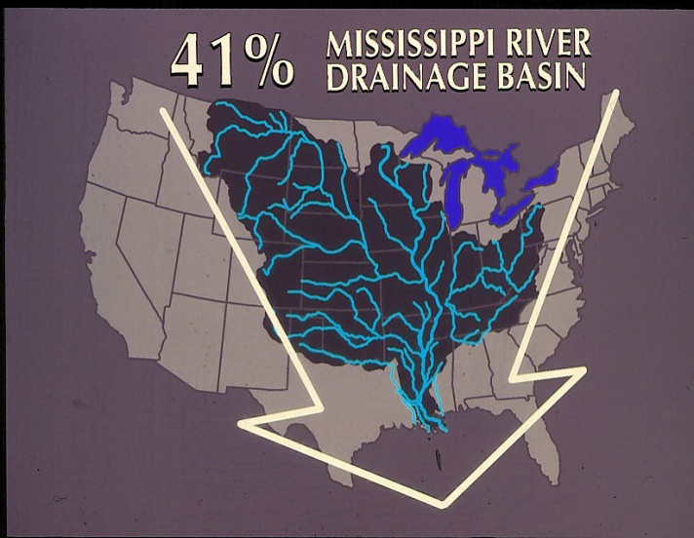


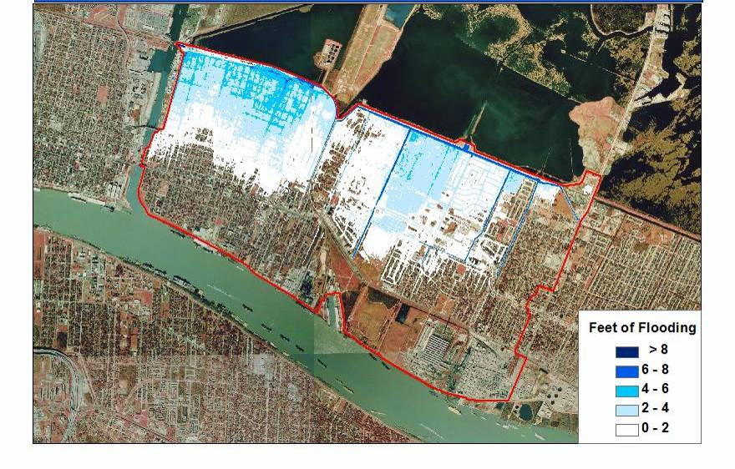
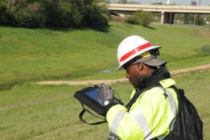
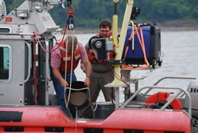
Civil Works “Overarching Strategy”
Integrated Water Resources Management
IWRM
A holistic focus on water resource challenges and opportunities that reflects coordinated development and management of water and related resources
IWRM considers economic benefits, ecosystem quality and health and public safety
Systems
Approach
Innovative
Financing
Adaptive Management
Collaboration and Partnering
Risk Informed Decisions
State of the Art Technology
“Cross Cutting Strategies”
Notes:
10

Slide 11
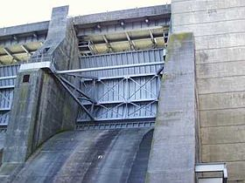
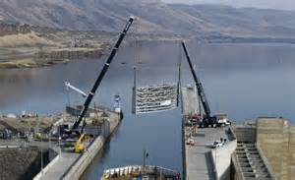

INFRASTRUCTURE STRATEGY
Life Cycle Portfolio Management
Asset Management
Alternative Financing
Training

Slide 12
Civil Works hot topics
WIIN 2016
OM 20/20
Sec. 408 Program
  (Non-Federal Modification of Existing Projects)
Regulatory: Pipelines
  Dakota Access Pipeline (DAPL)
Notes:
12

Slide 13
NEW AUTHORITIES UNDER WIIN 2016
Sec 1111 – Aligns the cost share for construction of harbors with the change in WRRDA 2014 modifying the cost-share for maintenance of harbors.
Sec 1322 – Clarifies prioritization of hurricane and storm damage reduction efforts directs Secretary to expedite completion of certain flood damage reduction and flood risk management projects and certain feasibility studies and a post-authorization change report, as well as of certain projects being carried out under Sec 211 of WRDA 1996.
Sec 1163 - Amends section 2036 of WRDA 2007 to require the Secretary to issue guidance regarding credits available from mitigation banks and in-lieu fee programs and provides that mitigation banks and in-lieu fee programs be considered reasonable alternatives.

Slide 14
MORE NEW AUTHORITIES UNDER WIIN 2016
Sec 1122 – Pilot program to carry out projects for beneficial use of dredged material, including projects across business lines and for promotion of broad array of benefits, managed by regional beneficial use agency teams, informed by stakeholders. Cost sharing per Sec. 204 of WRDA 1992.
Sec 1127 –Credit or reimbursement under this subsection for a discrete segment of a flood damage reduction project, or separable element thereof, before final completion of project or separable element.
Sec 1153 – Authorized to accept and use materials, services, or funds contributed by a non-Federal public entity, a nonprofit entity, or a private entity to repair, restore, replace, or maintain a water resources project… Potential opportunity for Non-Federal Interest placement and shaping of suitable dredged materials for placement area dike raising.

Slide 15
Civil Works Priorities
Delivery on Commitments
Asset Management
  Sustainability (lifecycle cost management)
  Risk Management – Risk Informed Decisions
Integrated Water Resources Management
Innovation – New Technology
Technical Competence
Mutually Supported Stakeholder Partnerships

Slide 16
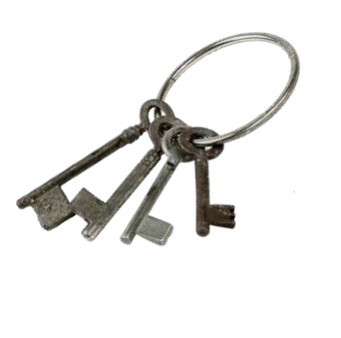

Stakeholders & Partnering are Key
Leverage efforts through partnerships
Understand and communicate Civil Works Value to Nation
Find consensus on major initiatives
  Identify funding to reach outcomes
  Engage in dialogue
Be mutually supportive
Shared Messages
Involve & Engage End-Users
Seek to Influence Decision-Makers: How can we better explain the value of infrastructure and define what constitutes resilient and sustainable infrastructure?

Slide 17
Questions
Notes:
17

Slide 18
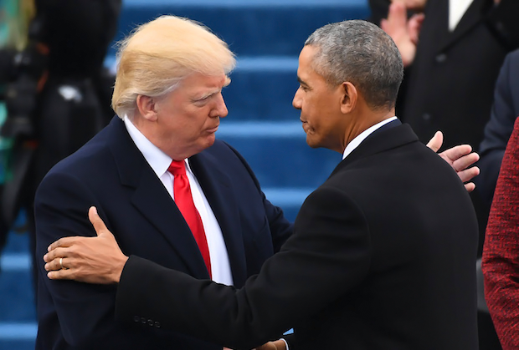
Current political landscape
The 45th* change in Administration experienced by the U.S. Army Corps of Engineers during our 241-year history
* Including George Washington’s in 1789
How does a change in Administration influence USACE operations?
Infrastructure investment
regulations
Immigration
Size of government
DOD Global Presence
DOD Force Structure
Installations
Sustainability
Notes:
3

