Slide 1

Mary Lamie, P.E.
Executive Director
St. Louis Regional Freightway

Slide 2
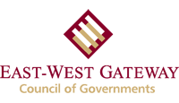


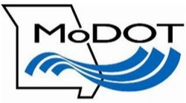
St. Louis Regional Freightway
Business unit of Bi-State Development
Launched in September 2014
Executive Director in July 2015
Support from both sides of the river

Slide 3

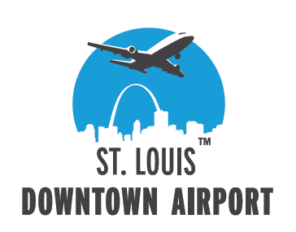
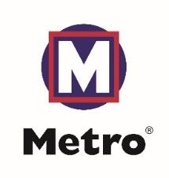

Bi-State Development: Five Business Enterprises
Established in 1949 through an interstate compact between Missouri & Illinois
Can cross local, county and state boundaries to plan, construct, maintain, own and operate facilities and infrastructure
Authorized to issue revenue bonds, collect fees and receive federal, state and private funds
Long history as a regional development authority

Slide 4
Mission and Goals
Mission: To optimize the region’s freight transportation network through public and private partnerships.
Goals: To produce results that strengthen the St. Louis Region by increasing job growth through manufacturing and logistics, and improving the local economy.
    Regional Freight Needs Analysis and Development Plan - Maximizing funding opportunities through public-private partnerships and improving multimodal capabilities
    Develop and implement a Marketing Plan – St. Louis Region is recognized as national and global premier freight hub.

Slide 5
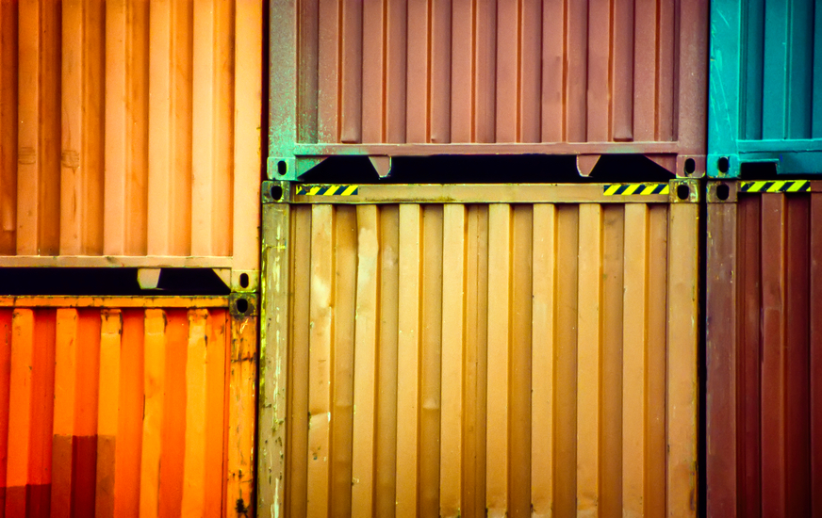
St. Louis Regional Freightway
  Members include manufacturing, logistics, industrial real estate, workforce development, economic development organizations, academia, all modes of transportation both the IDOT and MoDOT and the East-West Gateway Council of Governments.
    Needs Analysis and Freight Development Committee
    Terminal Rail Association of St. Louis – President Mike McCarthy
    Marketing Committee
    America’s Central Port - Executive Director Dennis Wilmsmeyer
    Policy Committee
    MO Baptist University Dean of Graduate Studies

Slide 6
Successes in the Two Years
  Public and private sector partnership (multimodal list of projects, improving the region’s overall competitiveness, supporting economic and new business development)
  Launched Thefreightway.com website (the premier source of information and point of contact regarding regional logistics capabilities and site selection)
  Engaging potential partners throughout the Midwest and into the Gulf of Mexico
  Hosting regional meeting on critical freight and logistics opportunities including the USDOT FHA (unique model for the country )
  Gaining critical support from congressional delegations from IL and MO
  Developed marketing and advocacy plans for the regional effort

Slide 7
Freight Development Committee (FDC)
Primary criteria included the following:
Economic Impact: How closely does the project align to the Freightway’s goals? (Improving the region’s overall competitiveness and create jobs throughout the region)
Multimodal Impact: What is the potential for the project to improve the flexibility, reliability, and connectivity of the region’s freight network?
Efficiency Impact: To what extent does the project increase the efficient use of the St. Louis region’s freight assets? Increasing the speed of freight, lowering the cost to move freight and improved reliability within the system.
Safety and Security in Travel

Slide 8
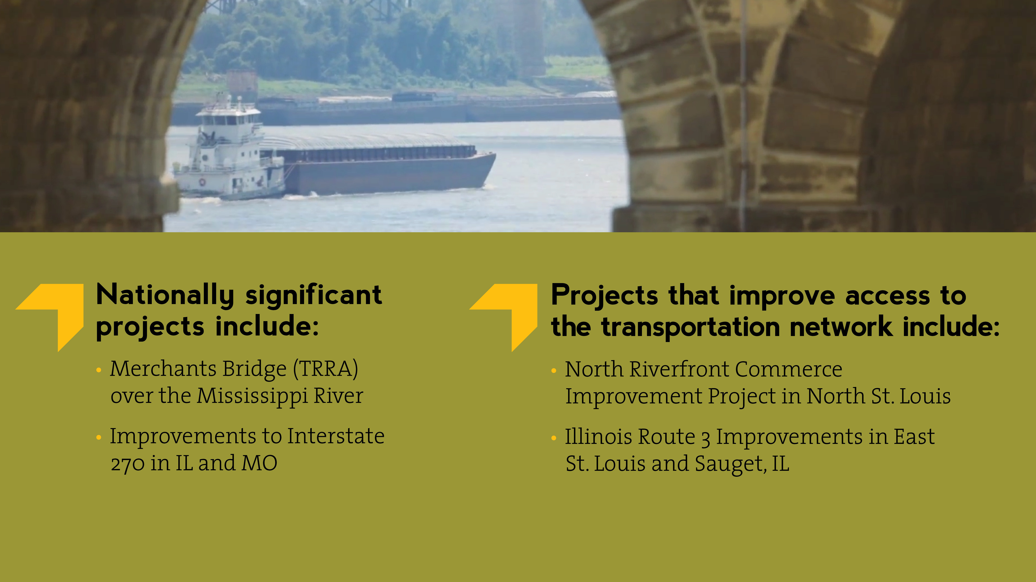

Slide 9
2016 FDC Accomplishments
Project list
  presented to the USDOT FHA Administrator Gregory Nadeau
  highest priority projects were discussed with the Administrator & his staff
St. Louis Region included with the 24 USDOT Freight Economic Roundtables
Responsible for letters of support for FASTLANE projects submitted by the region
Engaging discussions with MPO, DOTs and manufacturers, logistics, shippers and carriers

Slide 10
2016 FDC Accomplishments
Freight Development Project List presented, referenced and discussed during critical freight and logistic meeting with key decision makers – IDOT, MoDOT, elected leaders and business leaders
MoDOT will incorporate MO projects with the MO State Freight Plan
Member of IDOT State Freight Advisory Committee
October 2016 Freight Development Project List was unanimously endorsed by the East-West Gateway Council of Governments

Slide 11
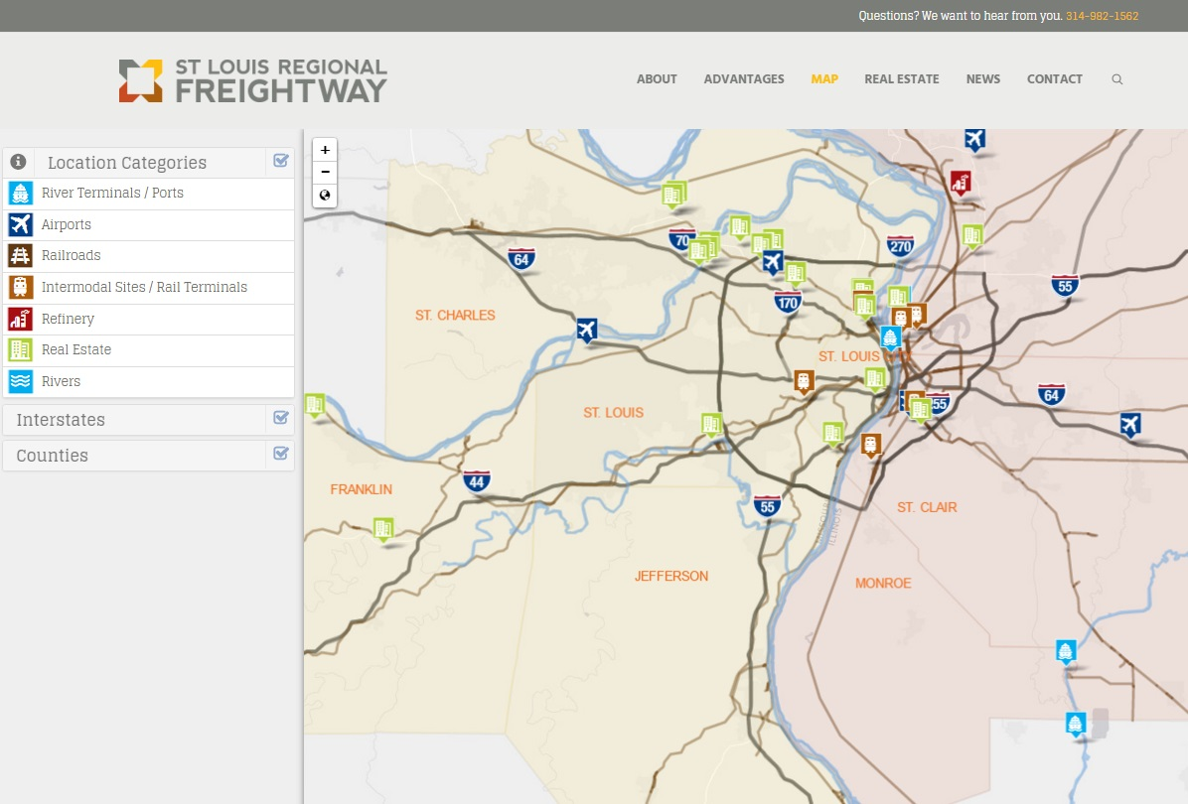
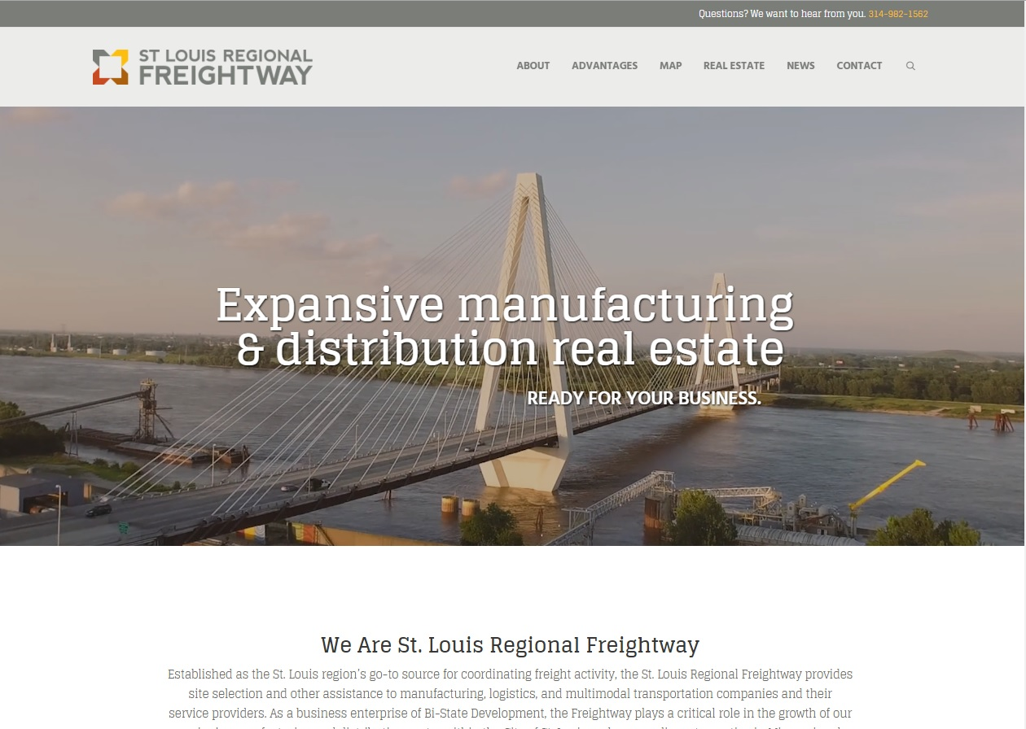
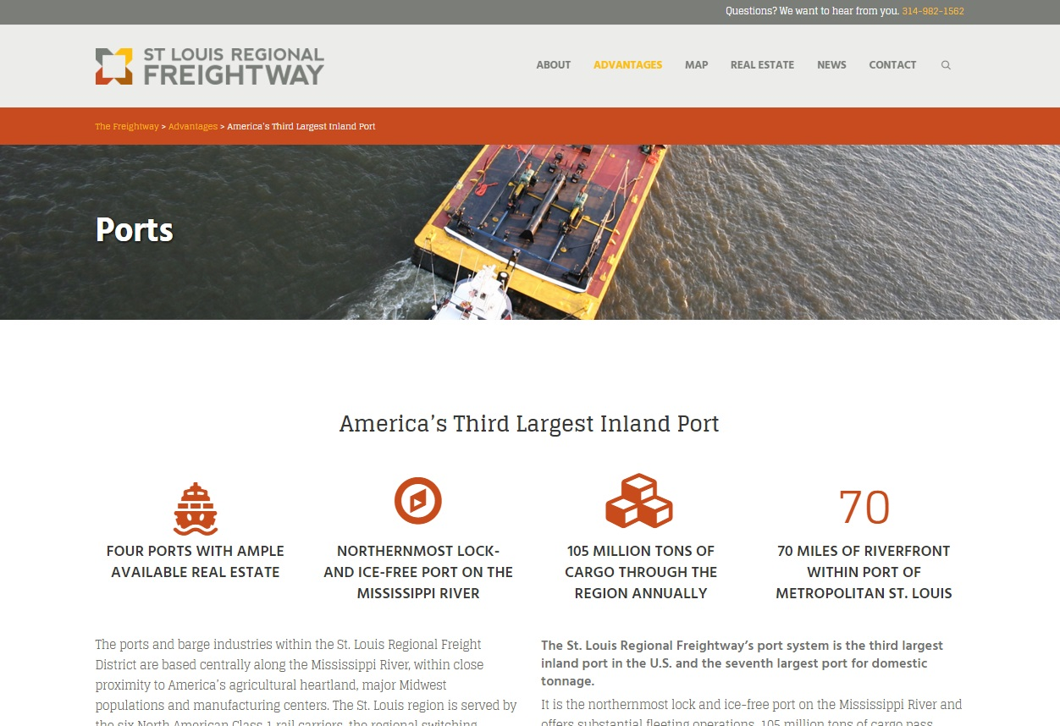



Region’s Digital Presence-April 2016
TheFreightway.com is our front door for attracting businesses, investors and real estate speculators to the region
The fact sheet and comprehensive real estate resource are tools for the entire region

Slide 12
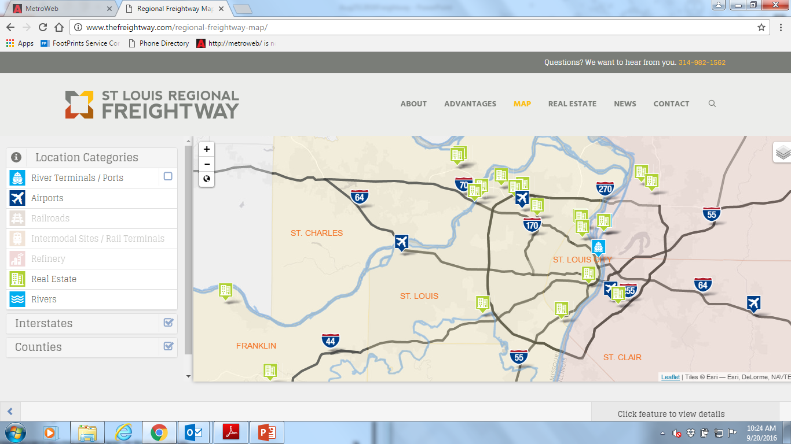
Top Industrial User Real Estate Sites

Slide 13
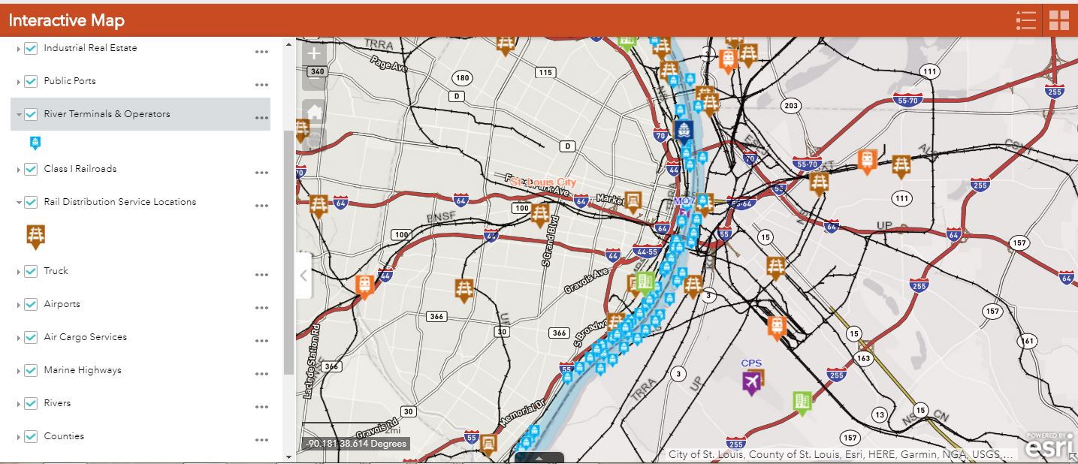
Updates to “Thefreightway.com” Map

Slide 14
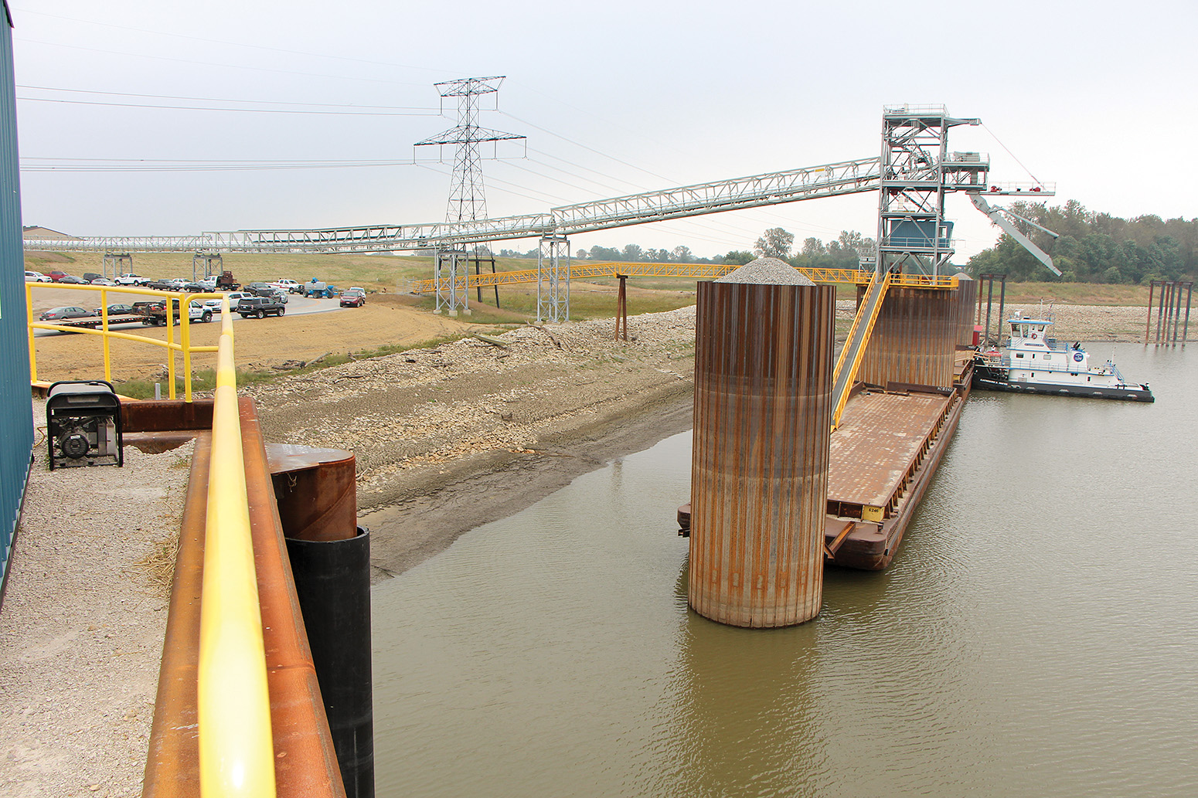
New ag and fertilizer barge transfer facilities
Most recent ag and fertilizer barge transfer facilities came on line.
  COFCO (2016) – New facility
  America’s Central Port –Madison Harbor (2015, $50 mil) – New facility
  Louis Dreyfus (2013) – New facility
  Municipal River Terminal - (2013) - Existing facility w/ $20 mil -new
  dock and (2017) $8.5 mil –rail unit train improvements
  Bunge (2011) – New facility
  Consolidated Grain & Barge (2010) – New facility
  A permit (2017) for an additional barge transfer facility was recently
  submitted to the USACE.
ACP (Photo by Nelson Spencer Jr.)

Slide 15
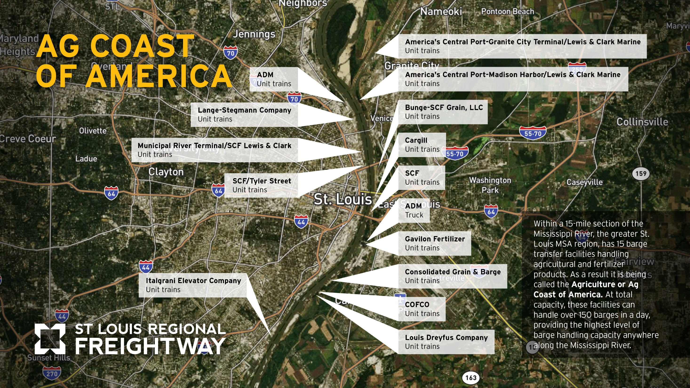
Ag Coast of America

Slide 16
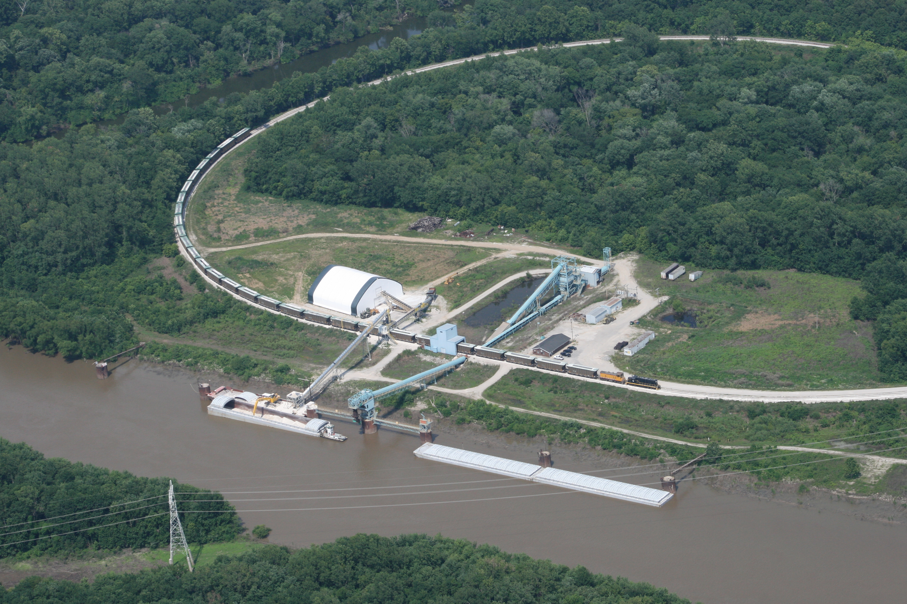
Cheaper train rates to large barge-loading facilities
Unit train capabilities
Offer cheaper rates to large barge-loading facilities
Carry 110 – 125 rail cars often with only one commodity,
typically for bulk goods like ag, fertilizer and coal
Grouping of cars reduces the time to assemble and
disassemble the train
The Region’s rail switching carrier, Terminal Railroad
Association (TRRA) of St. Louis and six Class I RRs supports
the region’s intermodal capabilities and provides national
access
    Kaskaskia Regional Port District #1

Slide 17
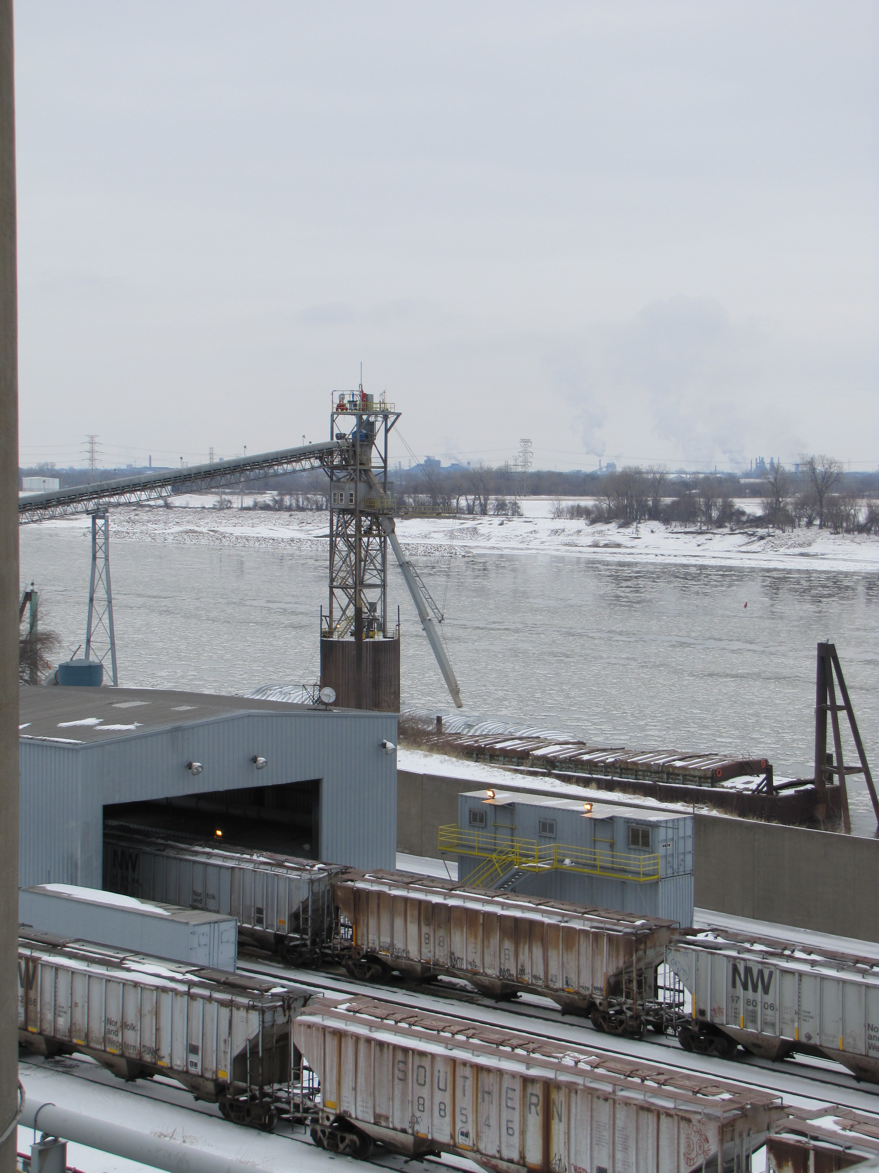
St. Louis Region’s Barge Traffic Growth
  Geographic advantage
    Centered in America’s agricultural
    Northernmost ice-free and lock-free access on the
    Mississippi River to and from the Gulf of Mexico
  Intermodal connectivity
  Excess capacity at river terminals and high
  concentrations of barges

Slide 18
Regional Economic Impact - Inland Water Transportation
  Inland Water Freight Transportation Port and Harbor Operations
  Marine Cargo Handling Supportive Activities Water Transportation
  Tow boat operators
  Average Annual Wage $ 75,000
  Total industry inputs 2015 $750,000,000

Slide 19
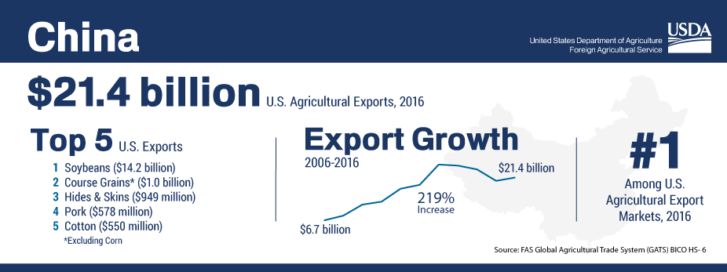
U.S. Agribusiness
COFCO International/Nidera is one of China’s state-owned food processing holding companies.
China’s largest food processing, manufacturer and trader
The U.S. is the main supplier of global demand for soybeans exports valued at nearly $22 billion

Slide 20
Global Macroeconomic Conditions & Market Share
  Production & Transportation Costs: Production costs per bushel for soybeans are lowest in Brazil. Lower handling and shipping costs help the U.S. remain competitive – but this advantage is slipping
  Market Position: U.S. world market share could further decline by 18.5 points without improvements in the U.S. infrastructure from the farm to the port
  Potential Economic Impact: A 1 percent decline in U.S. soybean export market share is equivalent to $500 mil in lost sales to U.S. farmers – inferring a potential annual loss of $9 bil

Slide 21
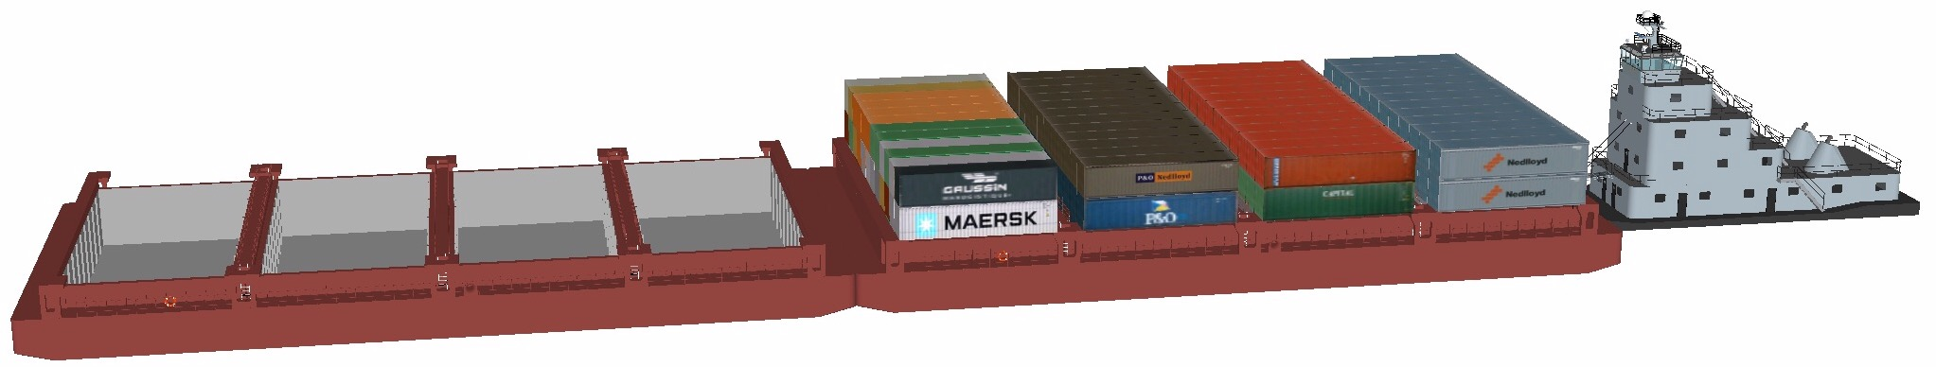
Container on Barge is a Hot Topic!
Container on barge (COB) is a form of intermodal freight transportation
Containers are stacked on a barge and towed to a destination on the inland waterway
In recent years, Mississippi River COB services have been focused on operations from Memphis south or the lower 600 miles of the Mississippi River

Slide 22
Container on Barge is a Hot Topic!
Goal: Expand commerce & trade through containerized cargo growth through intermodal rail and container on barge.
Alternative mode of transportation that allows the Nation to better compete in global markets
Could serve as viable alternate option in the event of supply-chain disruption

Slide 23
Moving forward with Container on Barge
  St. Louis Region has the infrastructure - Three ports with COB capacity
  Identify commodities that can withstand the additional transit times
  Metal scrap - Tires - Construction Supplies - Appliances - Automotive Parts
  Specialized Grain - Fabricated Steel - Seasonal Outdoor Furniture - Animal Feed
  Demonstrate COB service feasibility between inland cities in the Midwest and the Port of New Orleans via the Mississippi River system
  Coordinate with intermodal logistic companies

Slide 24
Container on Barge-What is next?
  Partnering with other regions in the Mid-West and into the Gulf of Mexico
  “Hub and Spoke” Container on Barge (COB) service to/from Mobile, AL and New Orleans connecting the Heartland region
  A “Hub and Spoke” service will allow for the inland ports to couple volume and barges located along the waterway system
  Also, combining the inland river container volume into a single main line operation, the shipper’s cost would be reduced by lower operating cost of the movement

Slide 25
MCLamie@TheFreightway.com TheFreightway.com

