Slide 1

St. Louis
Gateway to Prosperity
What does the Opportunity Look Like?
Ken Eriksen, Senior Vice President
September 28, 2017
St. Louis, MO
@ieg_vantage
@keriksen

Slide 2
Charting the Course
INTRODUCTION
Informa Economics IEG
MACRO ENVIRONMENT
Overview: Freight on upward trend
Context: Changing Freight Movement Dynamics in St. Louis
Challenge: Consequences of Infrastructure Impediments
Multi-Modal Optionality Delivering Opportunity
BARGE MARKET
Enlarged, Younger Fleet
Susceptible to Navigation Issues and Infrastructure Impediments
NEXT STEPS
Economic Impact Goes Far, Goes Deep
Preserve Opportunity and Growth

Slide 4
Macro Environment

Slide 5
Freight Movements have Strengthened

Slide 6
Transport Index Surging with Industrials
Leading Indicator of Activity

Slide 7
St. Louis Barge Loadings and Unloadings Record High, Despite Pull-Back with Coal

Slide 8
Grain and Soybean Barge Loadings been Shifting to more Downriver Segments

Slide 9
Infrastructure Framework
Challenge: Consequences of Infrastructure Impediments
Infrastructure Impediment = Inefficiencies
Inefficiencies = Less Effective Transport Capacity
Less Effective Transport Capacity = Higher Freight Rates
Higher Freight Rates = Lower Producer Returns
Lower Producer Returns = Lower Competitiveness
Lower Returns and Competitiveness = Reduced Economic Activity

Slide 10
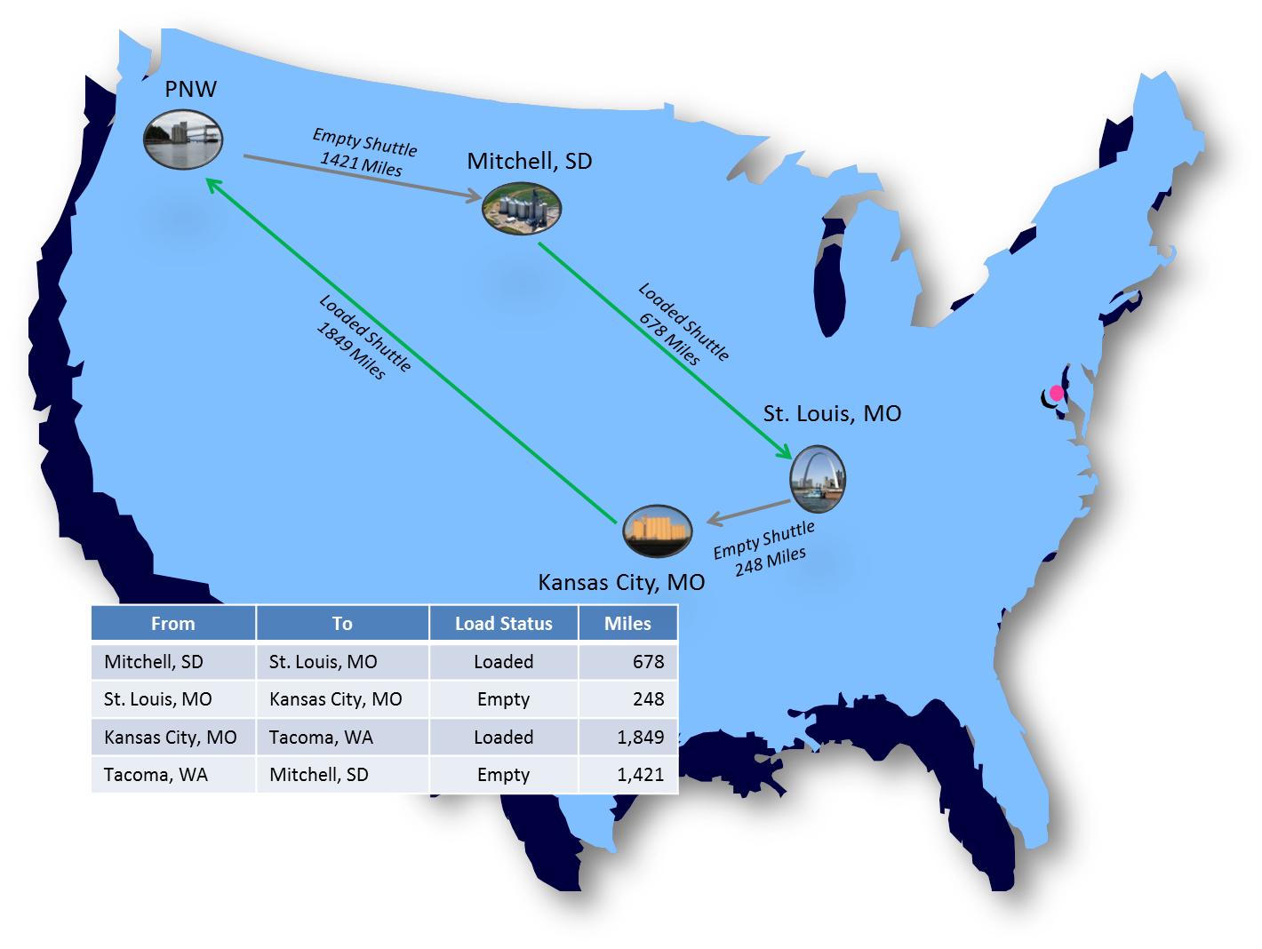
Mulitmodal Options – Maintain Long Hauls while Reducing Empty Miles

Slide 11
Panama Canal & Vessel Loadings; Opportunities and Cost Implications Due to Infrastructure Enhancement
Volumes Speak Volumes . . .
  Compare to base vessel loaded to 39.5 foot draft, about 56,700 metric tons cargo
  New locks will accommodate 50 foot draft and upwards of 97,000 dwt vessel.
  Sensitivity on higher loadings for deeper draft, adjusting for loading and unloading time, and higher fuel burn.
  Overall, toll structure not key determinant as much as heavier loadings.

Slide 12
Barge Market

Slide 13
Barge Fleet Expanded in 2016 for Covered and Tank

Slide 14
Covered Barge Fleet Under Less Pressure with
Sizeable Fleet

Slide 15
Open Barge Fleet Dynamics to see Stability in Demand and Right Sizing Fleet Size

Slide 16
Tank Barge Fleet to See Improved Utilization

Slide 17
Navigation Conditions Impacting Fleet Dynamics and Effective Fleet Size

Slide 18
Takeaways

Slide 19
Key Takeaways
Freight Movements Remain Strong
Transport Infrastructure Facing Challenges
St. Louis Continues to See Strong Volume Expansion
Modality Options Expand Market Access and Competitiveness
Barge Fleet Well Supplied
Navigation Conditions Impact Capacity
Economic Opportunity with Port Options

Slide 20
@ieg_vantage
@keriksen

Slide 21
@ieg_vantage
@keriksen

