Slide 1
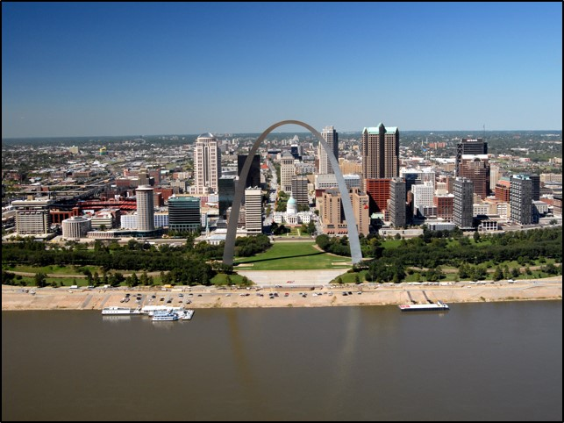
2017 National Waterways Conference
John Peukert
Deputy District Engineer for Programs and Project Management
St. Louis District
27 September 2017
Notes:
MVS is within the confluence of 3 major rivers
We are in the transition point from a pooled to open river.
Over the last several years we have experience many extremes.
-Flood of 2011
-Drought of 2012-2013
-Flood of 2013 (8th highest level measured in St. Louis 40.3 feet June 2013)
And in the last 3 years alone we have experienced 4 major floods, resulting in 10 levee systems that have breached and 24 that have overtopped in these last 3 years.

Slide 2
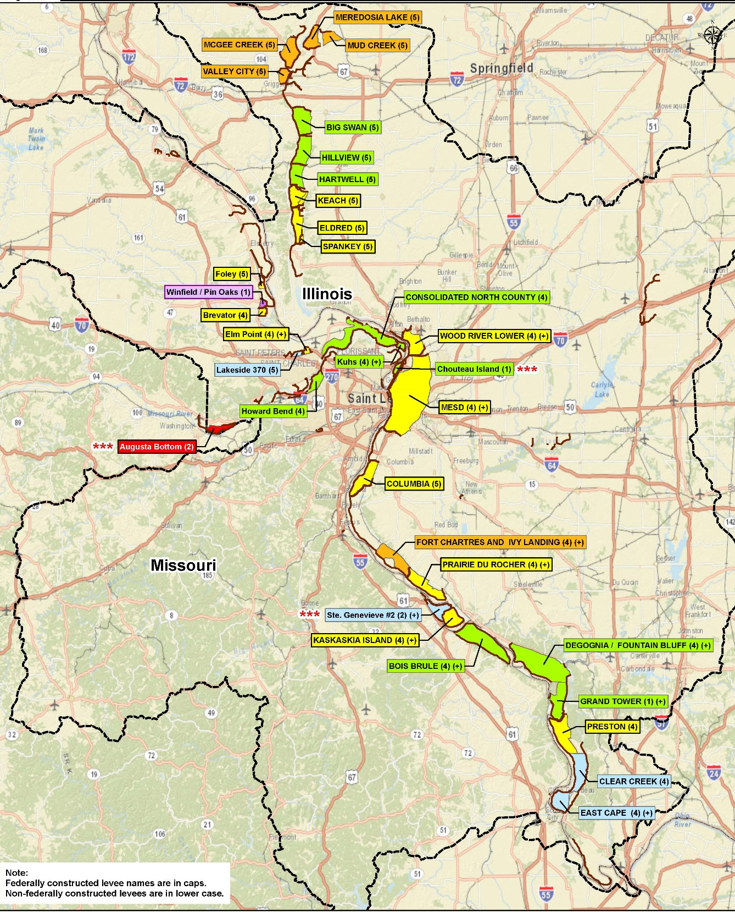
PL 84-99: 2015-2017 Flood Event Repair Projects
Notes:
Recurring events compromise system resiliency.
We are unable to rehab because frequency and magnitude of these events.
34 levees damaged since 2015 - included breached systems, overtopping, scour erosion, slides, wave wash, damage to gravity drains, or any combination of the above.
To date only one rehabilitation project has been complete.
These levees protect hundreds of thousands of lives, economic assets and critical infrastructure that is crucial to the nations supply chain.

Slide 3
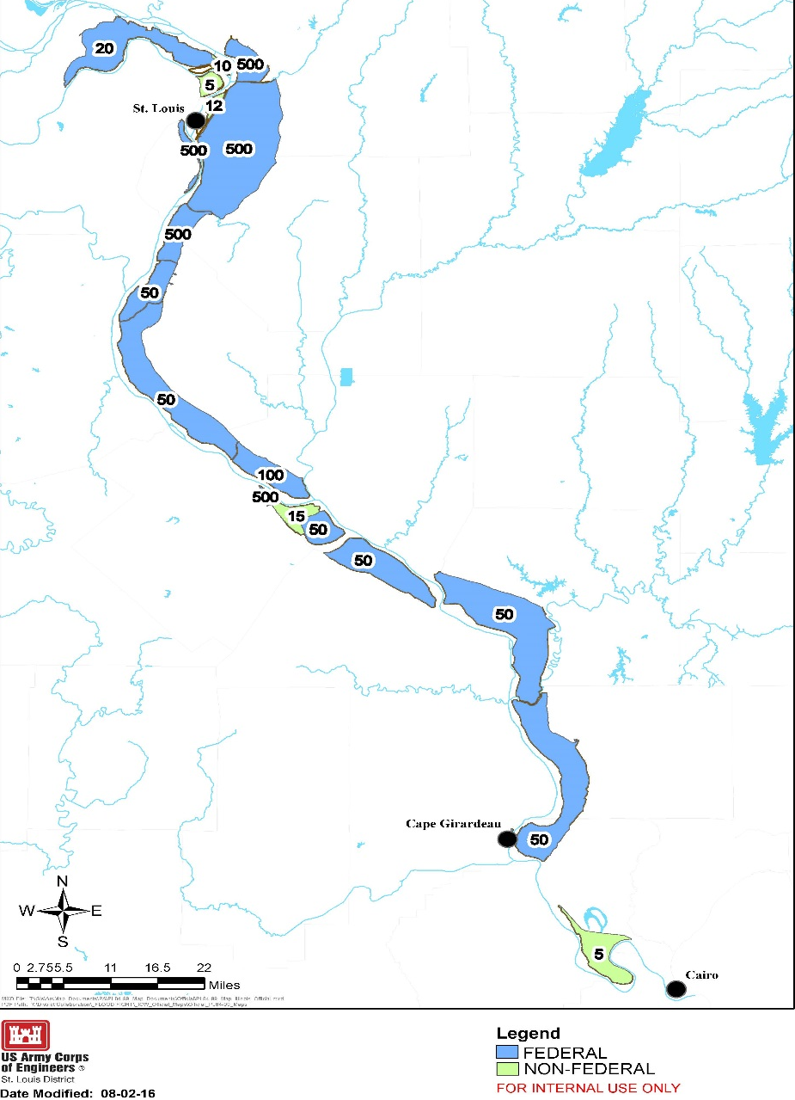
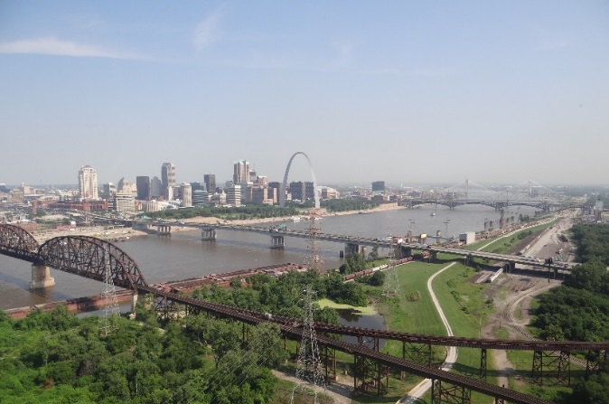
What’s behind these systems?
St. Louis District Levee Systems
67 levee systems.
750 miles of levee.
Reduce flood risks to 575,000 acres of economic and agricultural interests
Prevented $3.9B in flood damages during winter 2015/2016 flood.
Mississippi River Levee Systems between Alton to Gale, IL:
22 levee systems
316,000 acres,
350,000 people, and
$12.5B in economic assets.
East St. Louis Levee System
Notes:
Map reflects the Federally authorized and constructed Alton to Gale levees (leveed area in blue) and the non-Federal levees (leveed area in green) from the Missouri River south to the Ohio River.
Identifies varying levels of protection these ag and urban designed systems provide along 200 river miles.
67 levee systems (750 miles in length) protecting 575,000 acres of economic and agricultural interests within its boundaries.
Alton to Gale
Flood Control Act of 1936 and 1938
Constructed at 100% Federal cost.
Significant Federal Investment
Investment equivalent today of $1.7B(indexed to 2016 cost)
Provides Substantial Value to the Nation
$12.5B in economic assets
Reduces flood risk to 350,000 people
$3.9B in flood damages prevented in winter 2015/2016 flood
316,000 acres of leveed area (22 systems)
9 with > 100 year level of protection
13 with < 100 year level of protection
The Metro East Levee systems (Wood River, East St. Louis, Chain of Rocks, Prairie du Pont and Fish Lake) which protects over 288,000 people, 111,700 acres and major industrial, commercial, and residential property valued at over $7.2 billion.

Slide 4
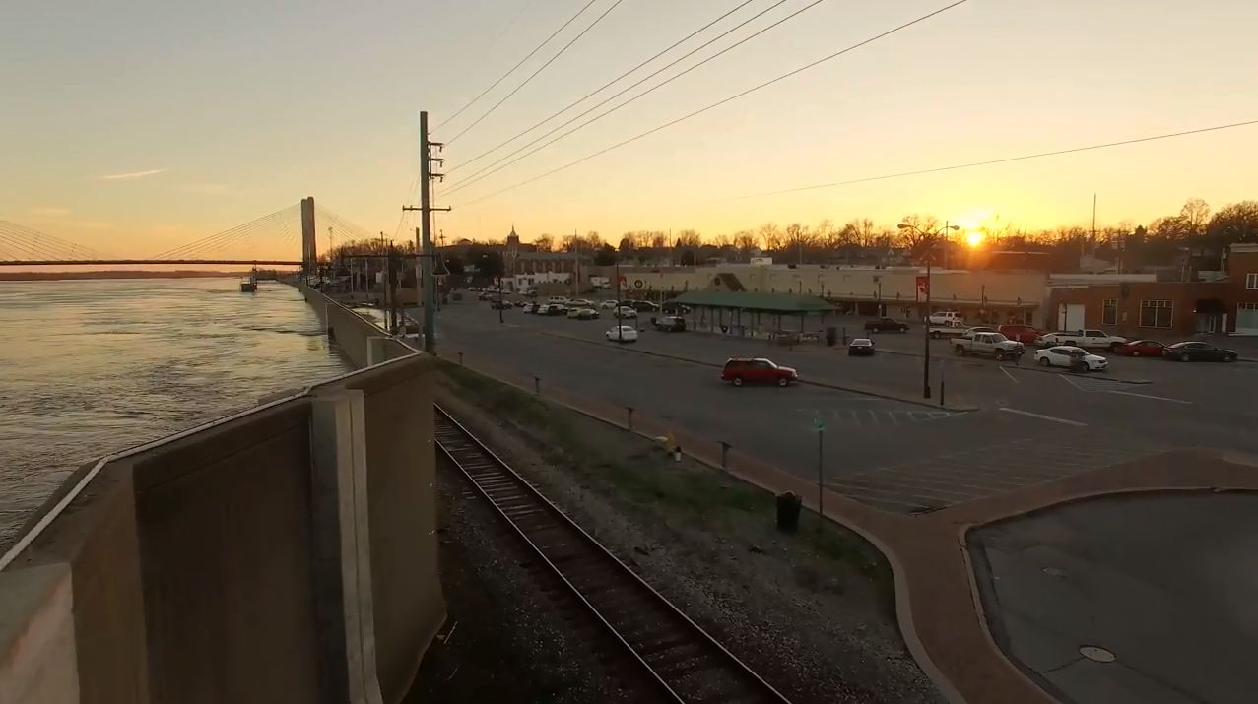
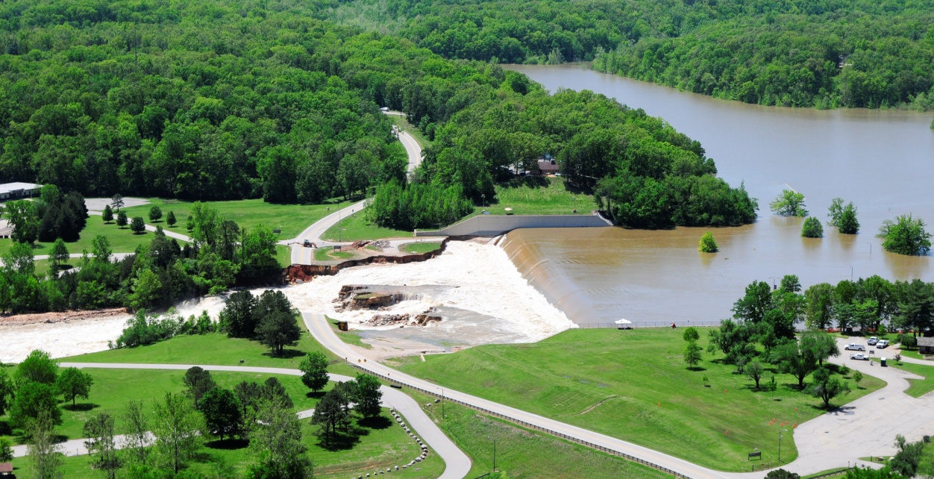
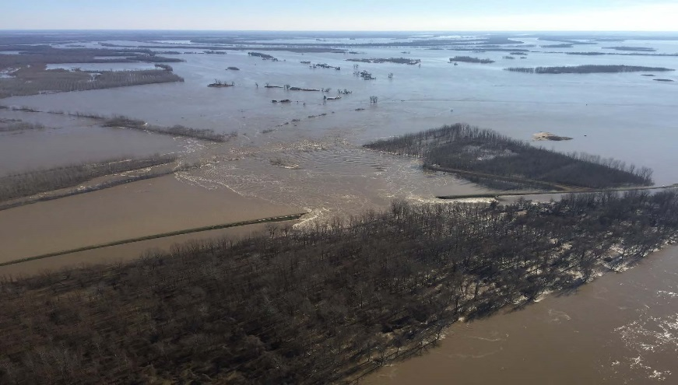
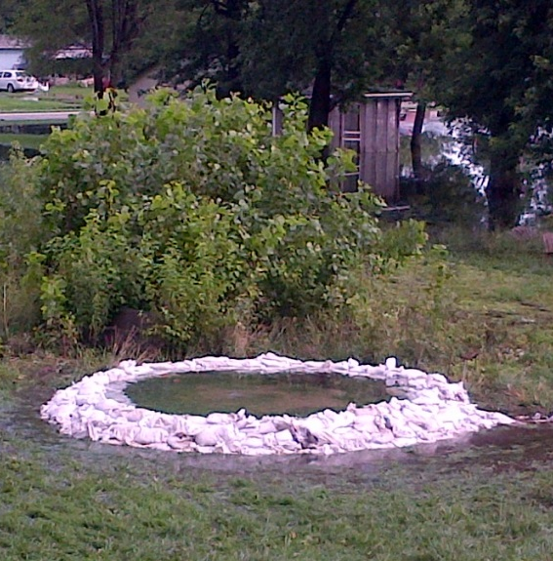
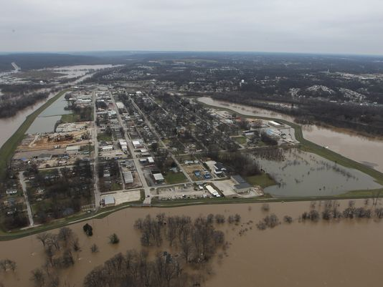
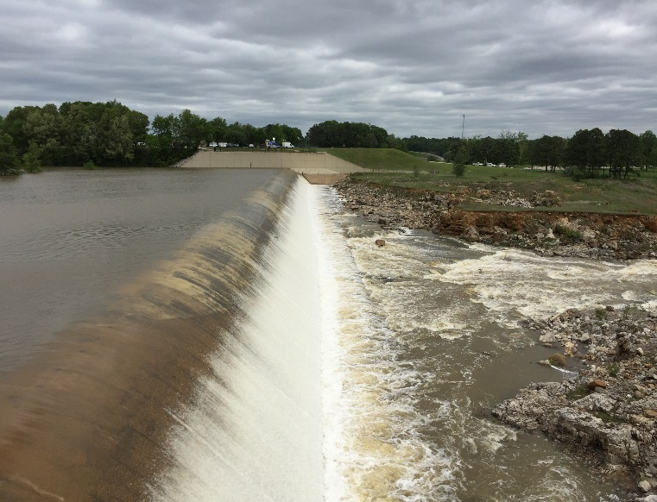
TESTING OUR FLOOD RISK MANAGEMENT LIMITS
Cape Girardeau, MO (2016)
Wappapello, MO (2011)
Costello L&D (2016)
Wappapello, MO (2017)
Sand Boil (2015)
Len Small Levee (2016)
Valley Park Levee (2015)
Wappapello, MO (2017)
Oakville, IA (2008)
Flood Response (2015)
Flood Fight (2017)
Notes:
What is challenging the resiliency of the system?
Recurrence of extreme events.
The FRM Cycle for the middle-Mississippi is damage-damage-damage
Recurring damages are driving up recovery cost.
We are observing underseepage more frequently and at lower river stages which is evidence that previous floods are undermining foundation soils.
Aged gravity drains collapsing and increasing overtop and breach risk.
Sponsor finances to cover costs from flood and continue O&M jeopardizes levee districts eligibility in the RIP.

Slide 5
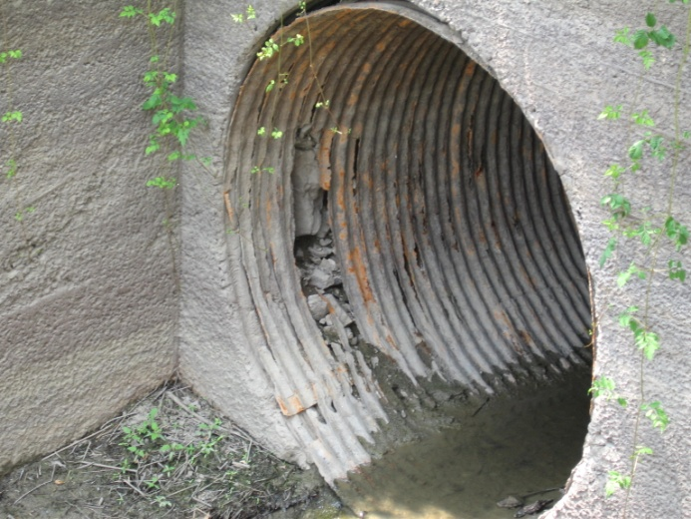
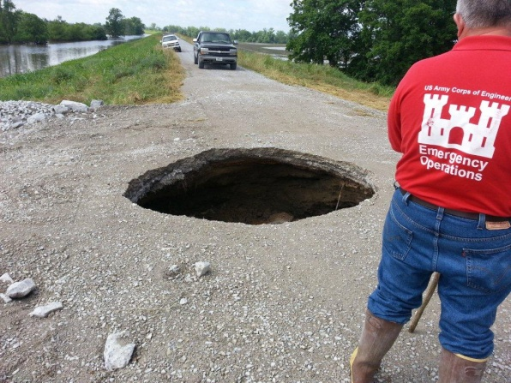
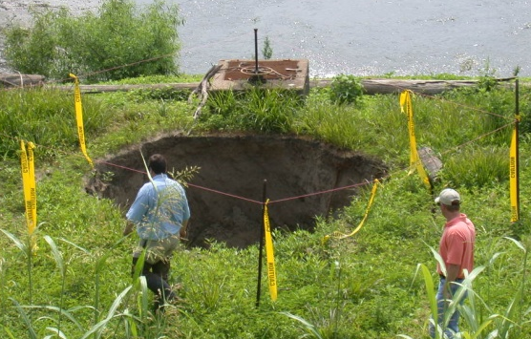
PL 84-99 ELIGIBILITY ISSUES
Partnered solution to address levee district flood damages.
Significant number of levee districts may become inactive in PL 84-99.
System-Wide Improvement Framework (SWIF) program is bridge to eligibility
Plan developed by levee sponsors and accepted by USACE to address system wide issues.
Notes:
Drains through levees across St. Louis District have surpassed their design life of ~40-50 years
Visual or CCTV inspection with documentation is required of levee owners every 5 years as part of normal levee Operations and Maintenance
Guidelines for pipe inspections provided to local sponsors
Significant number of levee districts in Illinois and Missouri will become inactive in PL84-99 rehabilitation program due to lack of culvert inspections
Working closely with local levee districts to keep them aware of the critical nature of these inspections and the risk to their RIP eligibility but much work still remains

Slide 6
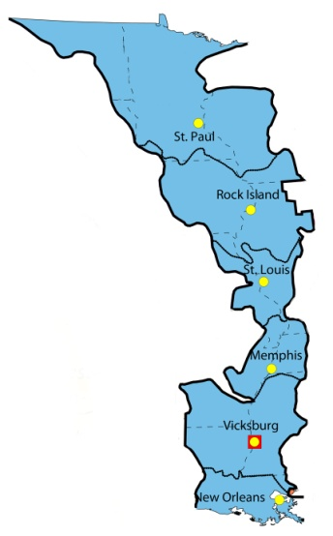
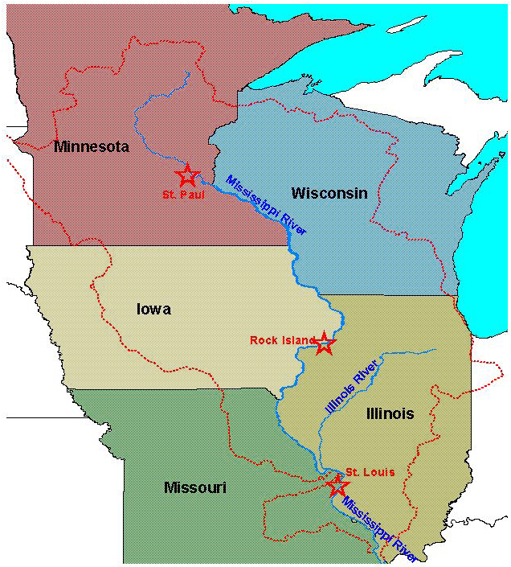
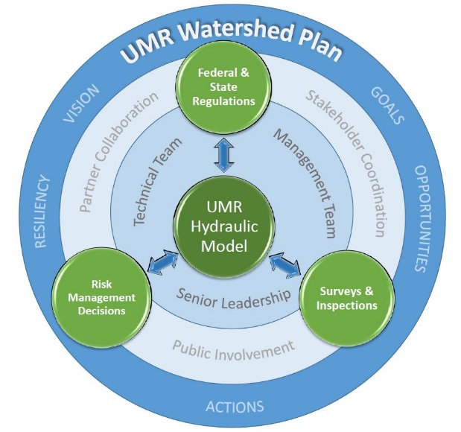
UPPER MISSISSIPPI RIVER FLOOD RISK MANAGEMENT
Vision
Predictable system that performs as intended and expected.
Must inform, transform, and guide present and future levee and floodplain modifications.
Resiliency, risk transfer, and nonstructural approaches must be key considerations.
Use a holistic watershed approach.
Challenges
Alignment and implementation of multi-jurisdictional state-federal-local authorities.
Transformation to integrated, holistic, and resilient FRM approaches.
Ensure the process is fully transparent.
Understanding impacts caused by changes in the river system.
Way Ahead
UMR Hydraulic Model.
Defining the UMR regional FRM challenge:
- Survey levee heights
- H&H model scenarios
Execute a collaborative Watershed Study.
Notes:
Two FRM focused efforts in the UMR.
Interest by the states in a watershed study that is Flood Risk and Sediment Management focused.
-Vision - is shared among those that attended a Summit held by the UMRBA in July 2017
2) UMR Hydraulic Modeling.
What are the current CHALLENGES to UMR FRM - see challenges bullets.
WAY AHEAD
Modeling is a tool to understanding the problems in the UMR!
Vision is to develop an implementable UMR flood Risk Management Strategy with primary goal of having a predictable system that performs as intended and expected.
The development of a flood risk management hydraulic model for the Upper Mississippi River (UMR) is an essential tool to understanding the risks that currently exist to the river communities and is a critical first step for the development of systemic flood risk management (FRM) strategy. The model is a tool to more accurately evaluate and communicate impacts of floodplain modifications that have occurred or may be proposed in the future.
Development of an UMR hydraulic model, in collaboration with Federal and State Partners, will be a valuable tool in evaluating alternatives & assessing potential individual/cumulative impacts of levee & floodplain modifications through future Watershed/Feasibility Studies or 408 evaluations.
Define the UMR regional FRM challenge:
- Survey levee heights
- Develop comprehensive H&H Model – collaboration tool
Build a coalition of stakeholders
Execute a collaborative Watershed Study

Slide 7
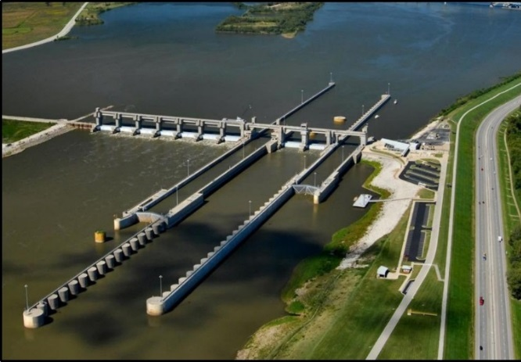
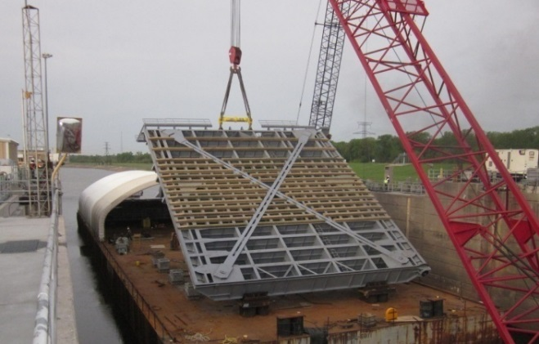
Inland Navigation
Value to the Nation
St. Louis District maintains 436 miles of channel and 5 locks/dams.
Port of St. Louis, 3rd largest port on the inland
In FY17 105M tons of commodities moved through St. Louis
Economic transportation cost savings of more than $1B.
Challenge
Constrained federal resources to maintain reliability in an aging system resulting in continued deterioration and costly unscheduled navigation closures.
Way Ahead
Maintain comprehensive inventory of high risk infrastructure.
Adequate/Equitable/Defendable “Baseline” funding stream.
Major Rehabilitation/Major Maintenance –– recapitalization of reliability and resiliency.
NESP–– long term sustainability of the navigation and ecosystem.
Informed funding priorities based on system risk.
.
Mel Price Locks and Dam
Alton, IL
Miter gate repairs - Locks 27, Granite City. IL
Notes:
INLAND NAVIGATION GOAL: The St. Louis District's navigation program supports a safe, reliable, cost-effective and environmentally sustainable waterborne transportation system on the Upper Mississippi River for the movement of commercial goods, public recreational access, and national security interests.
VALUE TO THE NATION: Keeping this system open is vital to the nation’s economy as more than 100 million tons of commodities annually pass through The Port of St. Louis, the third largest port on the inland waterway, saving more than $1 billion in transportation shipping costs creating a competitive advantage in world markets and passing on cheaper products for the American consumer. Our inland waterway system delivers agricultural products, construction materials and energy products. They are a vital piece to the nations economy supporting commerce and jobs. The system we maintain moves over half of U.S. farm exports, with total freight predicted to increase in the future. Concurrently the inland waterways support wildlife and habitat, and are a flourishing home to many Federally endangered species.
We operate and maintain 4 critical high use locks and dams on the Mississippi River, one on the Kaskaskia River.
Challenge: There are many burdens on the Federal Budget, many competing priorities, one of which is the reliability and efficiency of National Infrastructure. Many of the locks on the Upper Mississippi were constructed in the 1930’s and have had little more then routine O&M and emergency fix-as-fails repairs. Even Mel Price Locks and Dam in St. Louis, the “baby” on the system, is 30 years old now and showing challenges for our staff. As our farmers competitors in the global agricultural market continue to invest in their infrastructure, so must this nation.
Way Ahead: As the Corps continues to refine our process for prioritizing needed repairs, the need for consistent funding streams is apparent. We have seen increases in the last 4 appropriations for the O&M of our Navigation Infrastructure; but it is critical to have an adequate “baseline” budget for routine O&M of our locks/dams and channel maintenance, which is consistent with regard to performance metrics across the watershed. Given the age of our infrastructure, this must be augmented by logical consistent funding streams to re-capitalize the reliability of our locks and dams through Major Rehabs, and finally make much needed improvements to efficiencies as a long term capital investment strategy. The steps we are taking:
We maintain a comprehensive inventory of high risk infrastructure and keep “critical” Infrastructure Assessments current and relevant, keeping Operational Condition Assessments (OCAs) up to date.
Determining Adequate/Equitable/Defendable “Baseline” funding stream for routine O&M
Major Rehab/Major Maintenance - recapitalization of reliability and resiliency
NESP - long term sustainability of the navigation and eco system, with improvements to capacities and efficiencies
Working with the Asset Management process informs funding priorities based on system risk and consequence of failure.

Slide 8
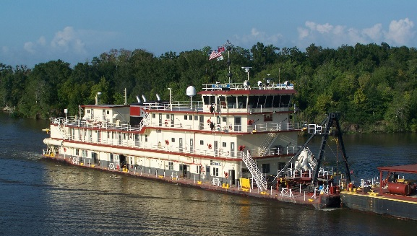
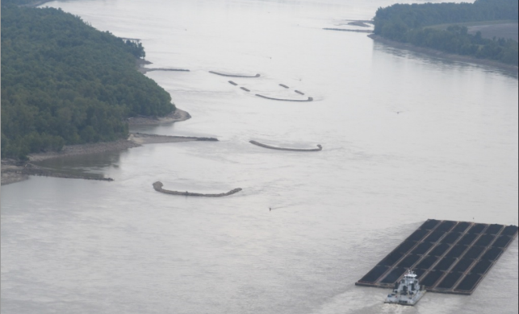
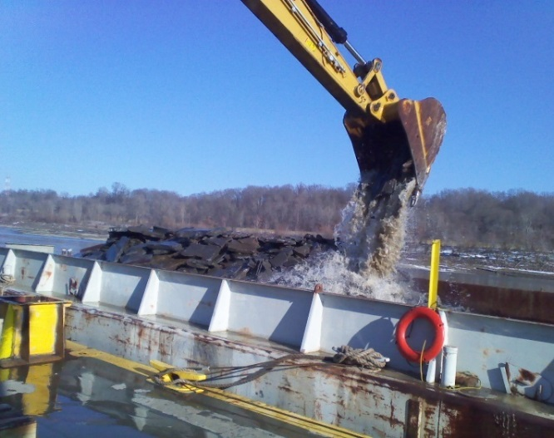
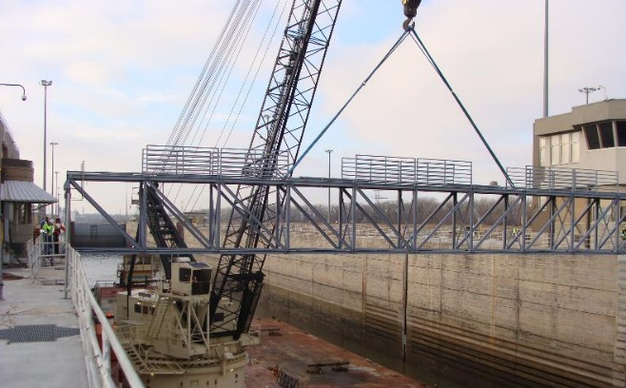
Navigation Outlook
Dredging
Our Dredge programing, particularly on the open river, is difficult to predict with changing river conditions. Annually we plan to dredge 3-5M cubic yards as a normal dredge season July through December. Last dredge season we moved 3.8M cubic yards at a total cost of $17.8M
Regulating Works
River Training Structures use the energy of the water to predictably move sediment, with a high benefit to cost ratio thru reduction of dredging.
Continue with construction on contracts awarded in late FY16, Dogtooth Bend Phase 6 and Grand Tower Phase 5.
Supplemental Environmental Impact Statement finalized August 2017, Record of Decision signed
Rock removal began 25 Sep.
Scheduled Lock Closures
Rock removal
Mel Price Main Lock –– Jan - Mar 2018 for replacement of control system, inspection of lift gate.
Locks 27 –– TBD, repairs to liftgate counterweight baskets
Costello Lock –– June 2018, 14 days to de-water, repair foundation relief system.
Notes:
DREDGING
typically occurs between the months of 15 July to 15 Dec
on average we dredge and open river dispose 3-5M cubic yards.
Last dredge season (July 16 thru Dec 16) we dredged 3.8M cubic yards at a total cost of $17.8M in order to keep the commerce on the river rolling. We had several short duration high river stage events which caused significant delays in our dredge schedule which the team had to work around.
As an item of comparison and to show the unpredictable nature of dredging on the middle Mississippi, the 2012-13 drought dredge season was extended thru February to maintain the channel at -7 on the STL gage and resulted in moving more than 10 million cubic yards of sediment.
REGULATING WORKS PROJECT
Provides a safe and dependable navigation channel from the mouth of the Missouri River to confluence of the Ohio River.
Project improvements are achieved by means of dikes, revetment, chevrons, construction dredging, and rock removal to maintain required navigation depth.
construct and maintain over 2000 regulating work structures.
The benefits of the Project include reduced dredging, increased reliability of the navigation channel during low water periods and reduced accidents & groundings.
Uses the energy of the water to predictably move sediment saving millions in dredging costs each year. With a high benefit to cost ratio, these structures enhance safety by improving navigation and providing ecosystem diversity.
Since the drought of 2012-13, removal of natural rock out cropping (pinnacles), remnants left from original construction of the channel, at Thebes and Grand Tower have been a primary focus of this program.
ROCK REMOVAL
Pinnacle removal contracts awarded between river mile 46 and 38.
Rock removal is accomplished primarily by use of hydraulic ram and grappling bucket, and is very dependent upon river stage to accomplish work. (has to be below 15ft at Cape Girardeau)
To date we are roughly 12% complete with all rock originally identified for removal. However, we removed enough rock to sustain the authorized 9-foot draft in these areas at 450 feet wide down to -7 on the St. Louis gage. The target of 600-foot at -7 will require approximately 7,500 cy of rock will be removed.
SCHEDULED LOCK CLOSURES
All scheduled closures are coordinated with industry and USCG
Mel Price Lock and Dam Aux Lock - 60 days (July-Sep 17) for control system upgrades has been successfully completed and the lock re-opened on schedule
Mel Price Lock and Dam Main Lock - 60 days (Jan-Mar 2018) for control system replacement as well as inspections of the liftgate and liftgate hoisting cables. These have both been the cause of emergency unscheduled closures in recent years. Most recently, in early Sep) cracks in the liftgate, found during routine inspection, caused a 3-day unscheduled closure which affected 37 tows….if this had occurred a month or so later, during the harvest shipment, the impacts would have been much much worse.
Locks 27 Main/Aux- Dates are yet to be determined and coordinated with Industry, but short 3-5 day non-concurrent closures of both locks for repairs to the liftgate counterweight baskets
Jerry Costello Lock and Dam - 14-day closure in June/July to dewater lock chamber and repair foundation relief system, inspect/repair gates and valves.
Lock and Dam 25 - Not a closure of the lock, but worth noting that critical repairs to the dam will continue in FY18. Innovative contracting and strategic planning has facilitated significant critical repairs to the dam to include replacement of the gate hoisting machinery, rehabilitation of the gate structures, and repairs to the service bridge spans.

Slide 9
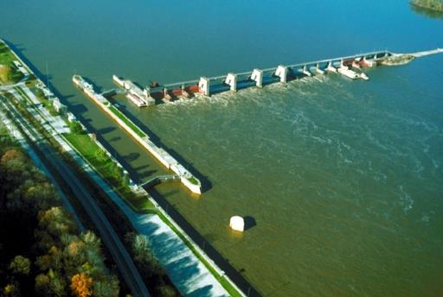
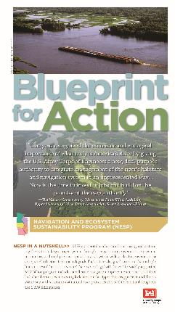
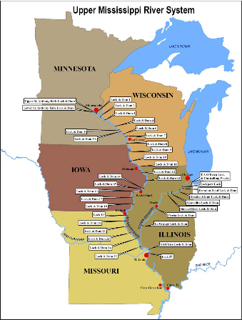
LOCK MODERNIZATION
NESP (Navigation/Ecosystem Sustainability Program)
The Upper Mississippi River System is a nationally significant ecosystem and commercial navigation system, connecting the heartland of America to the world.
Much of the current infrastructure is 80+ years old and is the cause of significant delays.
New 1,200-foot lock chambers at LaGrange, Peoria, Locks 20, 21, 22, 24, & 25 will:
Increases capacity and efficiency,
Provide redundancy at key points in the system, and
Improves safety.
Ecosystem Improvements will:
Reduce threat/degradation aquatic species and
Protect habitats.
Authorized WRDA 2007 at $4.2 billion
Navigation $2.4 billion (50% Federal / 50% IWTF)––Seven 1200-ft locks
Ecosystem $1.8 billion––225 projects to preserve & enhance ecosystem;
Supported by many diverse organizations.
Over $60M has been spent on planning and design. No construction funding to date.
With Olmsted nearing completion, project could be re-started in near future.
New 1200’ Lock Location
Notes:
NESP
The UMRS navigation system is vital for international competiveness in foreign markets, particularly agriculture.
The existing locks and dams on the Upper Mississippi River were constructed in the 1930's. Today’s modern barge traffic experiences significant delays due to the single 600-foot lock chamber design. Most of these locks have reached the end of their economic life and unscheduled closures continue to increase.
As an example, a 3-month unscheduled closure at LD25 could result in loss of $933M in economic activity (Sep 2016 USDA report prepared by Univ. of Tennessee)
Capital investment in new 1,200-ft lock chambers at identified locations on the Upper Miss will improve the navigation system capacity and reduce commercial traffic delays. The new locks would dramatically decrease lockage times and will increase system reliability:
Increases capacity and efficiency - that means more commodities shipped at greater economy giving America’s producers a competitive advantage in export markets
Provides redundancy at key points in the system, eliminating single points of failure by providing a second lock chamber. Also allows for year round operation and better planning of routine and non-routine maintenance…a better more reliable system all around
Safety is critical factor and is improved with 1200-foot locks over 600-foot locks because deckhands and lock operators are not engaged in the difficult task of breaking and making lines.
Degrading ecosystem - Diversity and abundance of native aquatic plants and animals are seriously threatened by degradation, loss of habitat and arrival of exotic species.
NESP was authorized in WRDA 2007 at $4.2 billion (2007 costs) as dual purpose navigation & ecosystem project with requirement for Comparable Progress.
Navigation $2.4 billion (50% Federal / 50% IWTF) - Seven 1200-ft locks, small scale measures to include mooring cells & switch boats
Ecosystem $1.8 billion - 225 projects to preserve & enhance ecosystem; 35,000 acres of floodplain restoration
Investment will generate significant national & regional economic development and create & support many long term jobs and the project is supported by Industry, environmentalists, shippers, and organized labor
A very unique coalition of Federal agencies, states, navigation interests, environmental organizations as well as organized labor support NESP implementation.
Significant effort has been put out on work at Locks 25 and 22 from 2005 to 2010. Construction at locks facilities could be ready to start in approximately 12 - 24 months upon receipt of CG funds.
Requires economic analysis & cost estimate update to be included for construction in President’s annual budget.
As Olmsted winds down and eases burden on the CG appropriation and the IWWTF, possible Construction Way Froward:
FY17: Restart LaGrange lock design, UMR Lock 22 & Lock 25 design, ecosystem project planning & design, and mooring cell planning & design.
FY18: Continue navigation & ecosystem planning & design. Start construction of Mooring cells at LD14, LaGrange, & LD24, LD22 Approach Walls, Wing dam notching in Pool 2
FY19+ Construction. Potential projects:
Ecosystem Restoration
Pool water level management - Pool 18
Shoreline protection for cultural site & island erosion in Pools 10 – 13, & Twin Island
Wing dam notching at Herculaneum
Forest Management at Reno Bottoms
Backwater & side channel restoration at Peoria Pool, Buffalo Island, & Schenimann Chute
Navigation
Switchboat implementation at LD25
Mitigation at Moore’s Island
New 1,200ft Lock construction at L25, L22, & LaGrange

Slide 10
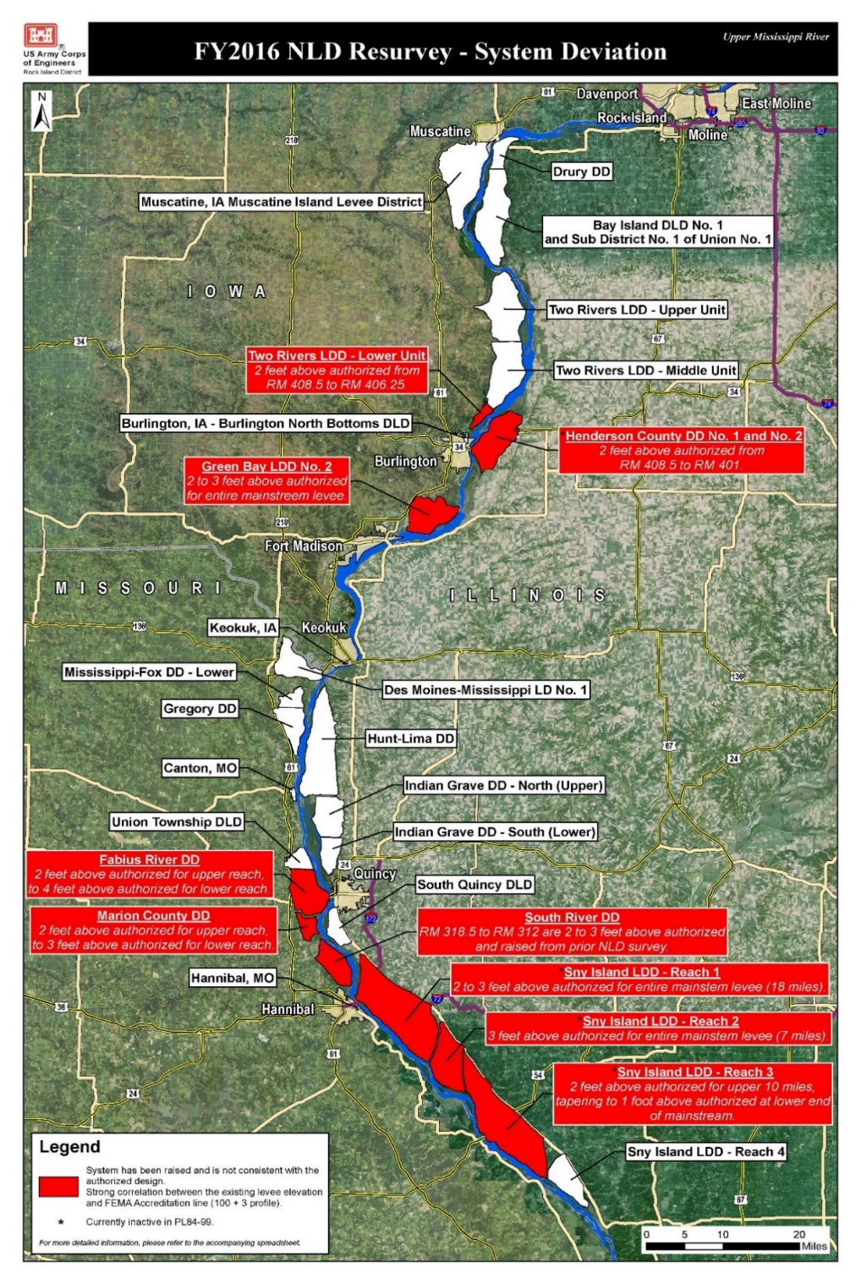
UPPER MISSISSIPPI RIVER LEVEE DEVIATIONS
MVR’s UMR inspections found significant sections of Federal levee districts to be two to four feet above authorized elevations.
MVS is evaluating heights of 50 federally constructed levee systems.
Ensure that levee sponsors are maintaining systems to the authorized level of protection.
No UMR systemic plan exists for managing floodplains or levee elevations.
UMR levees consist of a combination of Federal and non-Federal levees that were authorized, designed, and constructed at different times and to a variety of flood profiles.
Notes:
MVR’s UMR mainstem levee system surveys found significant sections of 7 Federal levee districts (10 systems) to be 2 to 4 feet above the levee systems’ federally authorized elevation. 2 levee districts are in IL, 3 in MO, and 2 in IA; involves 2 FEMA Regions (5 & 7).
Deliberate coordination & collaboration with the 3 States, FEMA Regions 5 & 7, & multiple levee districts, each working within their own authorities, programs, and processes, will be required to identify effective FRM solutions.
MVS is in the process of evaluating heights of 50 federally constructed levee systems. Surveys of each levee will be plotted against the authorized grade and historical levee elevations to discern nature and extent of any deviations.
The Corps is conducting these evaluations to ensure that levee sponsors are maintaining their systems to the Congressionally authorized level of protection. Unauthorized levee modifications may be injurious to the public due to improper design, inadequate construction, and/or increased flood risk to other levee systems and floodplain areas.
The impacts & risks from unauthorized levee modifications (raises) have not been thoroughly evaluated; there is potential for increased risk to the levee system, adjacent levees & floodplain areas.
Federal levee modifications require approval through the USACE 408 permission process (EC 1165-2-216) and State Floodplain Permits. The USACE 408 permission process requires an official determination that proposed modifications will not be injurious to the public interest and will not impair the usefulness of the project.
Should a deviation in levee grade be discovered, USACE authority would require the sponsor to: (a) restore levee to authorized height, or (b) pursue permission through the USACE 408 process; failure to comply normally results in levee system becoming inactive in the Rehabilitation Program (RP), under PL84-99 authority (not eligible for rehab assistance).
No UMR systemic plan exists for managing floodplains or levee elevations as in the MR&T system of the Lower Mississippi River. The UMR levees consist of a combination of Federal and non-Federal levees which were authorized, designed, and constructed at different times and to a variety of flood profiles.
UMR System performance is unpredictable as a result of a decentralized/locally-driven approach to FRM.

