Slide 1
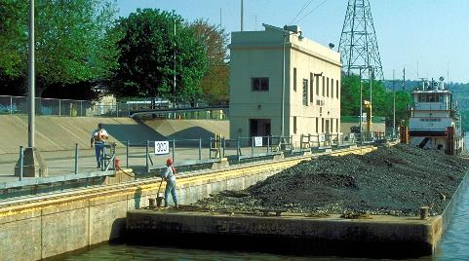
Inland marine transportation system (Imts) UPDATE
Steve Jones
National Waterways Conference
St. Louis, MO
28 September 2017

Slide 2
Background
USACE Inland Marine Transportation System Improvement Report published Sept 2008.
Report documented the findings and recommendations of 2 year study (Business Process Review) of Navigation Lock and Dam operations.
Study Focus – Improve System Availability, Reliability and Efficiency
Conducted by in-house multi-disciplinary team, which met with COE workforce and navigation industry.
115 ideas for potential improvements, grouped into 25 BPR categories.
Implementation began 1st Qtr FY09 with creation of Board of Directors (BoD) and Working Group (WG).
(Report adopted the term Inland Marine Transportation System (IMTS) to convey the nation-wide coverage of the BPR and the system-of-systems approach to improving the inland Navigation System)

Slide 3
Structure
IMTS Board
of Directors
IMTS Division/MSC Management Teams
IMTS Working
Group
Process
Action
Teams
Collaborative
Action
Teams
Standing
Ad hoc
Board of Directors (BoD)
  Chaired by Deputy CG for Civil Works & Emergency Operations
  Members are Division Commanders and HQ Operations Chief
Working Group (WG)
  Cross-section of skills from field, districts and divisions
  Process Action Teams (PATs)
  Collaborative Action Teams (CATs)

Slide 4
IMTS Working Group
Steve Jones | RAO | IMTS Program Manager
Kevin Baumgard | MVP | Ops Chief
Stephen "Scott" Beams | SAM | Floating Plant Manager/Locks & Dams
Sheryl Carrubba | NWD | NAV BLM
Patrick Chambers | MVD | MVD Nav BLM & Deputy C/Ops
John Cheek | LRD | LRD Maintenance Program Manager
Michael Cox | MVR | Ops Chief
Cody Eckhardt | HQ | Inland Nav PM
Douglas Ellsworth | HQ | Senior Asset Management Specialist
Kareem El-Naggar | LRD | Navigation Program Manager
Robert George | SWG | Lock Master
Tilton "Kellis" Higginbotham | SAM | Lock & Dam Supervisor
Fredrick Joers | INDC | Director
Willie Maynard | LRP | Lock Master NewCumberland Locks
Nathan 'Nate' McGowan | NWS | Ops Proj Mgr, Washington Ship Canal
Jeffery McKee | HQ02 | Navigation Business Line Manager
Bryan Peterson | MVP | Navigation Manager
Mark Pointon | IWR | NAV Business Line Manager
Brian Sapp | SAD | Navigation Business Line Manager
Doug Stamper | NAD | Navigation Business Line Manager
Marian Valentine | NWS | Ops Proj Mgr, Washington Ship Canal
Charles 'Eddie' Wiggins | ERD-MS | Associate Technical Director, Navigation
Gil Wootten | SWL | Chief, Operations Technical Support

Slide 5
Purpose
(IMTS BoD and Working Group)
Implement improvements that maximize the efficiency, effectiveness, reliability and sustainability of the Inland Navigation System
Identify and implement Best Practices
Provide foundation for “continuous improvement”
Notes:
.

Slide 6
IMTS WG Accomplishments
Standard Staffing Models
Standardized Position Descriptions (PDs)
Lock Operator’s Training & Certification
National Maintenance Workshops - Annual
National Maintenance Standard
Lock Levels of Service
Lock Operational Condition Assessments
Lock Operations Management Application
Crew Change Policy for Industry at Locks

Slide 7
IMTS WG Current Activities
3 Process Action Teams (PATs)
  Acquisition of Land and Floating Plant Equipment
  Optimize Shift Schedules
  Schedule Major Maintenance
Initializing Strengthen Leadership and Management PAT
IMTS Action Plan being developed (Road map for WG Future)
Development of IMTS Newsletter
Bi-weekly Web Meetings

Slide 8
Implementation Status
&
Action Plan Development
Working Group thoroughly reviewed all 115 Improvement Ideas and assessed their status and need for future action, including requirements to sustain improvement made.
59 Ideas Implemented
18 Ideas being addressed by PATs
20 Ideas require future action (PAT, etc.)
18 Ideas OBE or no longer recommended
Notes:
,

Slide 9
Draft Action Plan
Action Plan is intended to document future activities of the IMTS WG to ensure implementation and sustainment of recommendations from 2008 Report. It will also provide a platform for addressing new initiatives as they arise. In addition to implementing the 2008 report, the WG has proven to be an excellent forum for knowledge sharing and information exchange. The Action Plan is also intended to be a living document, updated annually. It is divided into 3 main sections, besides Introduction and Background. The sections are:
Short Term – Less than 2 years to implement – 9 items
Long Term – Greater than 2 Years to implement – 3 items
Sustain (Periodic or Continual) - 14 items

Slide 11
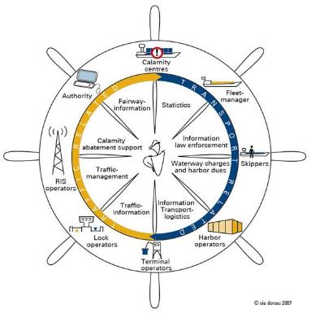
IMTS River Information Services
(RIS)
Bottom line up front
User-friendly, internet-enabled suite of services where all partners in the watershed can view shared, “harmonized” information that enables operational, tactical and strategic decision making for activities in and on the IMTS and drives their execution.

Slide 12
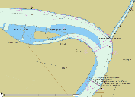
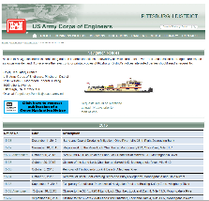
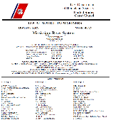
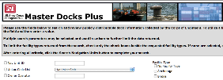
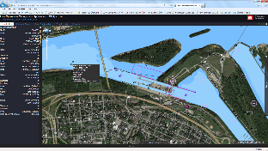
RIS Key Technologies
Inland ECDIS (IENC/ENC)
Vessel tracking and tracing
Notices to Skippers (USACE NTNI & USCG NTM)
Electronic Reporting (to USACE and other agencies)
Reference Data
Value added services (Readiness “bubble chart”/Apps, etc.)
Notes:
To provide these services we will engage these five RIS Key Technologies:
ECDIS - Electronic Chart Display and Information System
Vessel Tracking and Tracing Systems
Notice to Skippers
Electronic Reporting
Reference data

Slide 13
RIS TEAM COMMAND, CONTROL, COLLABORATION, COORDINATION & SUPERVISION
Commander
LRD
DCG Civil & Emergency Operations HQUSACE
Commander LRP
IMTS BOARD OF DIRECTORS
RIS TEAM
Working
Group
IMTS Division/MSC
Management Teams
WGEC
Process Action
Teams
(Standing)
Collaborative
Action Teams
(Ad Hoc)
Regional Collaborative
Action Teams
KEY EXECUTIVES GROUP
TECHNOLOGY & SERVICES GROUP
LEGEND
CHAIN OF COMMAND
OVERSIGHT, DIRECTION & DELIVERABLE ACCEPTANCE
COLLABORATION
EXISTING IMTS STRUCTURE

Slide 14
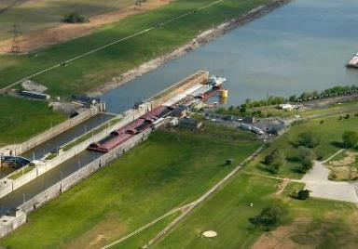
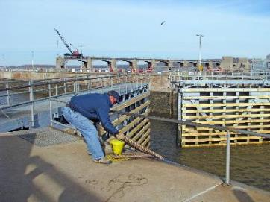
Final thoughts, comments and questions…
For more Information:
https://operations.erdc.dren.mil/navigation.cfm
Send Questions or Comments to:
IMTS@usace.army.mil
Steve Jones
601-631-4179
michael.s.jones2@usace.army.mil

