Slide 1
Dredging Industry National Waterways Conference
Richard Balzano, CEO
rbalzano@dredgingcontractors.org September 23, 2021

Slide 2
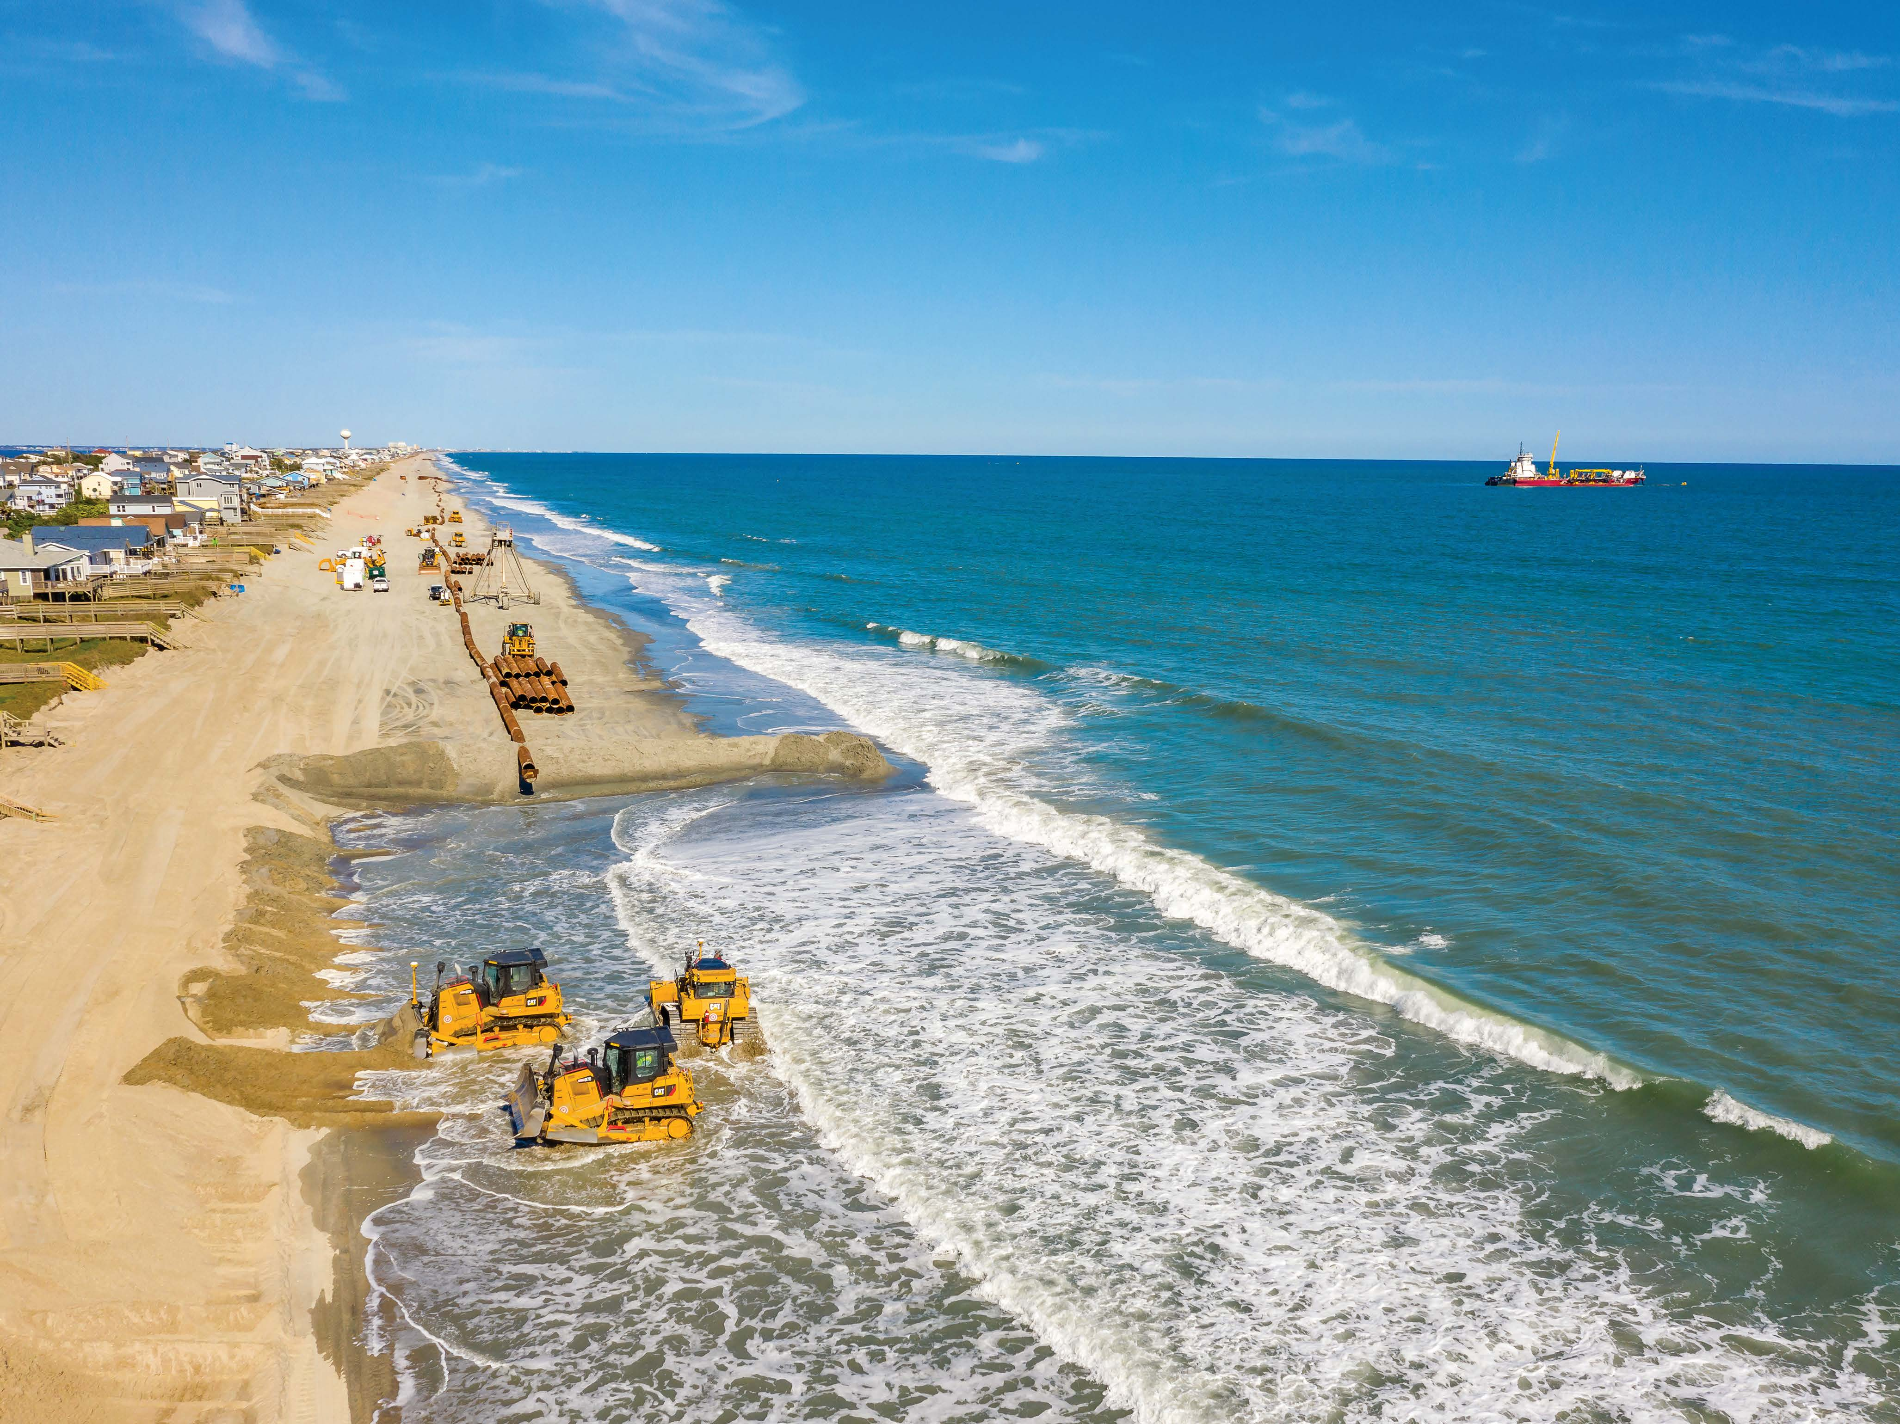
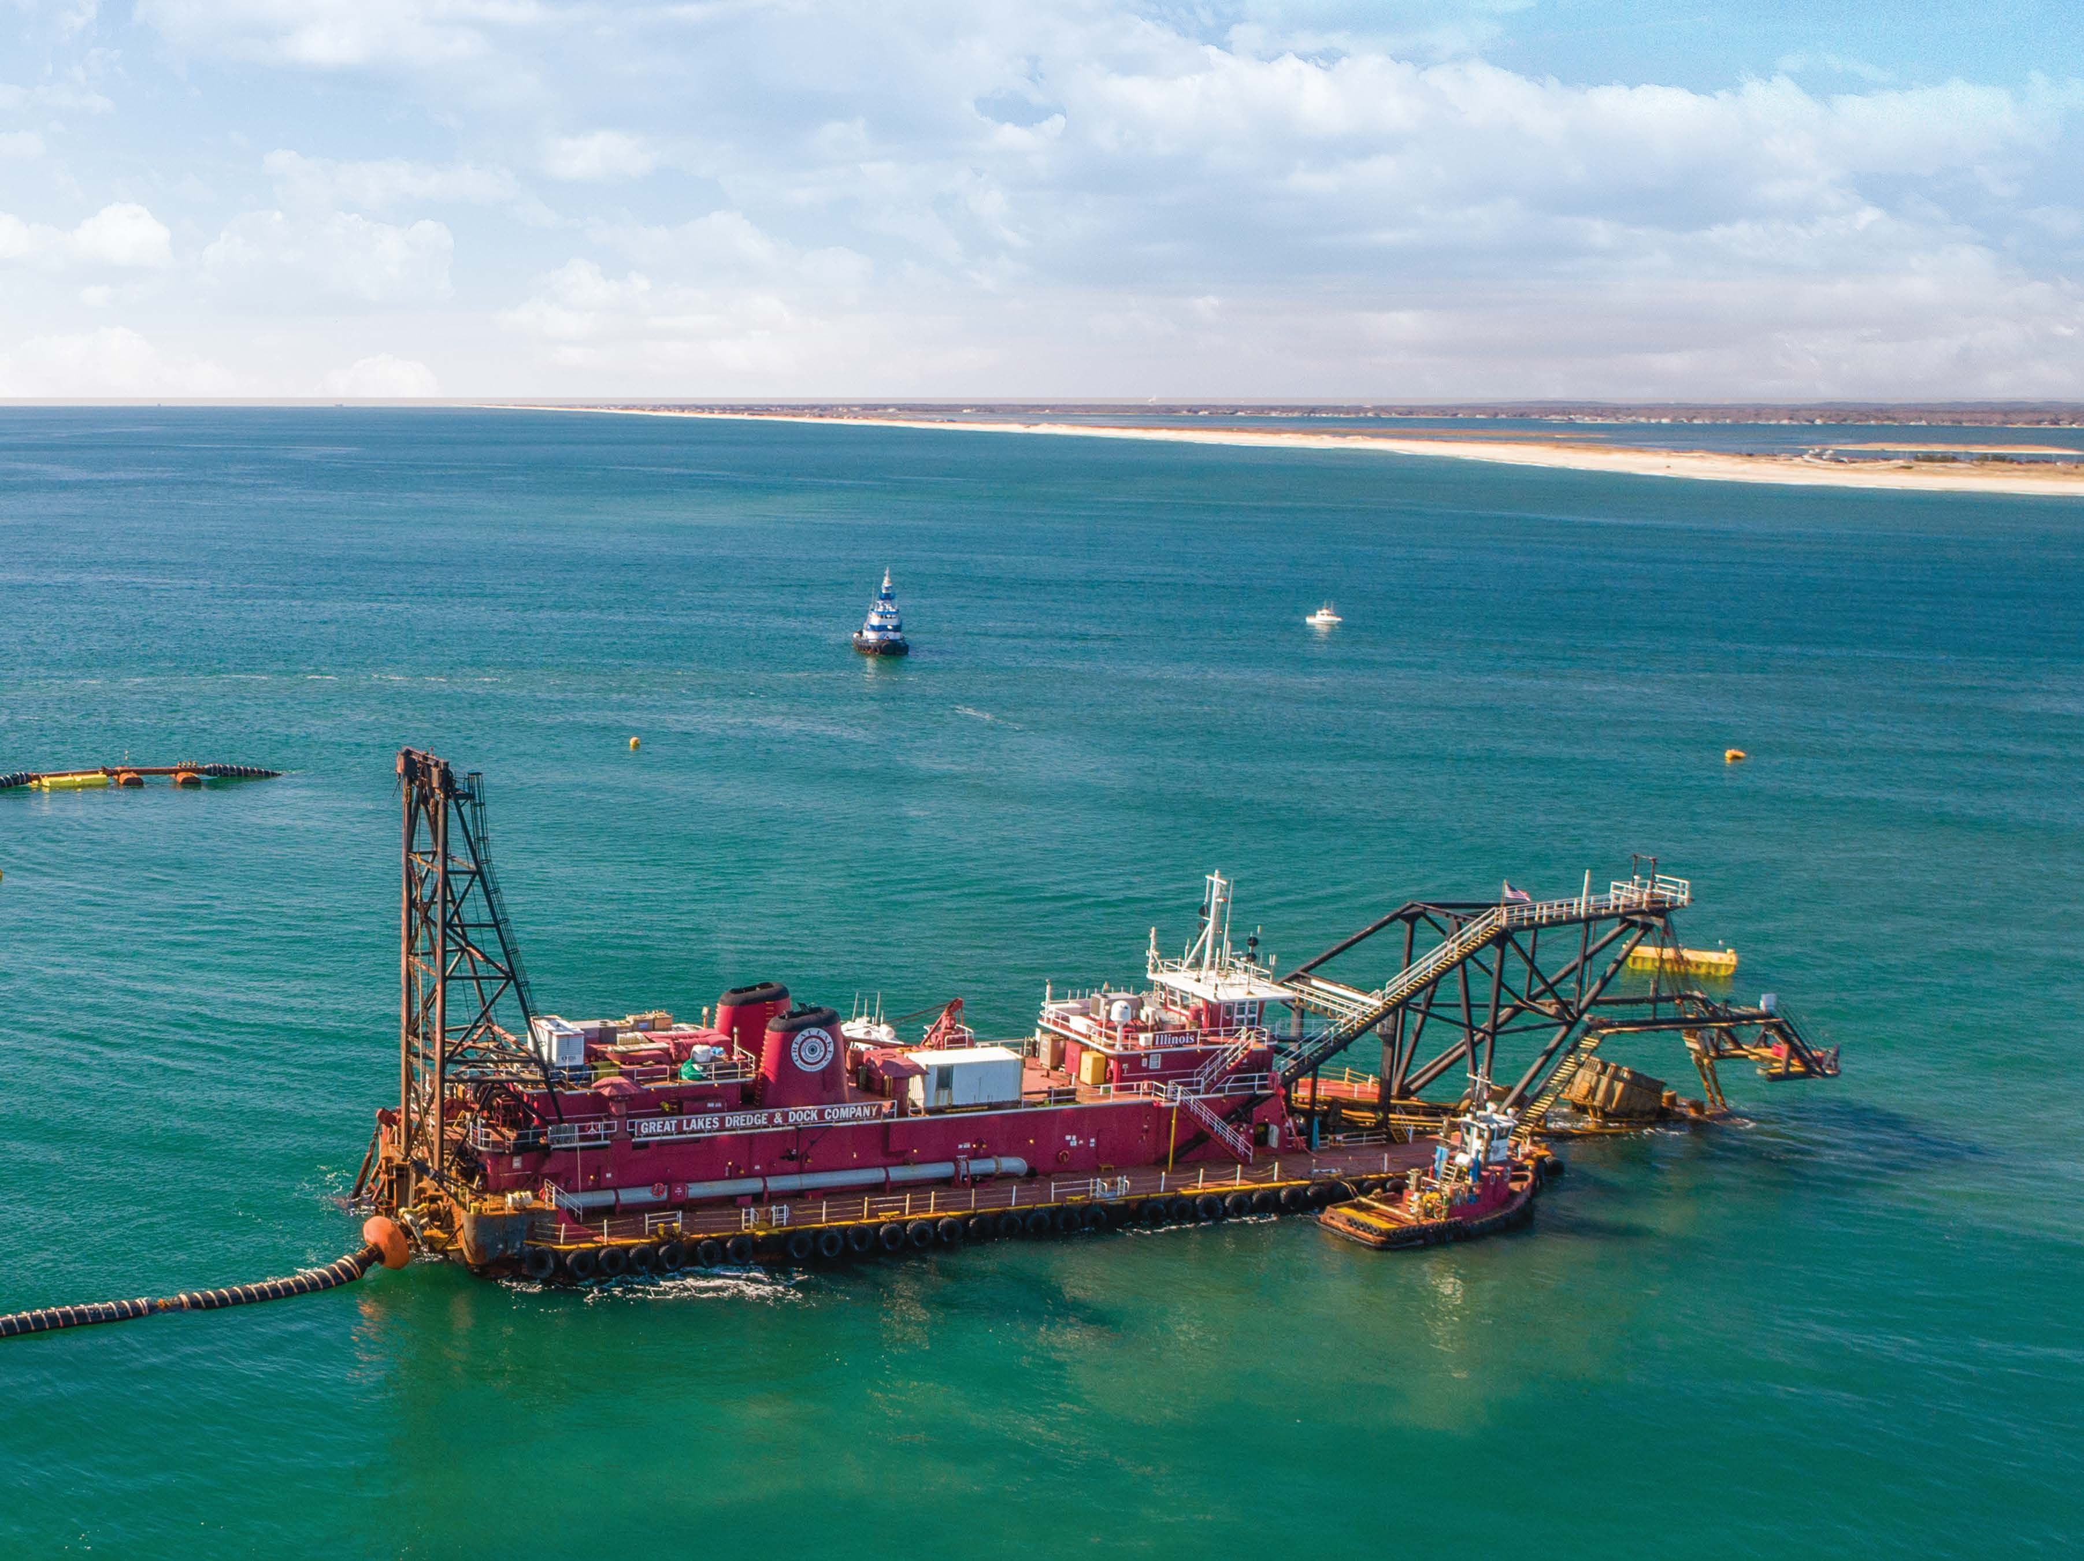
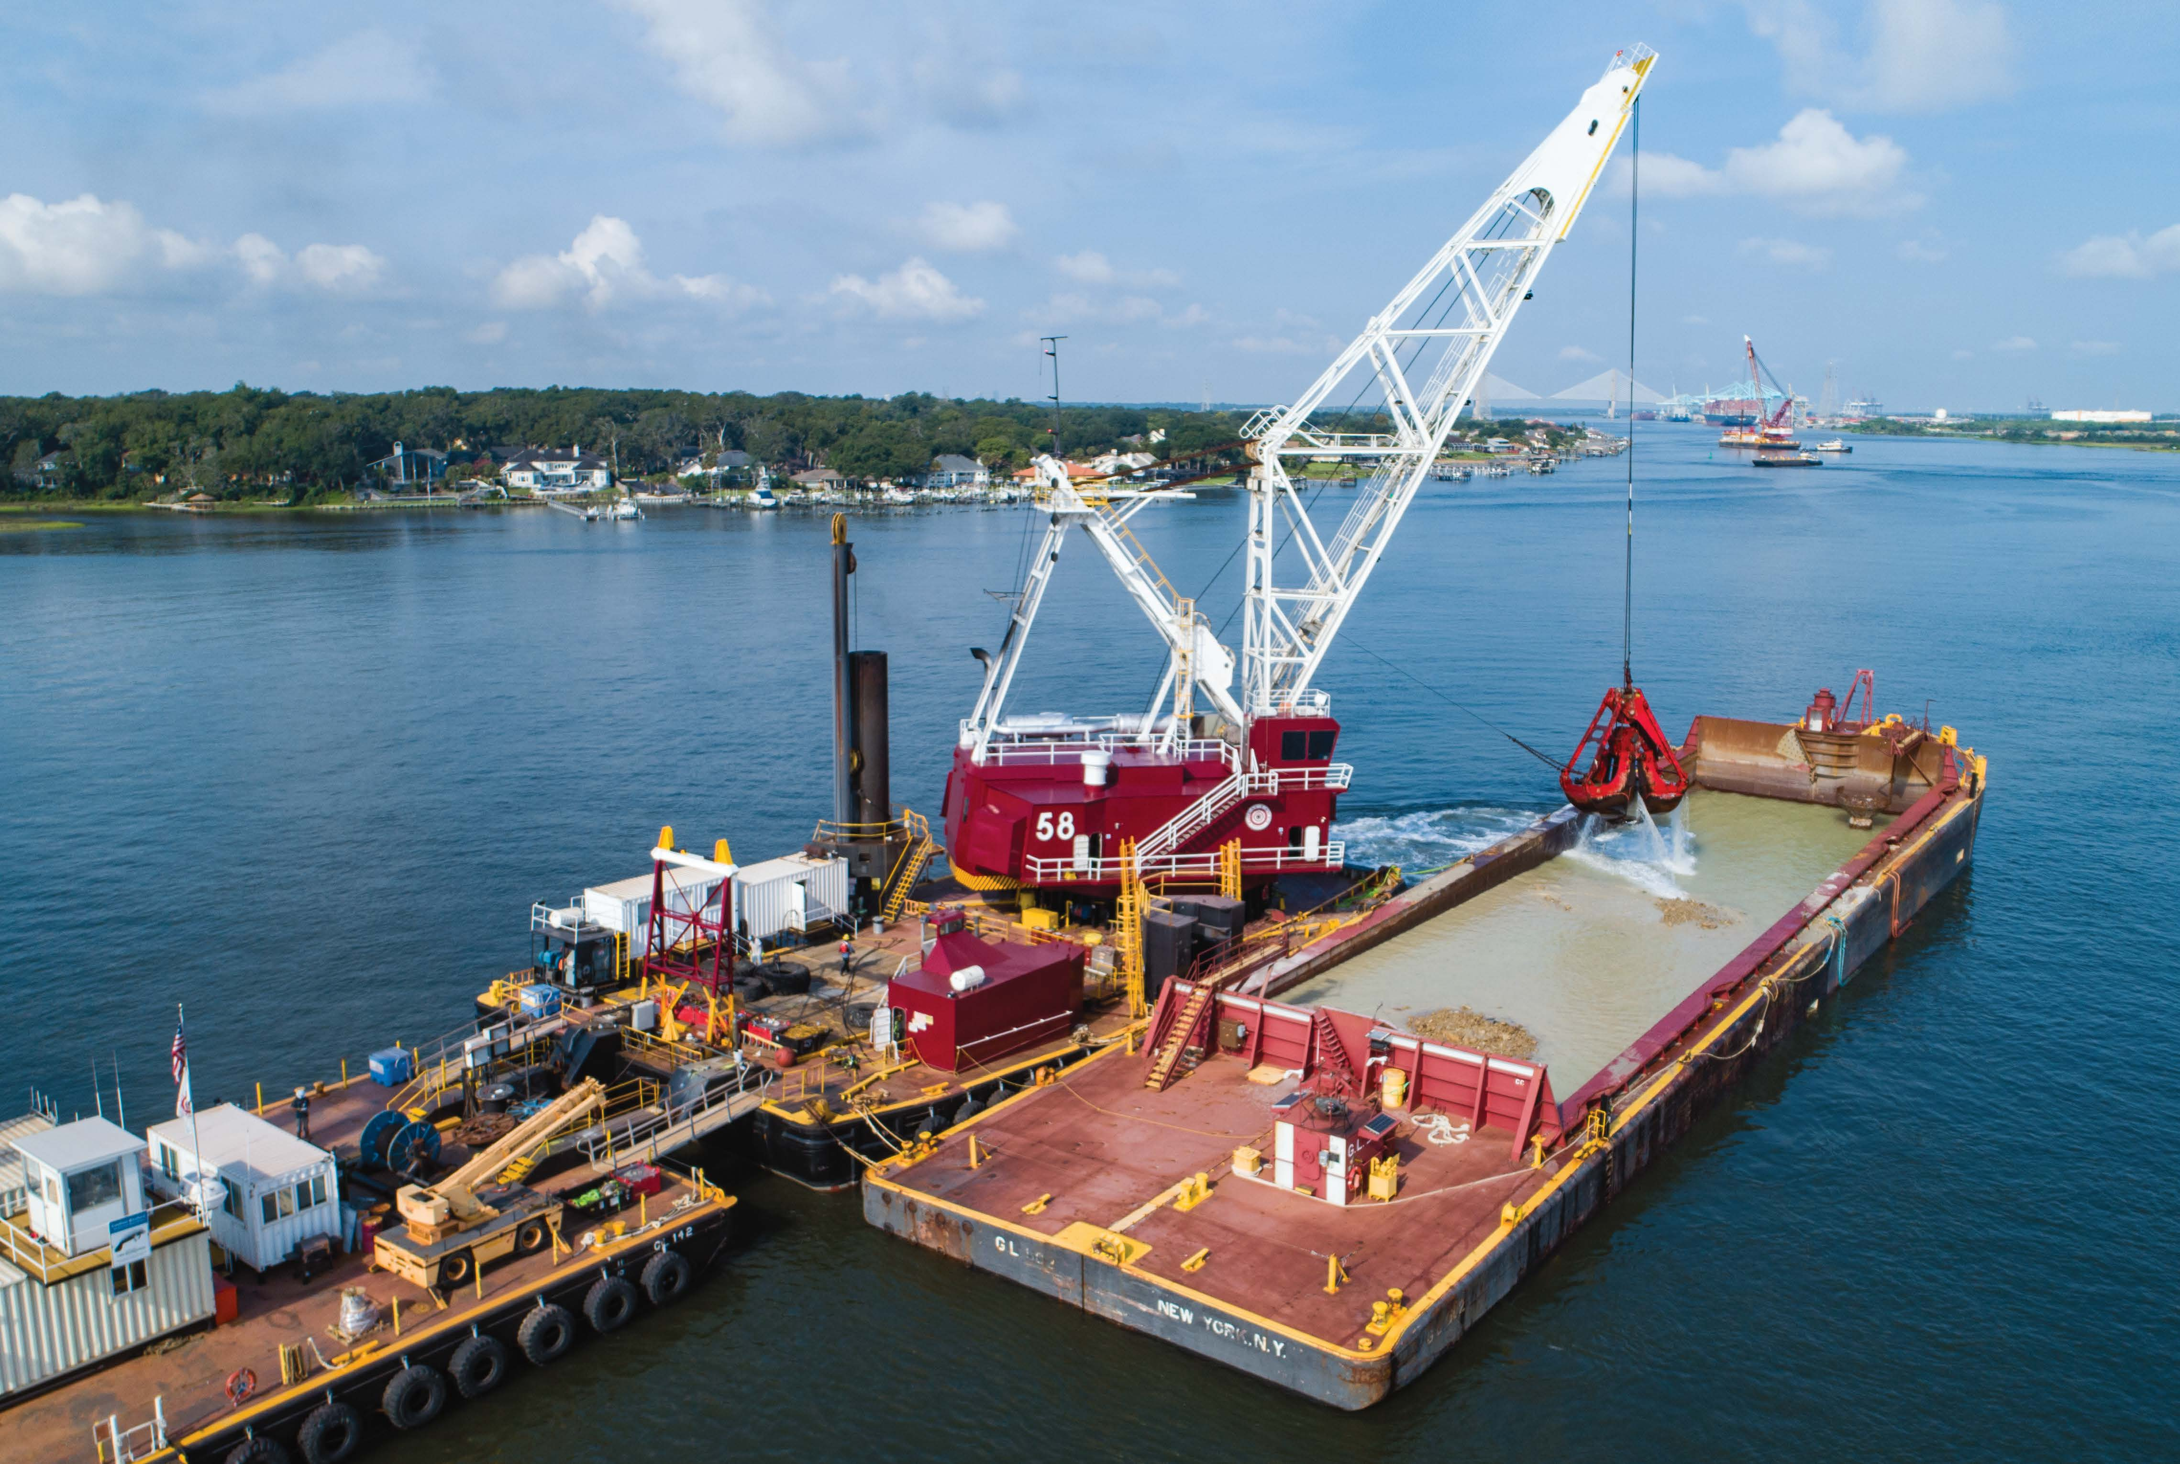
What We Do
Maintenance dredging of channels, berths and turning basins
Deeping and widening projects
Beach and wetland reclamation
Erosion deposits removal and repair
Subsurface mining
Marine construction

Slide 3
Our Priorities
The parentship between the Dredging Industry and USACE is critically important.
Together we keep the waterways open
Keep the National Economy Moving
Protect National Security
We help our Ports and waterways grow and compete in todays ever competitive global economy.
Coordinate and communicate with our customers:
“We are stronger when we work together!”

Slide 4
Challenges
Keeping the Government and Industry equations balanced:
Because Industry is investing
Marketplace is growing & showing stability
Industry investing w/out a contract in hand, not normal for maritime industry
These are long-term 30–50-yr. investments
Plan and coordinate w/ USACE and stakeholders as additional funding becomes available (HMTF, Infrastructure Bill, Federal Budget):
How is it going to be spent, on which project, over what period?

Slide 5
Challenges, continued
Help improve contracting and estimating with both the USACE and the industry
Long term commitments, forecasted schedules, and stable funding levels help us all

Slide 6
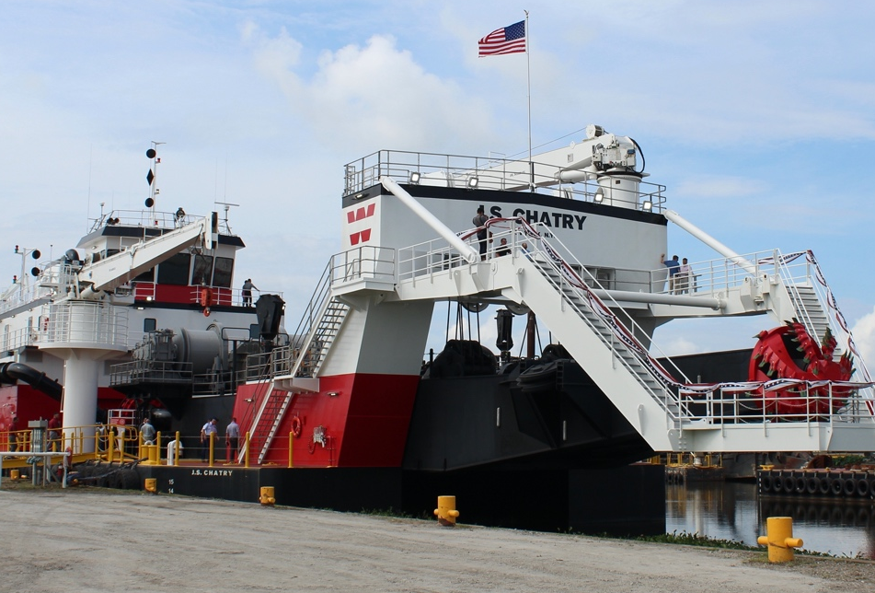
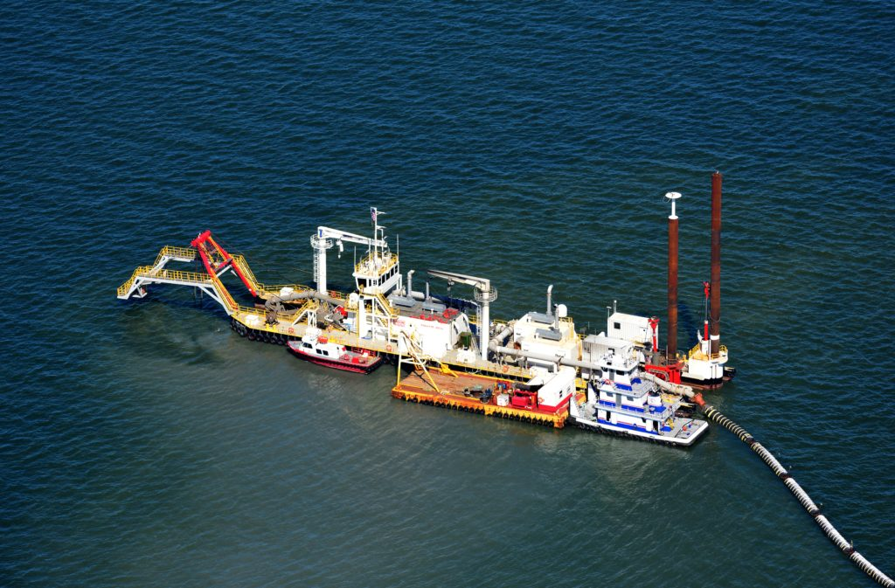
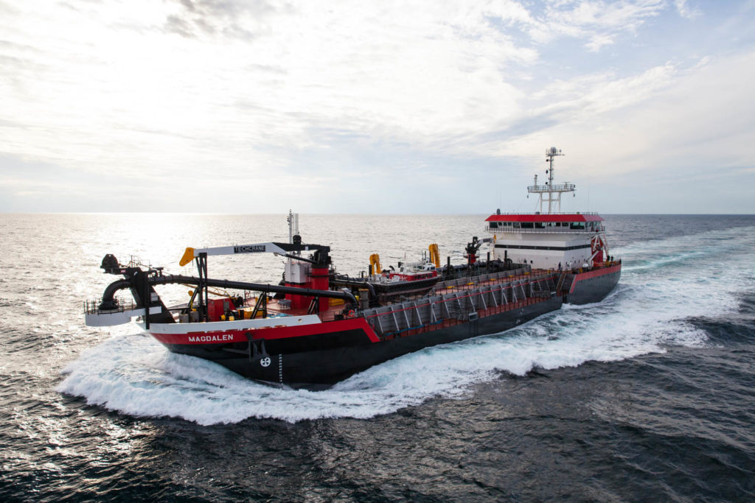
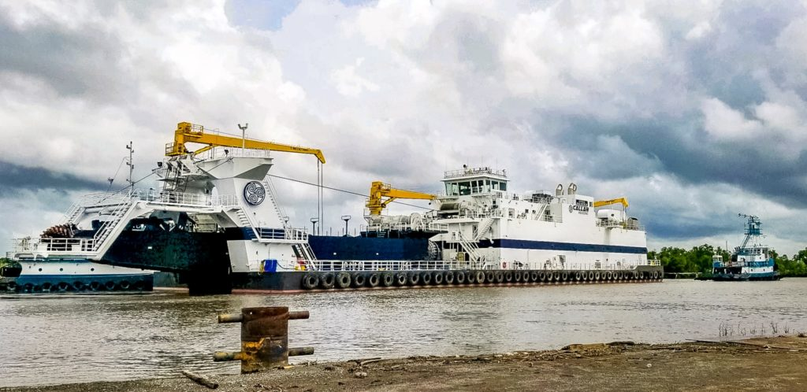
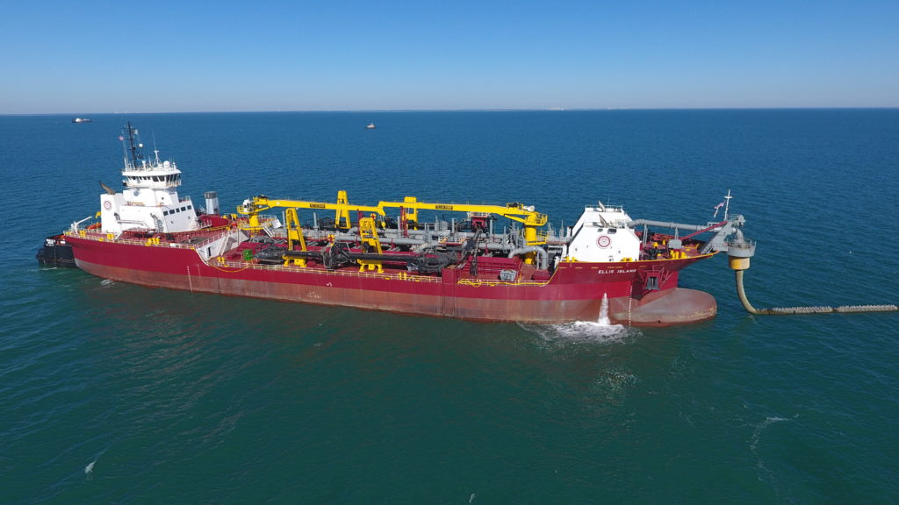
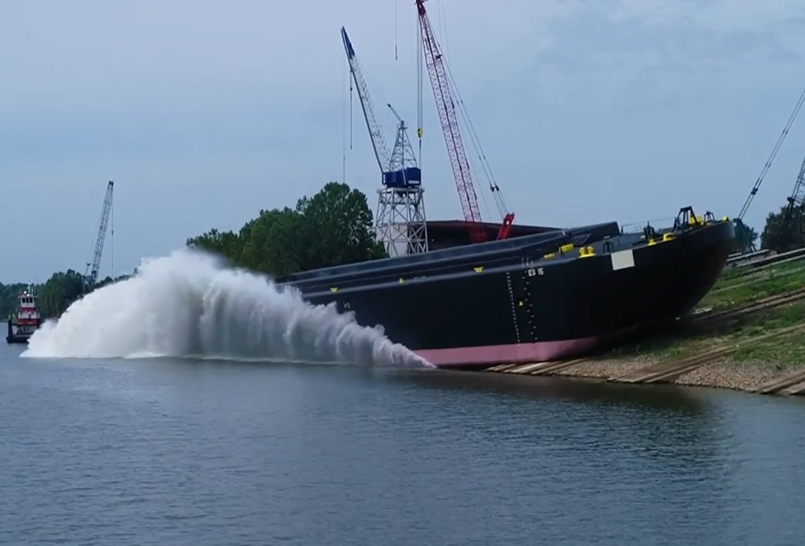
Commercial Fleet
$2 Billion Invested Since 2018
Delivered
Two Large Hopper Dredges (Over 23,000 cy)
Three Large Cutter Suction Head Dredges (32”, 30”, 30”)
One Large Dump Scow (6,000 cy)
Under Construction
Three Large Hopper Dredges (Over 30,000 cy)
Two Cutter Suction Head Dredges (28”, 27”)

Slide 7
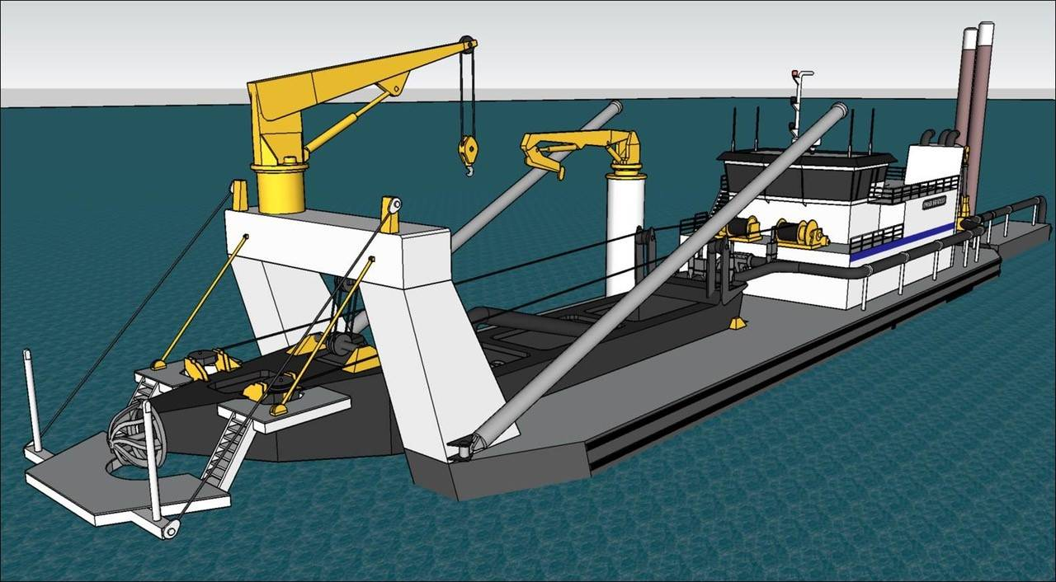
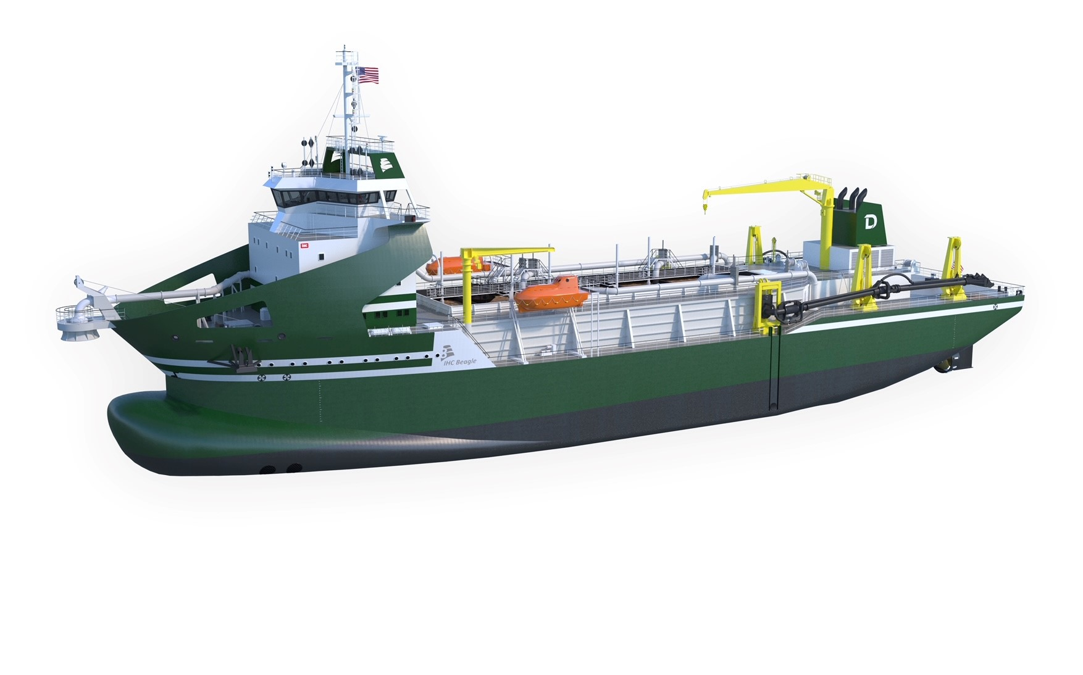
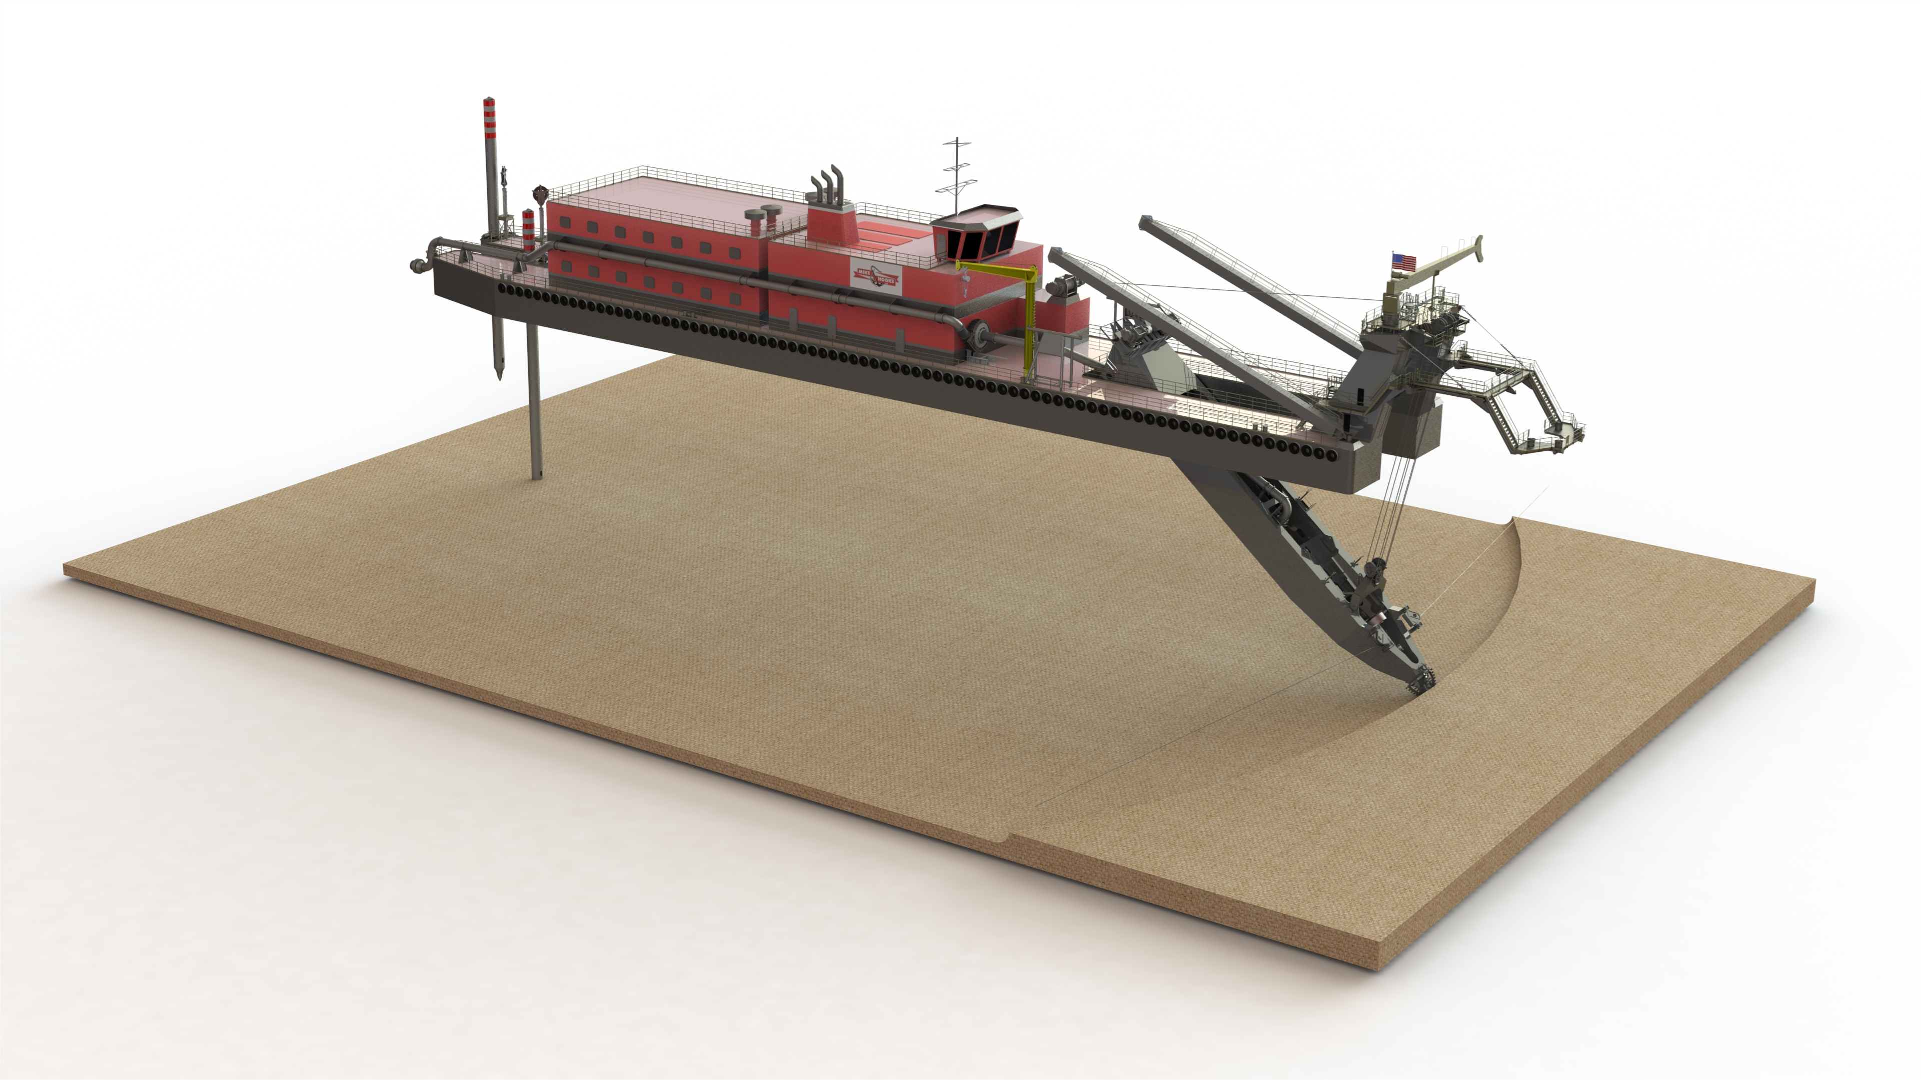
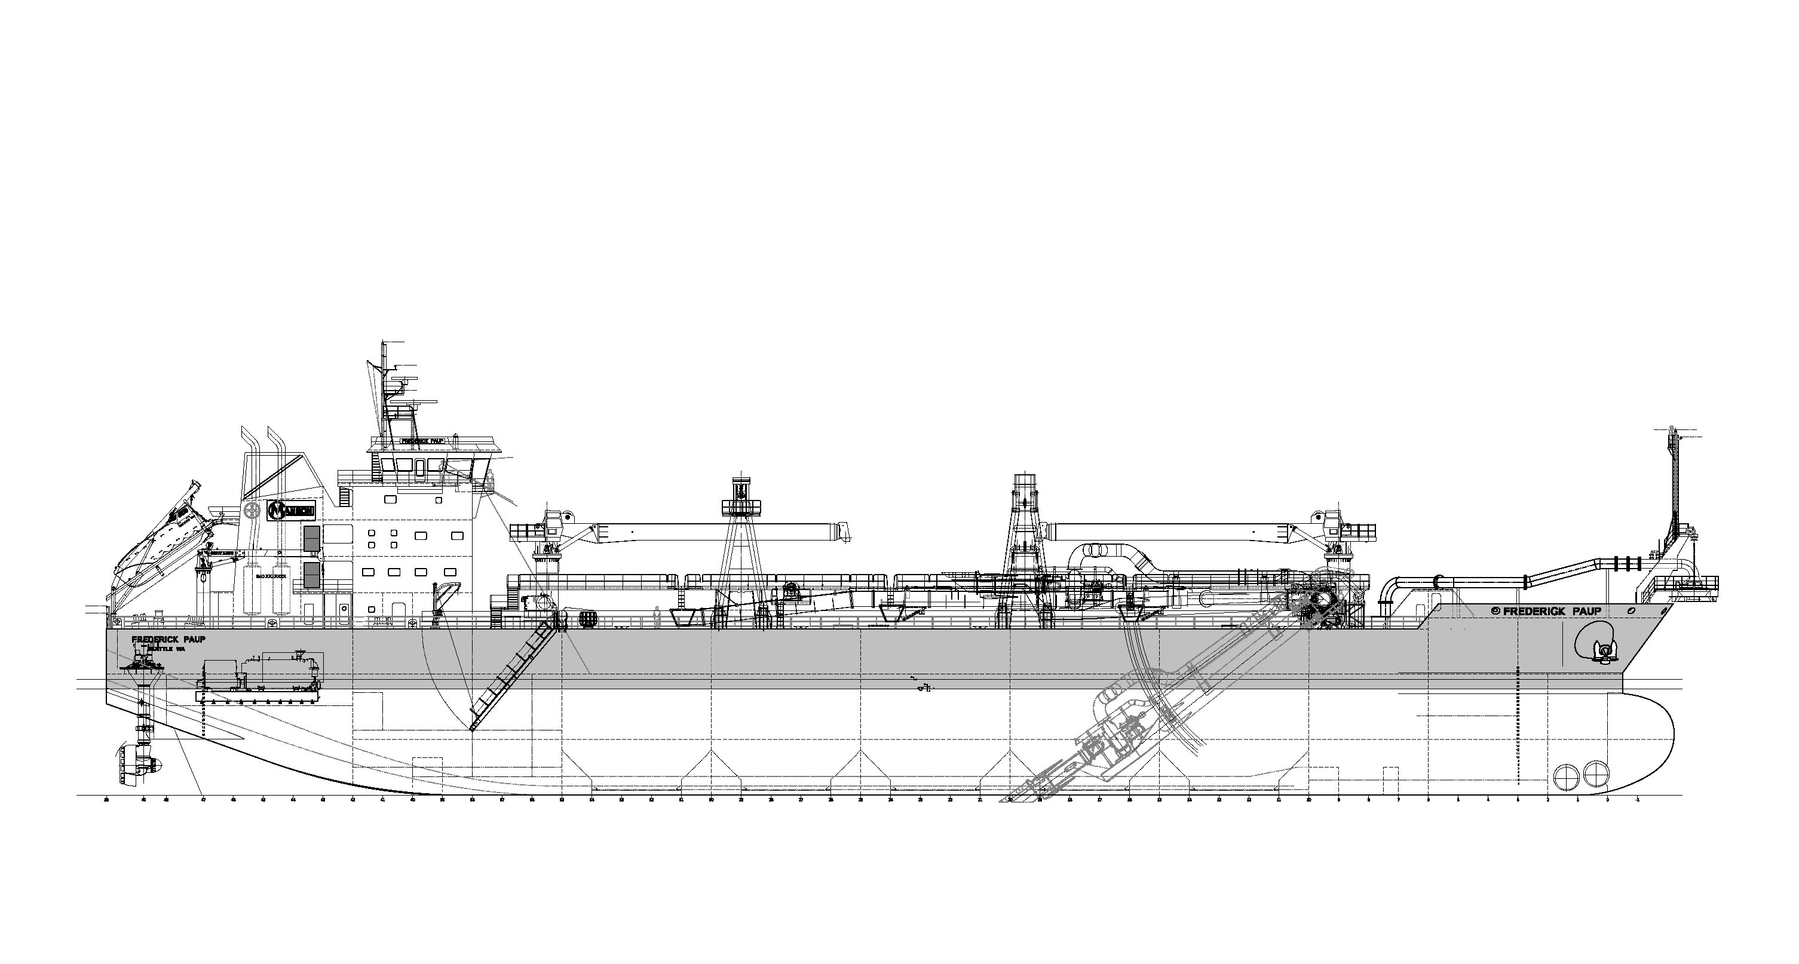
Commercial Fleet
$2 Billion Invested Since 2018
Contract Pending
Three Large Hopper Dredges (Over 29,000 cy)
Development Phase
One Large Hopper Dredge (10,000 cy)

Slide 8
Thank You
Questions?

