Slide 1
Office of Ports and Water Planning
Maritime Administration

Slide 2
America’s Marine Highway
Mission
To lead the development and expansion of Marine Highway services and to facilitate their integration into the U.S. surface transportation system.
Vision
The full integration of reliable, regularly scheduled, competitive, and sustainable Marine Highway services as a routine choice for shippers.

Slide 3
Legislative Authority
46 U.S.C §55601
Amended by Coast Guard and Maritime Transportation Act of 2012
Added non-contiguous U.S. ports
Amended by National Defense Authorization Act of 2016
Added unitized and palletized freight as well as cargo carried on passenger ferries

Slide 4
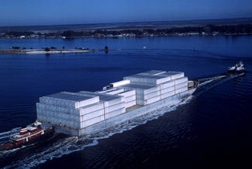
America’s Marine Highway
Old Vision
Coastal Routes >500 miles
HMT barrier
500 – 750 TEU U.S. Flag vessels

Slide 5
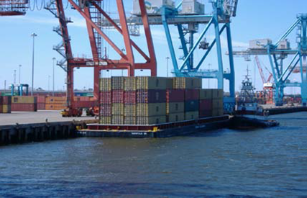
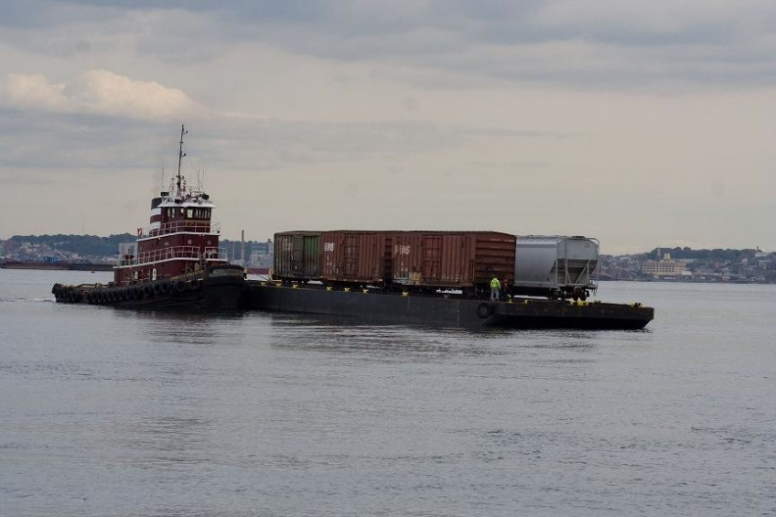
America’s Marine Highway
New Vision
Inland waterways and harbors
Use of existing tug/barge
Connecting metro centers
and coastal gateways

Slide 6
Marine Highway Routes
Notes:
Highway Routes.

Slide 7
Marine Highway Designated Projects and Grants
Notes:
Highway Routes.

Slide 8
Marine Highway Grants
FY 2010 ($7M)
James River Expansion Project ($1,100,000)
Cross Gulf Container Expansion ($3,340,000)
Tenn-Tom Waterway Project ($1,760,000)
FY 2016 ($5M)
Baton Rouge–New Orleans Shuttle on the M-55 - $1,758,595
Illinois Intrastate Shuttle on the M-55 - $713,000
James River Expansion Project on the M-64 - $476,748
New York Harbor and Container and Trailer on Barge - $1,632,296
M-55/M-35 Container on Barge Project - $96,000
Potomac River Commuter Ferry Project - $173,361
Notes:
The Consolidated Appropriations Act, 2016 provides $5 million in grant funds for America’s Marine Highway Program. These grants are intended to be used for the development and expansion of documented vessels, and port and landside infrastructure. Grants will be administered by the Maritime Administration’s Office of Marine Highways and Passenger Services. Only the 14 Marine Highway Projects that have been designated by the Secretary are eligible to apply for these grant funds.
Grant awards to 6 Designated Projects totaling $4.85M were announced by the Secretary in late October. These included planning grants, shoreside infrastructure, and a training simulator.
There is $5M in the current appropriations bill for FY17. Also, if a full-year CR is passed, the program will have another $5M for FY17.

Slide 9
Marine Highway Grants (cont.)
FY 2017 ($5M)
Estimated Mid-October NOFO publication
60-day open period w/ grant webinar
Only Designated Projects are eligible
To be used for the ‘development and expansion of”:
‘documented vessels’, and
‘Port and landside infrastructure’
FY 2018 ($7M) – Draft Senate Appropriations Bill
Notes:
The Consolidated Appropriations Act, 2016 provides $5 million in grant funds for America’s Marine Highway Program. These grants are intended to be used for the development and expansion of documented vessels, and port and landside infrastructure. Grants will be administered by the Maritime Administration’s Office of Marine Highways and Passenger Services. Only the 14 Marine Highway Projects that have been designated by the Secretary are eligible to apply for these grant funds.
Grant awards to 6 Designated Projects totaling $4.85M were announced by the Secretary in late October. These included planning grants, shoreside infrastructure, and a training simulator.
There is $5M in the current appropriations bill for FY17. Also, if a full-year CR is passed, the program will have another $5M for FY17.

Slide 10
Critical Elements for Creating Marine Highway Services
Proposed Projects must be located on a designated Marine Highway Route
A public/private partnership between ports, vessel operators, labor, and most importantly, shippers!
A solid business case including analysis of competing modes (truck and rail)
Adequate capital for start up and initial operations
A coordinated promotion effort by key stakeholders
Notes:
Bringing public and private partners together and maintaining a constant flow of communication and high level of energy is key to taking proposed services from the conceptual stage thru development to the demonstration phase.
A fully baked project needs to have solid market analysis, business planning, and financial capitalization sufficient to take the service to the point of self sustainability.
Projects need to be providing service along a designated Corridor, Connector, or Crossing in order to be considered for designation by the Secretary.

Slide 11
M-64 Express
Started in 2008 and expanded in 2010 with the help of MARAD grant funds
Utilization has increased by over 500% since 2008
Started w/ 5 boxes running once a week, now at 90% capacity three times a week
Reliable, regularly scheduled = confidence from shippers
New regional Intermodal Hub
Richmond has emerged as an logistics hub for the region
New 2900 acre logistics site feeding the Port of Richmond
Second AMH Grant ($476K) was awarded to expand the service to move reefer containers
Notes:
The Consolidated Appropriations Act, 2016 provides $5 million in grant funds for America’s Marine Highway Program. These grants are intended to be used for the development and expansion of documented vessels, and port and landside infrastructure. Grants will be administered by the Maritime Administration’s Office of Marine Highways and Passenger Services. Only the 14 Marine Highway Projects that have been designated by the Secretary are eligible to apply for these grant funds.
Grant awards to 6 Designated Projects totaling $4.85M were announced by the Secretary in late October. These included planning grants, shoreside infrastructure, and a training simulator.
There is $5M in the current appropriations bill for FY17. Also, if a full-year CR is passed, the program will have another $5M for FY17.

Slide 12
Port of Baton Rouge and Port of New Orleans Container on Barge
A partnership between the Seacor AMH, Baton Rouge, and New Orleans
Seacor AMH collects empty containers in Memphis, TN and moves them via barge to Baton Rouge, LA.
Chemical shippers (Dow, Shintech, Exxon) fill containers with exports and reload them on the barge
The barge is moved to New Orleans, LA for transfer to outbound vessels.
Project supported by a $1.76M AMH Grant to procure Material Handling Equipment.
Notes:
The Consolidated Appropriations Act, 2016 provides $5 million in grant funds for America’s Marine Highway Program. These grants are intended to be used for the development and expansion of documented vessels, and port and landside infrastructure. Grants will be administered by the Maritime Administration’s Office of Marine Highways and Passenger Services. Only the 14 Marine Highway Projects that have been designated by the Secretary are eligible to apply for these grant funds.
Grant awards to 6 Designated Projects totaling $4.85M were announced by the Secretary in late October. These included planning grants, shoreside infrastructure, and a training simulator.
There is $5M in the current appropriations bill for FY17. Also, if a full-year CR is passed, the program will have another $5M for FY17.

Slide 13
Current Program Efforts
Revised Marine Highway Rule
M-55 Route Development
M-95 NE Route Development
AMH Grant Administration

Slide 14
StrongPorts Program
A Collection of Investment Plan Best Practices and Tools, Developed by industry experts under a cooperative agreement between AAPA and the Maritime Administration.
Working with State Departments of Transportation, Metropolitan Planning Organizations, and ports to include
water transportation in State freight and
passenger transportation plan.
Notes:
The Maritime Administration’s StrongPorts Program is projecting a very busy 2015.
We have developed two initiatives that will impact port projects and funding both inside and outside their gates.
The first is the Port Planning and Investment Toolkit.
This toolkit is going to be a collection of best practices and tools that ports can use to develop investment grade infrastructure improvement plans.
The second is our PortTalk regional maritime collaboration initiative.
PortTalk collaborations are facilitated, day-long sessions where stakeholders from an individual State or region work together towards the development of their maritime transportation plans and projects.

Slide 15
Build America Bureau
Streamlines access to administered credit and grant programs:
TIFIA
RRIF
FASTLANE
Encourages innovative best practices
Provides technical assistance
www.transportation.gov/buildamerica

Slide 16
Fixing America’s Surface Transportation (FAST) Act
Signed into law December 4, 2015
$305 Billion for 5 years
Includes establishment of a national freight program that supports goods movement and the US economy
FASTLANE – USDOT Managed
National Highway Freight Program (NHFP) – State Managed formula program
TIGER - $500M, Application deadline – October 16
INFRA – $1.56B, Application deadline – November 2

Slide 17
Thank you!
Director - Scott.Davies@dot.gov
Port Finance: Kirk.Claussen@dot.gov
Port Planning: Travis.Black@dot.gov
Marine Highways: Timothy.Pickering@dot.gov

